Slide 1
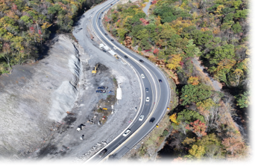
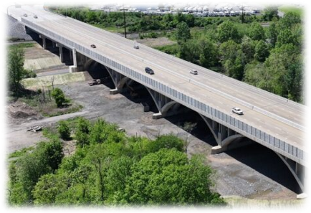
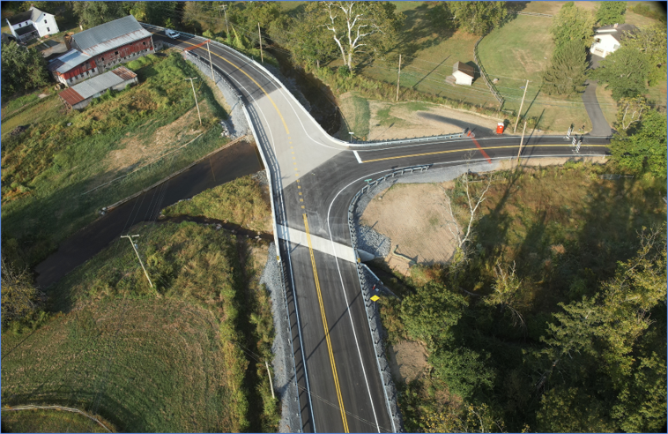
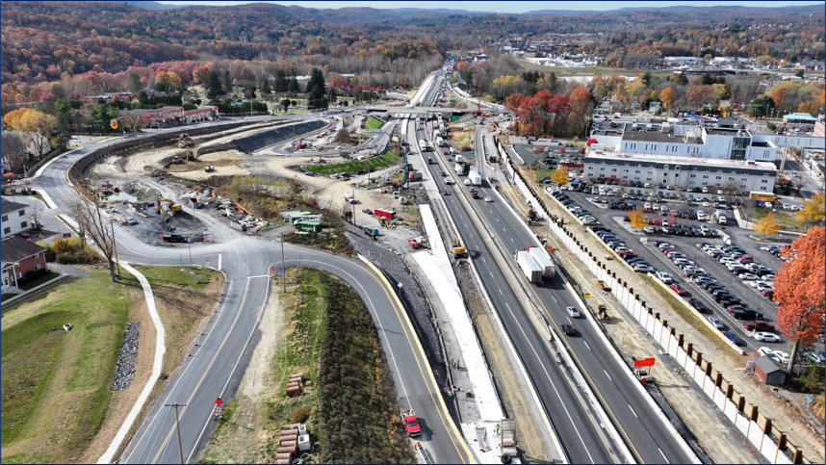
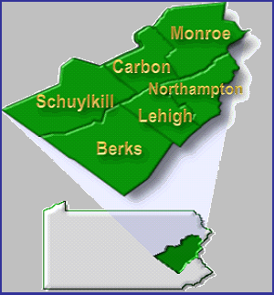
ASHE 2026
SR 61-14M
SR 78 -13B
Christopher J. Kufro, PE District Executive
SR 2041-03B
Scott Vottero, PE Assistant District Executive (Design)
Michael Guidon, PE Assistant
District Executive (Construction)
Bruce Bubser
Assistant
District Executive (Maintenance)
I-80 Exit 308
MARCH 17, 2026
March 18, 2025

Slide 2
ASSET Management
"A strategic and systematic process of operating, maintaining, and improving physical assets, with a focus on both engineering and economic analysis based upon quality information, to identify a structured sequence of maintenance, preservation, repair, rehabilitation, and replacement actions that will achieve and sustain a desired state of good repair (SOGR) over the life cycle of the assets at minimum practicable cost (23 CFR 515.5).”
  -FHWA definition
  Asset Management | Department of Transportation | Commonwealth of Pennsylvania
Notes:
*Raise hands if you’ve heard about Asset management in Transportation Planning and engineering*
Definition from FHWA above –
We have an extensive network here in the state (3rd in bridges and 5th in roads) – that means many, many assets to track, preserve and improve. Through guidance and direction from FHWA, we are shifting to asset management approach.

Slide 3
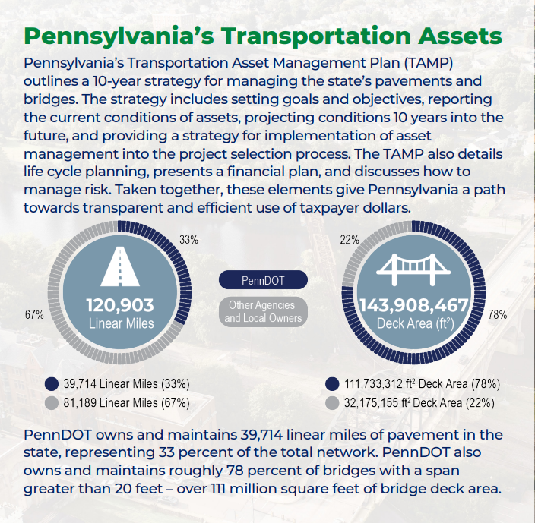
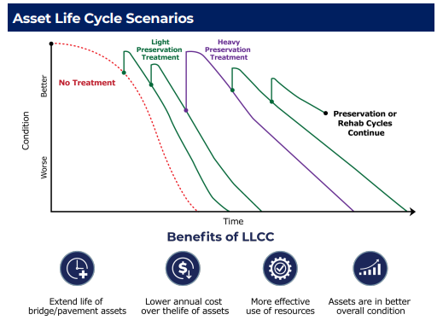
ASSET Management - TAMP
Microsoft Word - PA_TAMP_Mar_28_2023 PennDOT v test tracked copy.docx
Notes:
What does this mean for PennDOT?
Adoption of the TAMP in 2022. 10 year program to: establish targets and develop inventory on NHS system, forecast conditions for planning, and outline the state’s practices that will integrate into planning and programming during project development.
Why?
Chart on the shows the life cycle of a sample asset – preservation cycles extend the life vs no treatment or limited treatments, specifically implementing the lowest practical life cycle cost.
This visual embodies PennDOTs guiding asset management focus: “right treatment at the right time”.

Slide 4
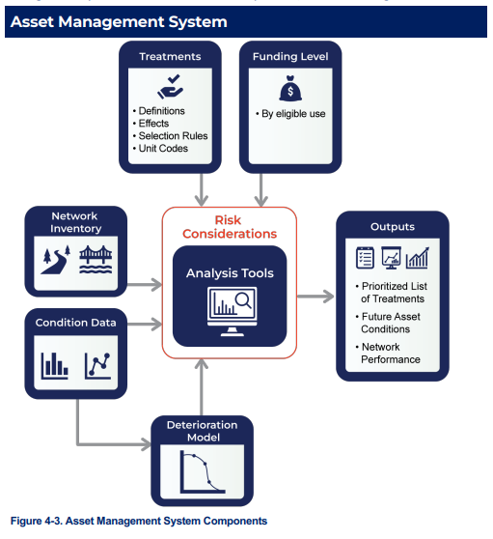
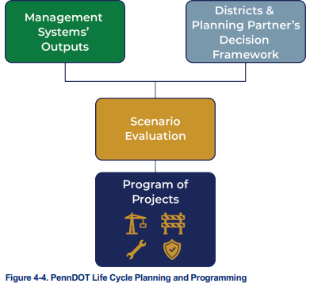
ASSET Management - Systems
Notes:
How will this get integrated?
Inventory assessment, conditions, funding eligibility are examples of key inputs that are reviewed within a localized or global network.
Outputs give metrics to the recommended treatments and timing, network conditions, and snapshots of the analyzed network utilizing the selected inputs.
These outputs are then incorporated into the pre-existing planning procedures to generate the most cost-effective program.

Slide 5
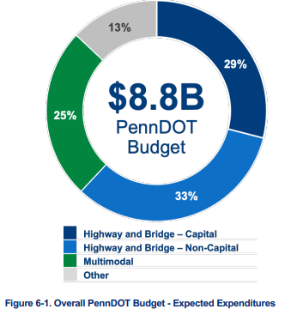
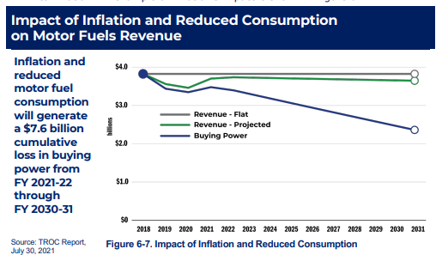
ASSET Management - Funding
Notes:
How do we implement this integrated asset management program?
At the time the TAMP was created, funding was projected flat (there have been some increases since the report was published) but we are still under shortfalls and have seen continued impacts of inflation reducing our buying power and project portfolio.
As mentioned before, we have had to evolve our thinking and processes. Incorporating these asset management facets with our planning partners while seeking alternates funding sources will allow us to maintain and improve the network and stretch the dollar

Slide 6
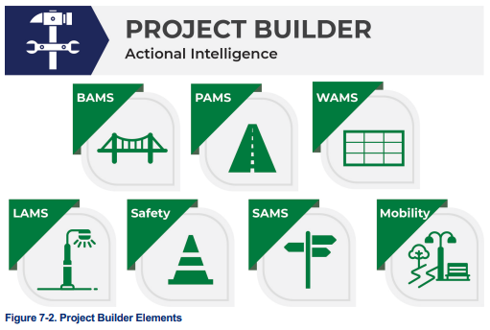
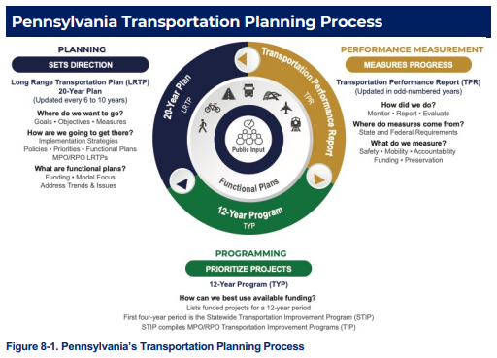
ASSET Management – Next Steps
Notes:
You’ve heard me overing all this info, so what's next and what does that mean for the everyone here?
New systems are being developed and implemented within the Department – BridgeCare is active, PAMS is continuing development, GAMP is beginning its development. Many more systems will feed into a comprehensive, encompassing project delivery system within our “programming phase”.
Project scopes will be developed with both site specific as well as corridor and regional impacts (as always) but using new techniques.
For example, the district will be continuing our regional preventative bridge maintenance projects and incorporating minor bridge work in pavement preservation jobs to reduce MPT and Mob costs.
Similar scoped projects will be bundled.
Cost saving paving techniques such as (Cold In place/Hot in place recycling, Break/Crack and Seat, intersection white topping) will be evaluated and utilized.
Geotechnical assets are being catalogued and will be pulled into the project discussion (failed geo assets increase by 1.5 to 4x the pre-failure project costs).
I personally feel that District 5 has gotten ahead of the TAMP with some of our prior and best practices, and we will continue to by adapting the new technologies and policies.

Slide 7
District 5 Project Portfolio
Notes:
Change gears to cover the remaining 2026 lets, major 2027 lets and upcoming engineering agreements to be advertised.

Slide 8
2026 Upcoming Lets
County | SR | Sec | Project Title | Let Date
Berks | 2005 | M89 | SR 2005 Micro Surface | 3/26/2026
Berks | 568 | BRM | RATS Bridge Preservation #10 | 3/26/2026
Berks | 2082 | BO2 | Berks High Volume Ralumac Microsurfacing # 2 | 3/26/2026
Northampton | 7302 | HMP | Hugh Moore Park Bridge Painting and Repairs | 3/26/2026
Berks | 3021 | STI | Spring Township Transportation Improvements | 4/1/2026
Lehigh |  | 06X | Ruppsville Road | 4/1/2026
Lehigh |  |  | Albert Street Allentown RRX | 4/1/2026
Lehigh | 29 | 05S | SR 29 - Shimersville Hill Safety Imprv | 4/9/2026
Schuylkill | 54 | M89 | Centre Street | 4/9/2026
Berks | 222 | SPS | District-Wide Small Site Paint Contract 2026 | 4/23/2026
Carbon |  |  | District-Wide GR 5-2, 5-4, & 5-6 | 4/23/2026
Lehigh |  |  | District-Wide GR 5-1, 5-3, & 5-5 | 4/23/2026
Northampton | 611 | M89 | PA 512 to Monroe Co Line | 4/23/2026
Berks | 2032 | BCB | Berks Box Culvert Bundle | 5/7/2026
Berks | 1026 | 04B | Long Lane over West Pine Creek Bridge | 5/7/2026
Notes:
SR 568-BRM – continuation of District’s Bridge Preservation projects in the RATS region on 7 structures throughout the county; estimated $3.3M
SR 29-05S - This project involves corridor safety improvements on SR 29 including the removal and relocation of fixed objects, the widening of the roadway for left turn lanes, the installation of new signal equipment and signal interconnection between signals at Buckeye Road and Ramer Street, and systematic signing and pavement marking upgrades in Upper Milford Township Lehigh County. Estimated cost $10.6M

Slide 9
2026 Upcoming Lets
County | SR | Sec | Project Title | Let Date
Berks | 2032 | 02B | Race Street over Swamp Creek | 5/7/2026
Carbon | 903 | 04B | 903 over Mud Run | 5/7/2026
Monroe | 80 | BO1 | I-80 Sec 17M Breakout #1 (Exit 303) | 5/7/2026
Monroe | 611 | BO1 | SR 611 & SR 2012 Signal Improve (I-80 Breakout #1) | 5/7/2026
Schuylkill | 1027 | SRT | Schuylkill River Trail Mill Creek | 5/7/2026
Berks | 345 | M89 | SR 345 Resurface | 5/21/2026
Lehigh | 378 | M89 | Hill-to-Hill Bridge to SR 22 w Ramps | 5/21/2026
Northampton | 248 | 11M | 25th Street to SR 611 in WilsonBoro/City of Easton | 5/21/2026
Northampton |  | LSC | Linden Street Two-Way Conversion | 6/4/2026
Schuylkill |  | FDB | Forest Drive Bridge Replacement | 6/4/2026
Lehigh | 309 | 14M | PA 309 Resurface | 6/4/2026
Lehigh |  | SRP | 100 Steps Restoration Project | 6/18/2026
Lehigh | 309 | KBP | King's Route 309 Business Park Roundabout | 6/18/2026
Lehigh | 4009 | 02B | Hollenbachs Bridge | 6/18/2026
Monroe | 209 | 03S | 209 Holy Cross Road to Hollow Road | 6/18/2026
Notes:
SR 80-B01 – first of the 3 I-80 recon projects in Monroe county; 3.2 segment miles encompassing the 303 interchange replacement; Estimated $209.5M
SR 309-14M - This project includes safety improvements of PA 309 in North and South Whitehall Townships, Lehigh County. This betterment work involves mill and overlay, concrete patching, shoulder widening, guiderail upgrades and movement markings. These improvements also include the addition of turning lanes, traffic signal upgrades, upgraded drainage, structure repair work, a culvert extension, sidewalk and ADA upgrades, and bus stop upgrades. The project will also reconstruct (realign) SR 4003 (Orefield Road) and PA 309 intersection to accommodate truck turning movements and signal replacement. Estimated $18.3M
SR 209-03S - This project involves corridor safety improvements in Middle Smithfield Township. US Route 209 / Holy Cross Road intersection to be closed and US Route 209 / SR 2023 (Hollow Road) intersection will be relocated perpendicular to US Route 209. The intersection will be unsignalized. There will be no center turn lane in the corridor however a left turn lane will be added along US 209 at the Hollow Road Intersection. The project will extend to the Middle Smithfield Elementary school driveway but will not have any changes to that intersection. Project is located in Middle Smithfield Township, Monroe County. Estimated $3.5M

Slide 10
2026 Upcoming Lets
County | SR | Sec | Project Title | Let Date
Northampton |  | WBI | Wilson Borough Improvements | 6/18/2026
Lehigh | 143 | BC2 | Box Culvert Bundle-Round 2 | 7/2/2026
Northampton |  | TRS | Two Rivers Trail Gap 9A - South | 7/2/2026
Carbon | 2002 | 04S | Delaware Ave Signal Improvements | 7/16/2026
Monroe | 715 | 04B | PA 715 Stone Arch Replace | 7/16/2026
Monroe | 940 | VPS | Village of Pocono Summit Improvements | 7/16/2026
Monroe | 940 | TPS | Tobyhanna Pocono Summit West | 7/16/2026
Northampton | 2018 | 02S | Freemansburg Ave (SR 2018) Safety Improvements | 7/16/2026
Berks | 1029 | 01B | Smoketown Road over Little Sacony Creek | 7/30/2026
Berks | 2016 | 01B | Bellevue Avenue over Readng Blue Mtn & Northern RR | 7/30/2026
Lehigh | 378 | 03B | Hill to Hill Bridge Rehabilitation | 8/13/2026
Schuylkill | 25 | TVS | Tri-Valley School District School Zone Signals | 8/13/2026
Berks | 78 | SPP | I-78 Weigh Station | 8/27/2026
Berks | 78 | 33M | I-78 Grimes Interchange Removal | 8/27/2026
Monroe | 611 | LRS | SR 611 Learn Road (T-537) Safety Enhance. Project | 8/27/2026
Notes:
SR 378-03B - This project involves a rehabilitation of the Hill to Hill Bridge (SR 378) over the Lehigh River, Norfolk Southern railroad and several city streets in the City of Bethlehem, Lehigh County. Estimated $87.5M
SR 78-SPP & 33M – Weigh Station construction between exits 19 and 23 in upper tulpehocken, berks county. 33M Grimes interchange removal @ MM 14.9. Let as parent child for total of $7.9M

Slide 11
2026 Upcoming Lets
County | SR | Sec | Project Title | Let Date
Northampton | 78 | 10M | I-78 WB - Easton Rd to SR 33 | 8/27/2026
Northampton |  |  | Lehigh Canal Abbott Street Bridge | 9/3/2026
Berks | 501 | 02B | Lancaster Ave over Swatara Creek | 9/17/2026
Lehigh |  | AST | Albert Street D&L Trail | 9/17/2026
Monroe | 33 | 05S | PA 33 Median Barrier SR 2002 to SR 2008 | 9/17/2026
Berks | 1010 | HFT | High Friction Surface Treatments (Berks 2027) | 10/1/2026
Berks | 4011 | BPN | BPN - 4 Guide Rail Upgrades - 2027 | 10/1/2026
Berks | 12 | 04S | SR 12 Alsace Manor Int Impvmnts | 10/22/2026
Berks | 222 | 28M | US 222 Widening | 10/22/2026
Berks | 625 | ACT | Angelica Creek Trail Extension | 10/22/2026
Lehigh |  | MLP | Martin Luther King, Jr. Drive Ped Improvements | 10/22/2026
Lehigh |  | HSC | Hickory Street Connections | 10/22/2026
Monroe | 7214 | LLB | Lessig Lane (T-410) over Cherry Crk | 10/22/2026
Schuylkill |  |  | Tamaqua Riverwalk | 10/22/2026
Monroe | 2012 | BRM | NEPA Br Preserv & Repair 8 | 10/22/2026
Notes:
SR 78-10M - concrete patching and drainage improvements on I-78 WB, extension of the acceleration lanes at SR 412, and maintenance/rehabilitation of a couple of basins; estimated $14.9M
SR 33-05S - This project involves the installation of a concrete median barrier along with milling, concrete patching, overlay of the travel lanes and shoulders, guide rail upgrades, drainage improvements, and pavement markings along PA 33 in Hamilton Township, Monroe County. Estimated $13.2M
SR 222-28M - This project involves the reconstruction and widening of US Route 222 in Richmond, Maidencreek and Maxatawny Townships, Berks County. The highway will be widened to four lanes, a median barrier will be installed, as well as roundabouts at Pleasant Hills Road and Richmond Road. Bridge replacement on US Route 222 over the tributary to Moselem Creek. Estimated $83.8M

Slide 12
2026 Upcoming Lets
County | SR | Sec | Project Title | Let Date
Northampton |  | SBE | South Bethlehem Greenway Trail Extension | 10/22/2026
Lehigh | 2026 | CS9 | Borough of Coopersburg Streetscape - Phase 9 | 11/5/2026
Northampton |  | EII | Downtown Easton Intersection Improvements | 11/5/2026
Northampton | 248 | ETC | Traffic Calming & Pedestrian Accommodation Improve | 11/5/2026
Lehigh |  | LED | Allentown LED Streetlight Conversion | 12/3/2026
Lehigh | 2005 | 05M | Lehigh Street Betterment | 12/3/2026
Berks | 419 | 03B | Rehrersburg Road over Trib Mill Creek | 12/10/2026
Lehigh | 2002 | ASZ | City of Allentown - School Zone Traffic Safety Upg | 12/10/2026
Northampton | 412 | MPI | Main Street and Polk Valley Road Improvements | 12/10/2026
Notes:
2026: 73 projects with CON estimate of $571.4M; 19% of states estimated lets not counting south bridge
2025: 43 for $103.3M awarded amount

Slide 13
Major 2026 lets
County | Route | Section | Title | Let Estimate
Berks | 419 | 02B | North Third Street over Tulpehocken Creek | 1/14/2027
Monroe | 196 | 01S | Sterling Road Safety Improvements Area 1 | 2/11/2027
Berks | 422 | 21B | Penn Avenue over Cacoosing Creek | 2/25/2027
Berks | 4040 | BRB | SR 4040 (Old Route 22) Bridge Bundle | 2/25/2027
Berks | 4040 | 01B | SR 4040 (Old Route 22) over Trib to Northkill Crk | 2/25/2027
Monroe | 2036 | 01B | Shiffer Rd (SR 2036) over PA 33 | 3/11/2027
Berks | 422 | 23S | SR 422 Ben Franklin Congested Corridor | 3/25/2027
Berks | 12 | 03S | SR 12 Elizabeth Avenue | 3/25/2027
Schuylkill | 209 | BCB | Box Culvert Bundle - Round 1 | 4/1/2027
Berks | 222 | 33M | SR 222 Warren Street NB Auxiliary Lane | 4/1/2027
Lehigh | 2018 | BRM | LVTS Bridge Preservation & Repair 8 | 4/1/2027
Northampton | 3023 | 05S | Pave PA 33_I-78 to US 22 | 5/13/2027
Berks | 924 | 06B | State Hill Road - SR 222 SB to Norfolk Southern RR | 5/27/2027
Schuylkill | 61 | 15M | Main Blvd over Trib of Catawissa Crk (3) | 8/12/2027
Berks |  | RSD | PA 61 Restoration Phase 2B | 8/12/2027
Lehigh | 611 | 11M | 611 /715 Improvements | 8/12/2027
Monroe | 222 | 24S | 222 Auxiliary Lane-Wyomissing "Hard Shoulder" | 9/30/2027
Notes:
About 75 projects estimated for a total of ~$275M

Slide 14
Agreement & SOI Best practices
Communication on projects
  Early and often as problems arise
  Cost
  Schedule
  Role changes
Invoices
  Timely & Accurate
Quality Control
Issue
Solution
Team
Experience
Values
SOI
Notes:
Thank all the firms for efforts and hard work.
Communication critical in all phases of the agreement – identify problems as they arise, develop potential solutions and set up discussion with key district personnel, especially for cost, schedule or team member changes.
Invoices should be reviewed for accuracy, completeness and are timely.
Internal QC is critical to maintain the project schedule.
PM’s and designers are owners of the project on the dept behalf.
SOI’s are similar. Do your homework for project Specific agreements – present your potential solutions and discuss how they are relevant to the site with the team’s background and experience.
Open Ends are more generic – reference past relevant experience. Discuss the teams capabilities and values.
All interconnected when being considered during selection process.

Slide 15
2026 design projects
E06674 | Berks | 100-BCB | Berks Box Culvert Bundle #2
E06675 | Berks | 1003-OTB | Berks Bridge Removals - SR 1003 Ontelaunee Lake Bridge & Penn St over Maiden Ck
E06676 | Berks | 7103-01B | Berks Municipal Bridge Replace/Rehab - High Boulevard & Parkview Rd
E06677 | Lehigh | 1015-0 | American Parkway Safety Improvements
E06678 | Lehigh | 3004-0 | SR 3004 Hill Top Road over Little Lehigh Creek
E06679 | Lehigh & Northampton | 7301-0 | LVTS Local Bridge Replace/Rehab - S. Albert St over Lehigh Canal & Jacksonville Rd
E06680 | Northampton | 1016-0 | SR 1016 Delabole Road over Waltz Creek
E06681 | Lehigh & Northampton | 3005-0 | LVTS Bridge Preservation & Repair 9
E06682 | Monroe | 7206-MBB | NEPA Municipal Bridge Bundle
E06683 | Schuylkill | 4042-MAB | SR 4042 Minersville Arch Bridge Rehab
Notes:
Publish for advertise spring into summer – selection summer

Slide 16
Thank you!
Scott M. Cressman, PE
Project Delivery Engineer – District 5-0
sccressman@pa.gov

