Slide 1
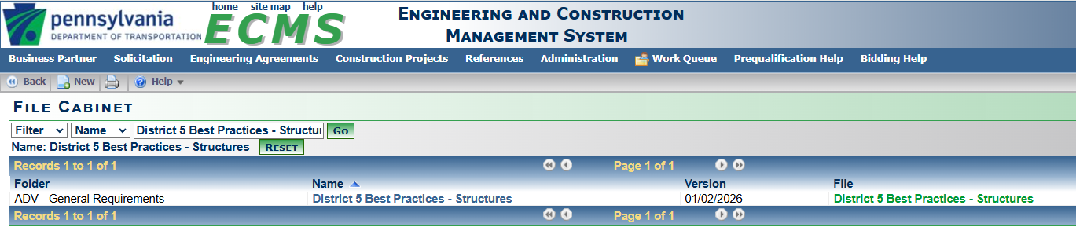

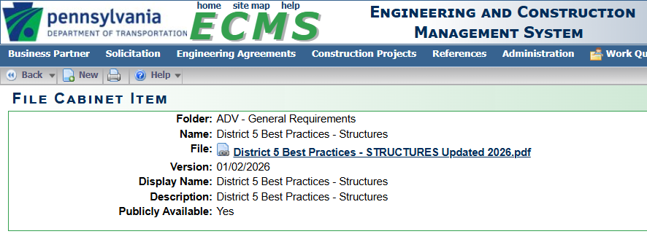
DISTRICT 5 BEST PRACTICES
Notes:
District 5 Bridge has developed an updated Best Practices document for Structures
Other units are working on updating their best practices as well

Slide 2
DISTRICT 5 BEST PRACTICES
ADMINISTRATIVE
Pre-TS&L Meetings
  Similar to Pro-Team Meetings
  Cut down on back and forth with TS&L Submissions
  Some items to Discuss:
    Traffic staging during the project and the amount of bridge overbuild required.
    Discussion of scour and other hydraulic issues involved with determining the hydraulic opening of the new bridge
    Discussion of the project site
    Discussion of any public feedback the designers have received and how they were incorporated.
Investigation results to be included in Meeting Minutes in TS&L submission
TS&L Submissions to ALWAYS include ANALYSIS runs
DON’T work too far ahead on the TS&L
  Have a good understanding of rest of project first
S-number requests – to be handled by District
  Designer should not make request

Slide 3
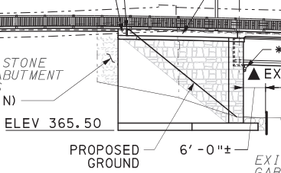
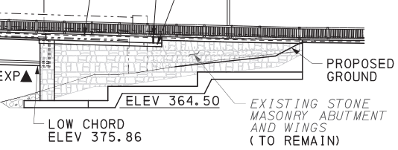
DISTRICT 5 BEST PRACTICES
ARCHITECTURAL SURFACE TREATMENTS (AST)
Need for AST is to be determined by coordination with the Cultural Resources Unit and/or public input.
If anticipated account for AST thickness in analysis runs
Historic Structures – color and pattern to match existing
On substructures – extend below groundline

Slide 4
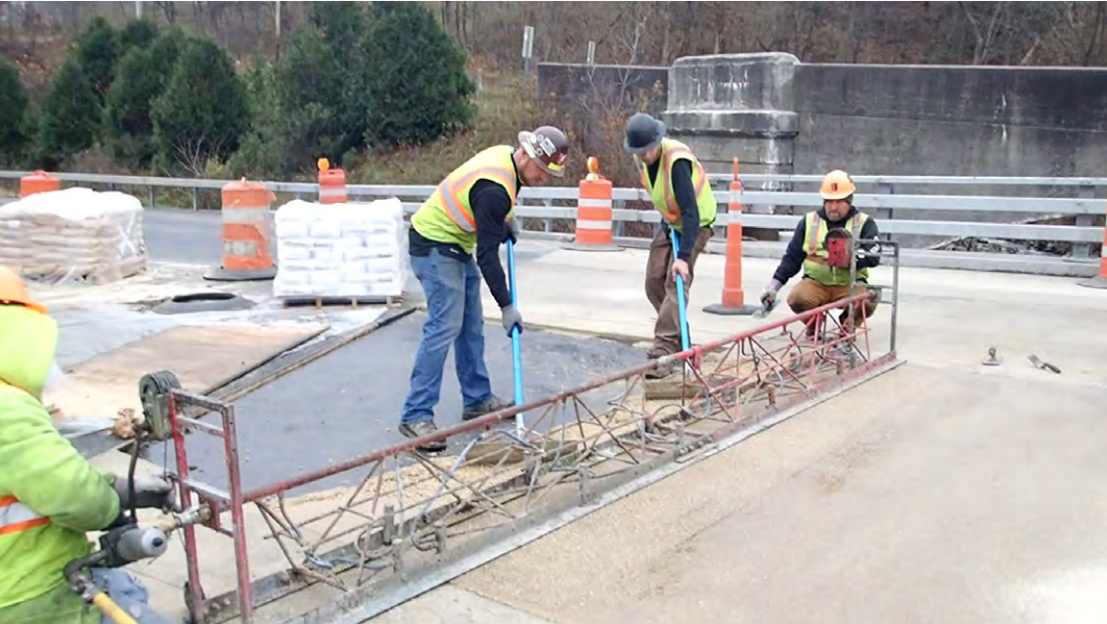
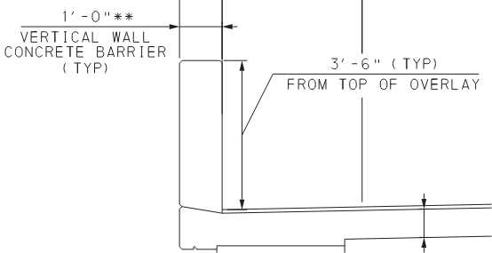
DISTRICT 5 BEST PRACTICES
DECK OVERLAYS
New Structures
Overlays are to be proposed on all new structures
  Generally PPC, LMC, or Epoxy
Staged Construction – If no overlay when opened to traffic then Mechanical Groove new deck
No Protective Coating on deck
Barrier Heights:
45” F-shape TL-5 barrier – no changes to height
42” F-shape and others
    Increase height of curb or barrier by overlay thickness
Notes:
See DM-4 C13.7.2 for 45” F-Shape overlay placement
Note on BD-601M regarding 42” F-shape going from TL-5 to TL-4

Slide 5
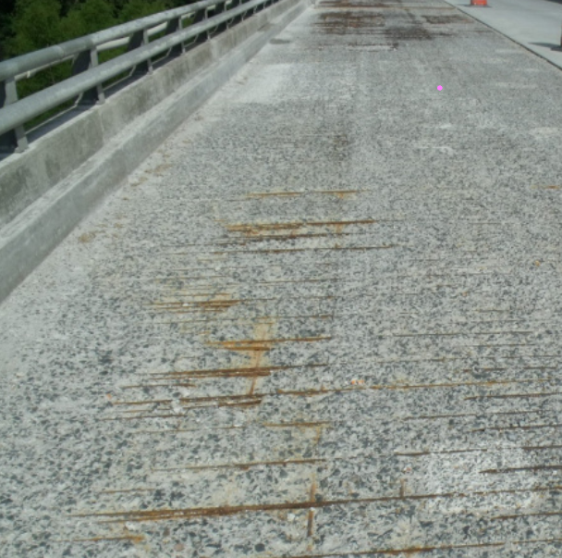
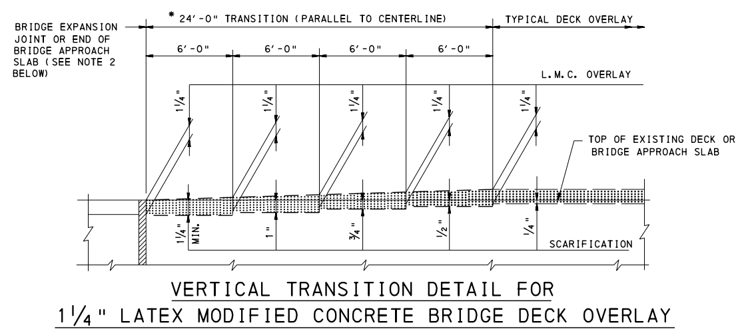
DISTRICT 5 BEST PRACTICES
DECK OVERLAYS
Preservation & Rehabilitation
Deck CR > 6 = No hydrodemolition & PPC
Deck CR </= 6 = Hydrodemolition & LMC
Max Placement depth 4”
Tie into approach elevations
It is possible for LMC or PPC to be considered part of structural deck
Asphalt with waterproofing as last resort
Notes:
Have gotten approval from manufacturer to use PPC as patch material – still need to follow curing requirements for concrete in Pub408 – still limited to 4” depth
For structural overlay – hydrodemolition is a requirement and 1.25” thickness for LMC and 1” thickness for PPC
If asphalt with waterproof membrane proposed – concrete deck patches need to be done first.
Transition diagram from BC-783M

Slide 6
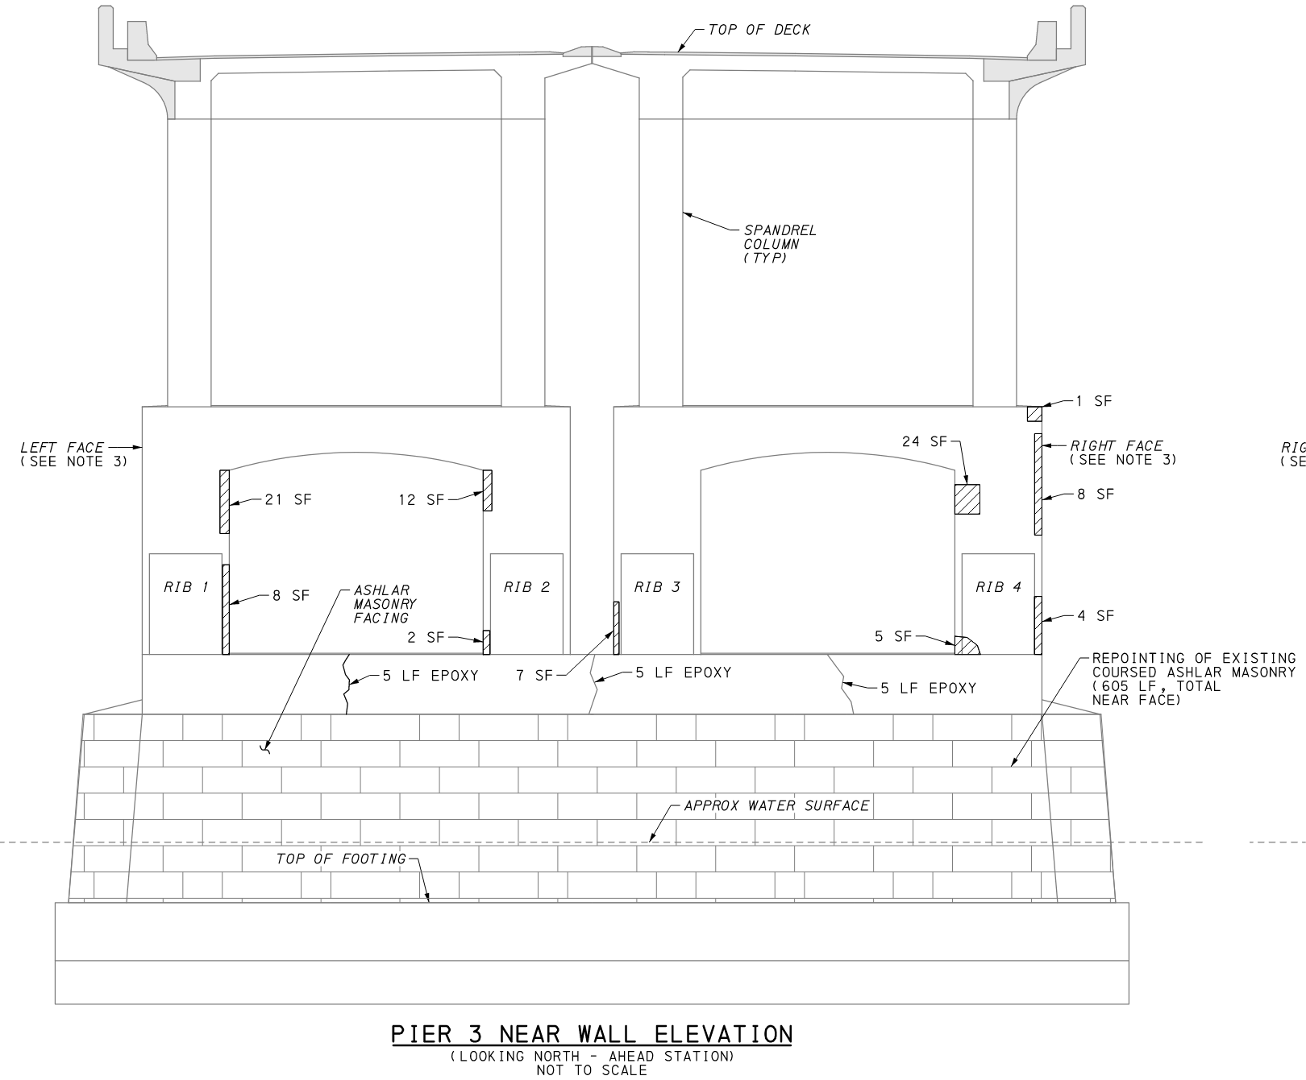
DISTRICT 5 BEST PRACTICES
Preservation & Rehabilitation Projects
ALWAYS include an Unforeseen Bridge Repair Item
  Can further subdivide (Unforeseen Steel, Unforeseen Bearings, etc.)
Concrete Repairs:
  Perform sounding inspection in FD
  Increase quantity by another 25% at least
  Create diagram for plan set
  Beware sensitive locations – Concrete Encased I-beams or Truss Members
  Shallow Exposed Reinforcement - Paint
  Shotcrete not preferred – consult DBE
Notes:
Standard Special Provisions exist for Unforeseen repair items
Concrete repair quantities always increase in construction
Try to make educated decisions about what locations may be combined in construction to minimize cutting
Sensitive locations can see large sections delaminate due to repair activities – try to include extra quantity or limit repair to just painting
Shallow exposed reinforcement – clean and apply grey epoxy paint or use blister repair
Few locations where District willing to accept use of shotcrete – overhead primarily

Slide 7
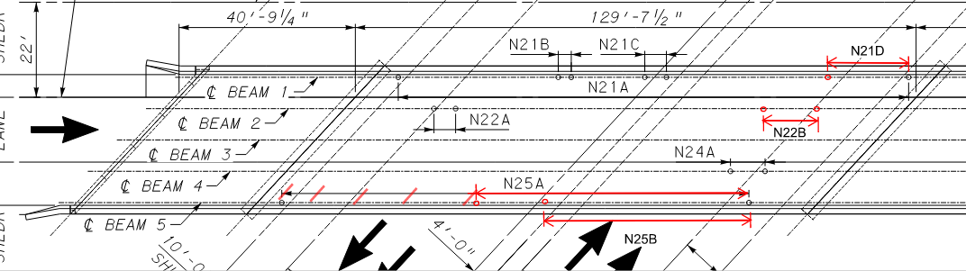
DISTRICT 5 BEST PRACTICES
Preservation & Rehabilitation Projects Cont’d
Material testing highly encouraged for Rehabilitation projects.
  Steel coupons to verify strength
  Concrete cores to test chlorides and check for ASR
Zone/Spot Painting
  General locations of zone/spot painting to be shown
    Helpful for bidding purposes
    Access and Containment
  Use SF Unit for item
  Try to match existing color
Notes:
Material testing results have changed scope of work on previous projects from rehabs to replacements
Paint locations on plans help bidders determine access and containment needs to get better prices
SF unit helps Construction negotiate in the field if any under or overages

Slide 8
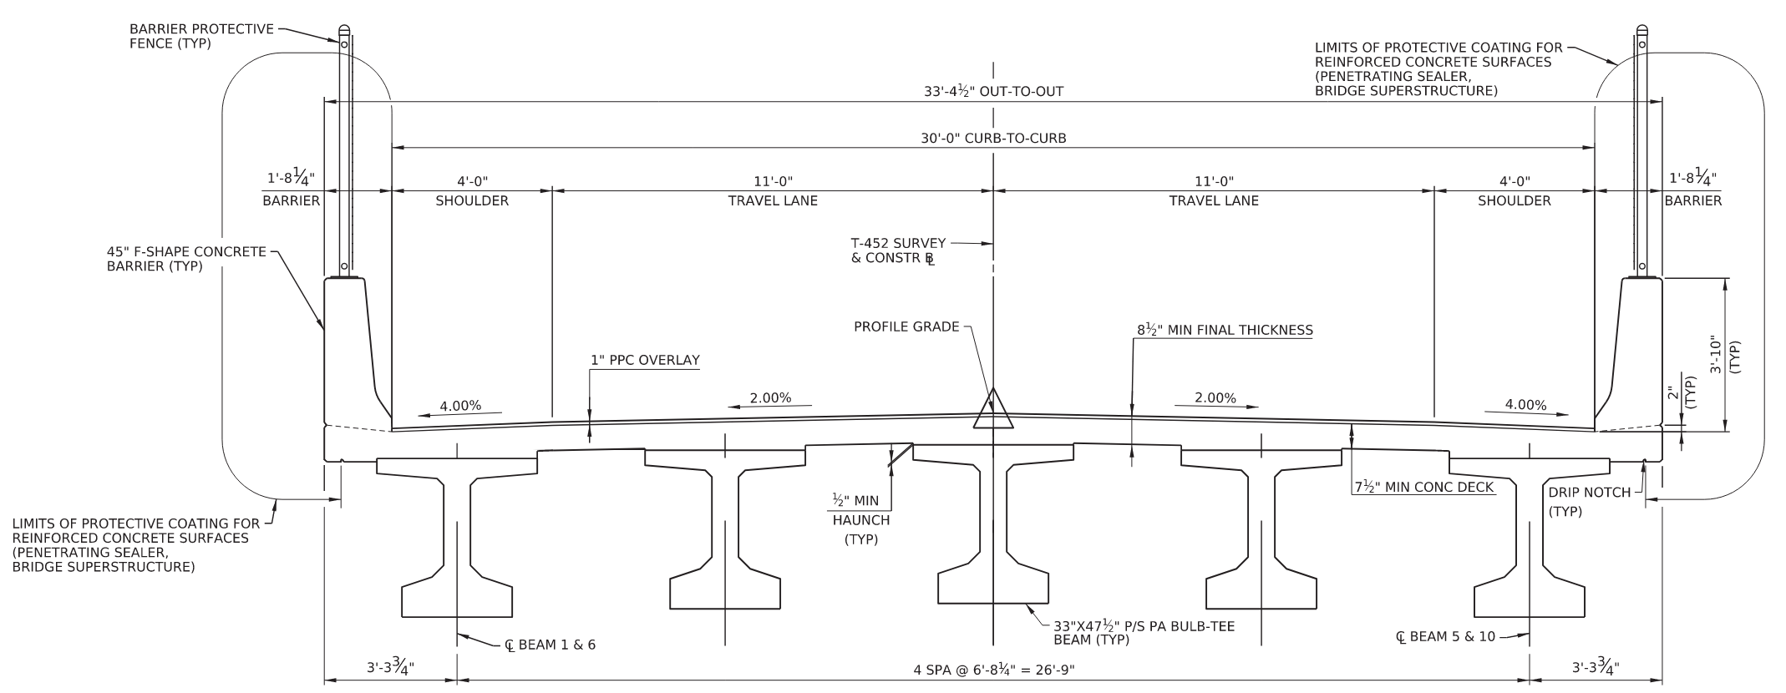
DISTRICT 5 BEST PRACTICES
Replacements
Bridge Drainage:
AVOID DRAINS ON BRIDGE IF POSSIBLE!
Scuppers with downspouts preferred over curb drains.
Bearings:
Consult Bridge Unit for Neoprene Pad Testing
HLMR Disc Bearings – Specify as an as-built item
Protective Coating Limits:
Extend at least to drip notch
Protective Fencing:
Use anytime crossing over a roadway
Follow DM-4 requirements for RR’s and Suicide Fencing as well
Notes:
Please change L&G of roadway or lane/shoulder geometry if at all reasonable.
Since HLMR bearings are manufacturer dependent, provide general dimensions/requirements and use a SP to have contractor update plan sheets

Slide 9
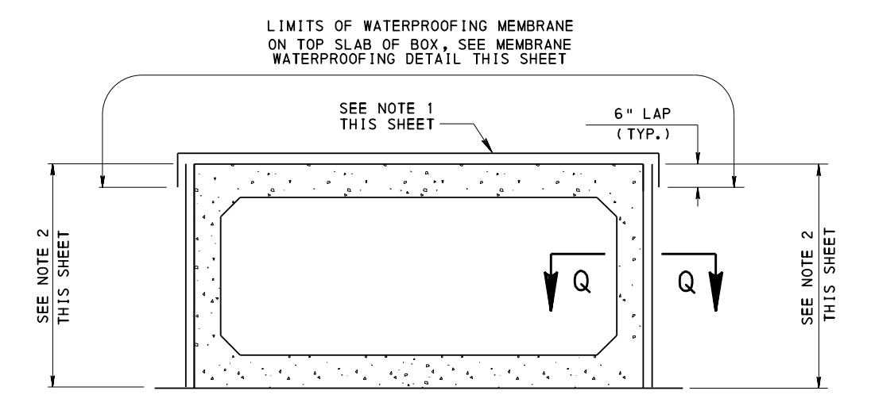
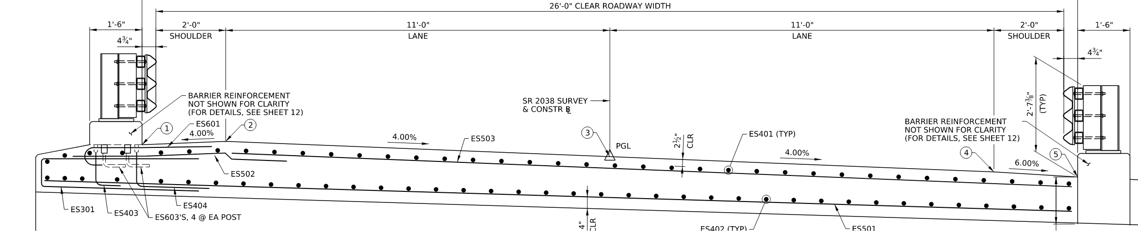
DISTRICT 5 BEST PRACTICES
Replacements – Box Culverts
If culvert is at grade and needs a distribution slab DO NOT include membrane waterproofing on the top slab.
If distribution slab is 10” thick or greater than provide 2 layers of reinforcement.
Wingwalls with independent footings (CIP or Precast) should have BFE no higher than bottom of cut off wall.
Notes:
Distribution slab is attached with many L-shaped dowels. Any waterproofing membrane will get poked full of holes in this situation.
Use waterproofing detail from BC-788M only when culvert is under asphalt or fill.
Thicker slabs are typically used where roadway profile and H&H requirements don’t allow for a minimum asphalt thickness so wearing surface is the distribution slab.
BD-632M has somewhat conflicting notes between CIP and Precast wingwall footing elevations, this is the District preference due to scour.

Slide 10
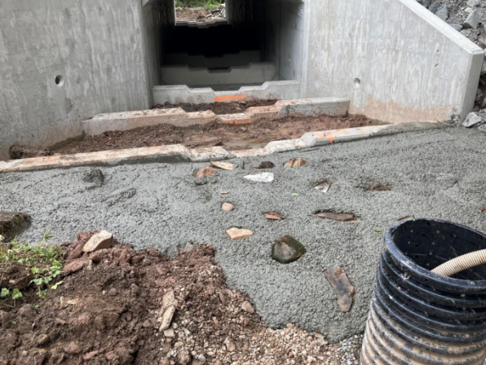
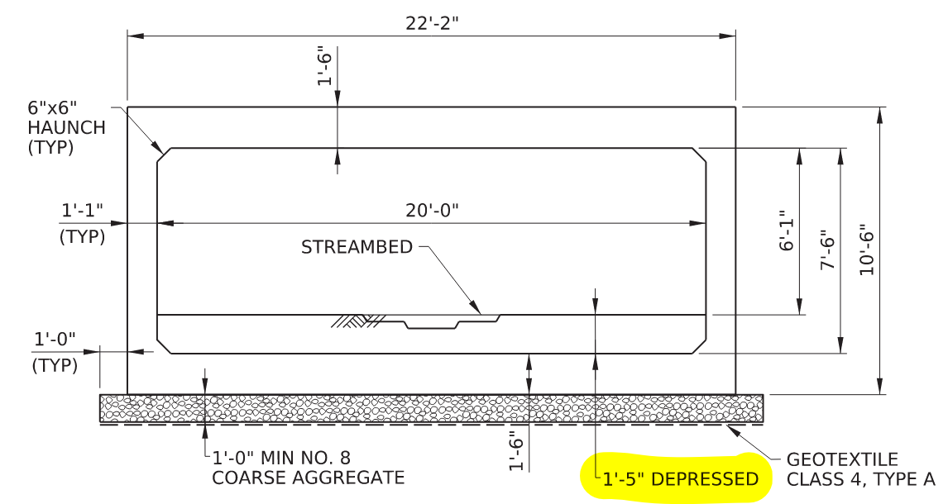
DISTRICT 5 BEST PRACTICES
Replacements – Box Culverts (Baffles)
Alternate Baffle Design from PAFBC is preferred
  Not in current BD standards, should be in update.
  If culvert over depressed, increase height of baffle
Contractor placed Streambed Material
  If culvert rise <5’ generally allowed to naturally fill
  If culvert rise >5’ contractor placed
  On EV streams ALWAYS contractor placed
Grouted cutoff walls
  Place grout to lowest elevation of weir
  Grout can only extend 5’ along stream length

Slide 11


DISTRICT 5 BEST PRACTICES
Replacements – Misc.
District open to Adjacent Box Beams
  If H&H shows pressure flow
  If spacings between adjacent webs are smaller than beam width for spread box beams
Steel superstructures:
  Default color: FC-25183
  Weathering steel color: FC-20122
  Check with District if weathering steel proposed
If replacing a structure with open-grid decking check with Bridge Unit regarding reuse of deck
Notes:
Often adjacent beams will decrease superstructure depth and allows a 5” deck rather than 8” minimum
County maintenance may want to reuse open grid decking on existing structures but reusing is based on deck condition

Slide 12
DISTRICT 5 BEST PRACTICES
Questions?
Gary Calotta, PE
gcalotta@pa.gov
610-871-4579

