Slide 1
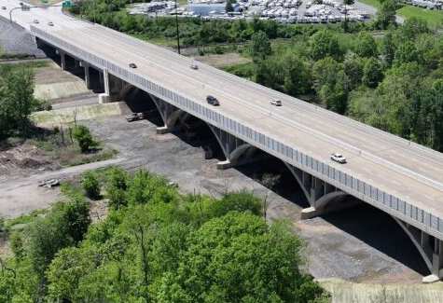
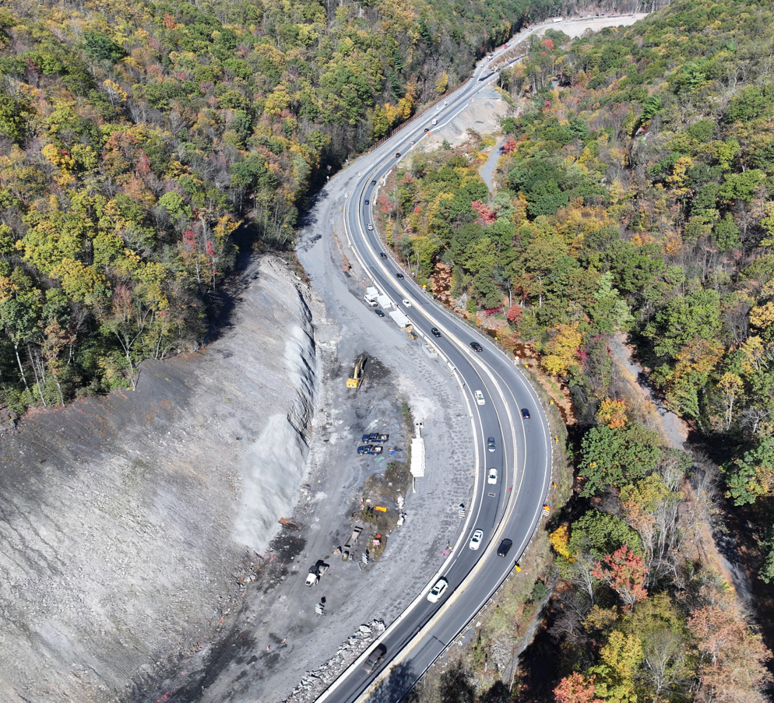
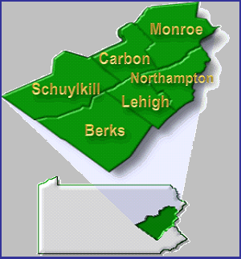
ASHE EVENT 2026
SR 78-13B
SR 61 – 14M
Christopher J. Kufro, PE District Executive
Scott Vottero, PE Assistant District Executive (Design)
Michael Guidon, PE Assistant
District Executive (Construction)
Bruce Bubser
Assistant
District Executive (Maintenance)
March 2026
Notes:
TEAM OVERVIEW
Staff Changes
QA\QC
FUTURE WORK - CRESSMAN

Slide 2
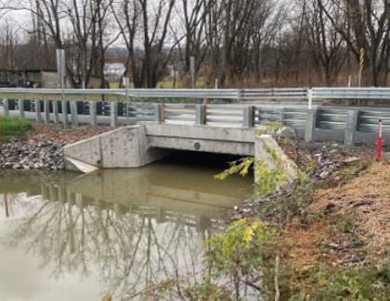
District 5-0 Statistics
3,290 miles of highway (2,445 miles on high level network)
65% of network is high level
8,389 total snow lane miles
2nd in Interstate Segment Miles (345)
3rd in DVMT (26 million)
2,138 bridges (9,474,791SF of deck area)
228 state bridges that are SD (10.66%)
51 state bridges that are posted (2.6%)
8 state bridges that are closed (0.37%)
Local Bridges
806 locally-owned bridges
206 local bridges that are SD (25.55%)
151 local bridges that are posted (18.73%)
22 local bridges that are closed (2.73%)
SR 1035 Berks County
Notes:
Berks County ECMS#85650
Contractor: CriLon Corp
Designer: Larson Design Group, Inc
IIC: Dalia, Brandon J.
CI Firm: CDR
Completion: 12/12/2025
ECMS# 85650 Box Bundle

Slide 3
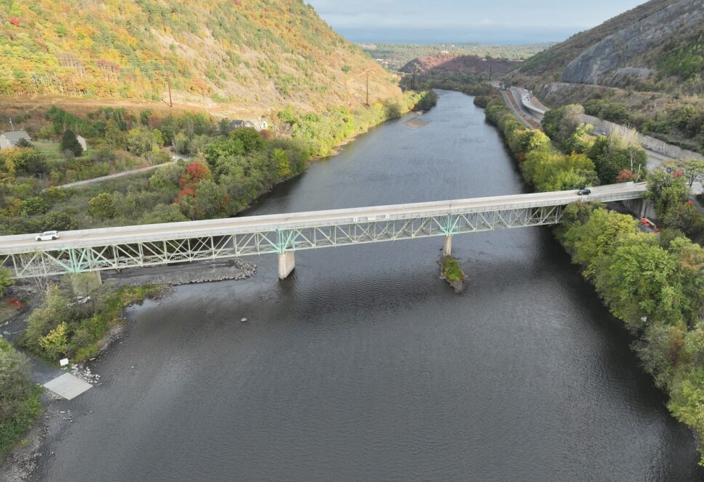
Construction program
Currently $1.06B in Construction

Slide 4
bridge condition trends
Notes:
Updated as of 01/30/2026

Slide 5
Project Delivery District 5 – Total Lettings

Slide 6
Tip funding & future considerations
2025 – 2028 TIP
 | LVTS | NEPA | RATS | Total
NHPP | $60.933 | $26.365 | $47.878 | $135.176
STP | $28.615 | $33.335 | $21.977 | $83.927
State | $93.409 | $71.692 | $74.416 | $239.517
BOF | $22.340 | $21.834 | $16.334 | $60.508
HSIP | $20.761 | $12.783 | $13.124 | $46.668
CMAQ | $27.888 | $2.189 | $17.396 | $47.473
CRP | $2.351 | $6.118 | $1.636 | $10.105
CRPU | $6.473 | $0.000 | $3.028 | $9.501
TAU | $5.152 | $0.000 | $2.410 | $7.562
STU | $55.199 | $0.000 | $25.823 | $81.022
BRIP | $33.977 | $22.897 | $29.671 | $86.545
Total | $357.099 | $197.213 | $253.693 | $808.005

Slide 7
Tip funding & future considerations
2027 – 2030 Draft TIP
 | LVTS | NEPA | RATS | Total
NHPP | $54.959 | $23.215 | $41.993 | $120.167
STP | $28.790 | $29.065 | $22.048 | $79.903
State | $89.685 | $59.051 | $71.242 | $219.978
BOF | $22.455 | $18.701 | $16.321 | $57.477
HSIP | $21.842 | $10.040 | $13.461 | $45.343
CMAQ | $28.058 | $2.202 | $17.502 | $47.762
CRP | $2.290 | $5.049 | $1.606 | $8.945
CRPU | $6.505 | $0.000 | $3.043 | $9.548
TAU | $5.179 | $0.000 | $2.423 | $7.602
STU | $55.471 | $0.000 | $25.950 | $81.421
BRIP | $34.104 | $19.773 | $29.620 | $83.497
Total | $349.338 | $167.096 | $245.209 | $761.643

Slide 8
Tip funding & future considerations
2027 vs 2025 TIP
 | LVTS | NEPA | RATS | Total
NHPP | ($5.974) | ($3.150) | ($5.885) | ($15.009)
STP | $0.175 | ($4.270) | $0.071 | ($4.024)
State | ($3.724) | ($12.641) | ($3.174) | ($19.539)
BOF | $0.115 | ($3.133) | ($0.013) | ($3.031)
HSIP | $1.081 | ($2.743) | $0.337 | ($1.325)
CMAQ | $0.170 | $0.013 | $0.106 | $0.289
CRP | ($0.061) | ($1.069) | ($0.030) | ($1.160)
CRPU | $0.032 | $0.000 | $0.015 | $0.047
TAU | $0.027 | $0.000 | $0.013 | $0.040
STU | $0.272 | $0.000 | $0.127 | $0.399
BRIP | $0.127 | ($3.124) | ($0.051) | ($3.048)
Total | ($7.761) | ($30.117) | ($8.484) | ($46.362)

Slide 9
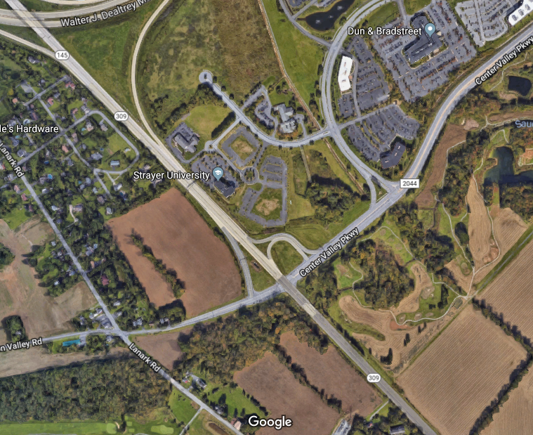
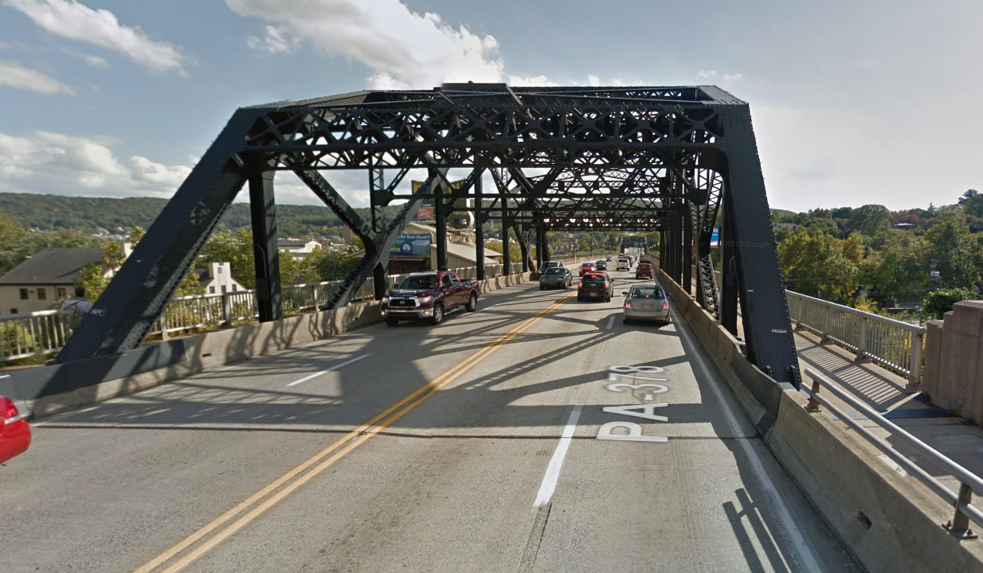
Major design projects
LVTS
SR 309/Center Valley Interchange
SR 22/191 Interchange Reconstruction
SR 378 Hill to Hill Bridge
78 Reconstruction
SR 22 Widening
NEPA
I-80 Reconstruction (303–307)
SR 611/715 Phase 1 & 2
80-28M Bartonsville Reconstruction
SR 443 Pine Grove
SR 209 Safety Improvement
RATS
SR 222-28M South of Kutztown
US 422 West Shore Bypass Reconstruction
SR 61 Phases 1 & 2
LVTS - SR 309/Center Valley Int
LVTS - SR 378 Hill to Hill
80 Reconstruction (303-307)
222 North Widening
RATS - SR 422-29M West Shore Bypass

Slide 10
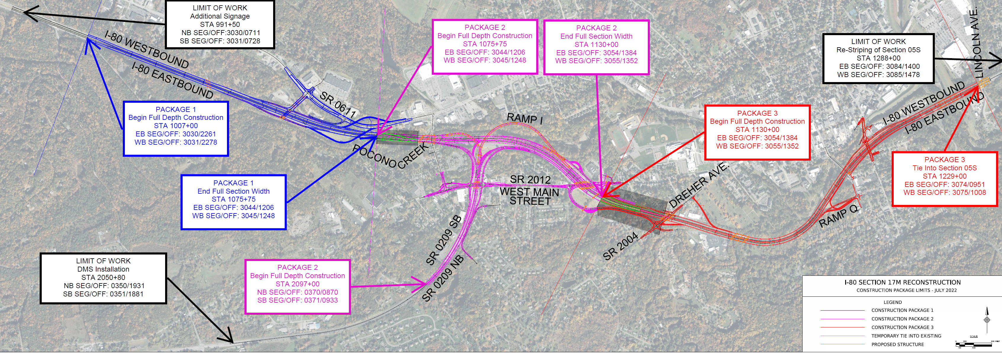
Major design projects
Interstate 80 Reconstruction – Stroudsburg Monroe County
Notes:
The I-80 - Section 17M Interstate Reconstruction Project is located in Monroe County. The purpose of this project is to reconstruct Interstate I-80 from segment 3040 (exit 303) in Stroud Township to segment 3074 (Exit 307) in the Borough of East Stroudsburg, Typical Section on I-80 shall include: 12’ travel lanes, 10’ inside shoulders, 12’ outside shoulders, and full interchange acceleration and deceleration lane lengths. Two lanes of traffic in each direction must be maintained on I-80 during construction activities. All structures over I-80 mainline are to be lengthened to accommodate four (4) lanes on I-80 at all times during construction activities and provide 16’ 6” vertical clearance. All structures carrying mainline I-80 will be evaluated for rehabilitation vs replacement options to include widening to accommodate the typical section specified above.

Slide 11
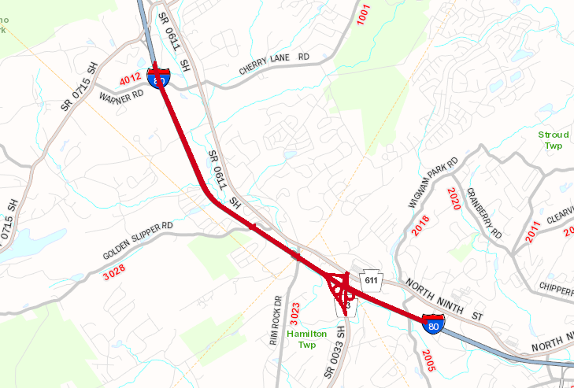
80-26M - Bartonsville Reconstruction
Notes:
The purpose of the SR 80 Section 26M is the reconstruction of approximately 5 miles of Interstate 80 from the SR 4012 (Warner Street) Bridge, just east of Exit 299, through the SR 33 Interchange (Exit 302). The project includes a slight reconfiguration of the interchange to provide adequate mobility, eliminate weaving areas and extend acceleration/deceleration lane lengths, as well as rehabilitation or replacement of 3 mainline bridges, 5 overhead bridges and 1 ramp bridge, replacement or widening of 5 culverts, construction of rock cut/fill areas, adding new overhead signage, and updated Intelligent Transportation Systems (ITS). Two (2) lanes of traffic in each direction must be maintained on I-80 during construction activities

Slide 12
Major design projects
422 West Shore Bypass– Berks County
Notes:
The project consists of highway reconstruction/widening of US 422 (West Shore Bypass) from the Buttonwood Street overpass to east of the I-176 interchange in Cumru and Exeter Townships, West Reading Borough, and the City of Reading, Berks County. The project length is approximately 5.01 miles. The project will include widening the roadway to accommodate three (3) travel lanes in each direction; full reconstruction of the Penn Street/Penn Avenue interchange and Lancaster Avenue interchange; partial reconstruction of the Bingaman Street Bridge and associated bicycle and pedestrian connections; replacement of the Schuylkill River Bridge and US 422 over Norfolk Southern Railroad bridges west of the I-176 interchange; reconstruction of the I-176 N to US 422 W on-ramp; and preventative maintenance activities on the US 422 bridges over Brentwood Drive, the Schuylkill River east of Lancaster Avenue, and the Schuylkill River.

Slide 13
Major design projects
222 North Widening– Berks County
Notes:
The proposed project consists of highway reconstruction/widening beginning east of Schaeffer Rd (T-757) to the Kutztown
bypass, excluding intersection improvements at Moselem Springs Rd (SR 662) (approximately 4 miles) in Maiden Creek, Richmond, and Maxatawny Townships, Berks County, PA. The improvements shall include widening the roadway to two (2) travel lanes in each direction with a center median barrier. Structure replacement at a Tributary to Moselem Creek and culvert lengthening are anticipated. Preliminary Engineering, Environmental Documentation, Final Design and Construction Services for these

Slide 14
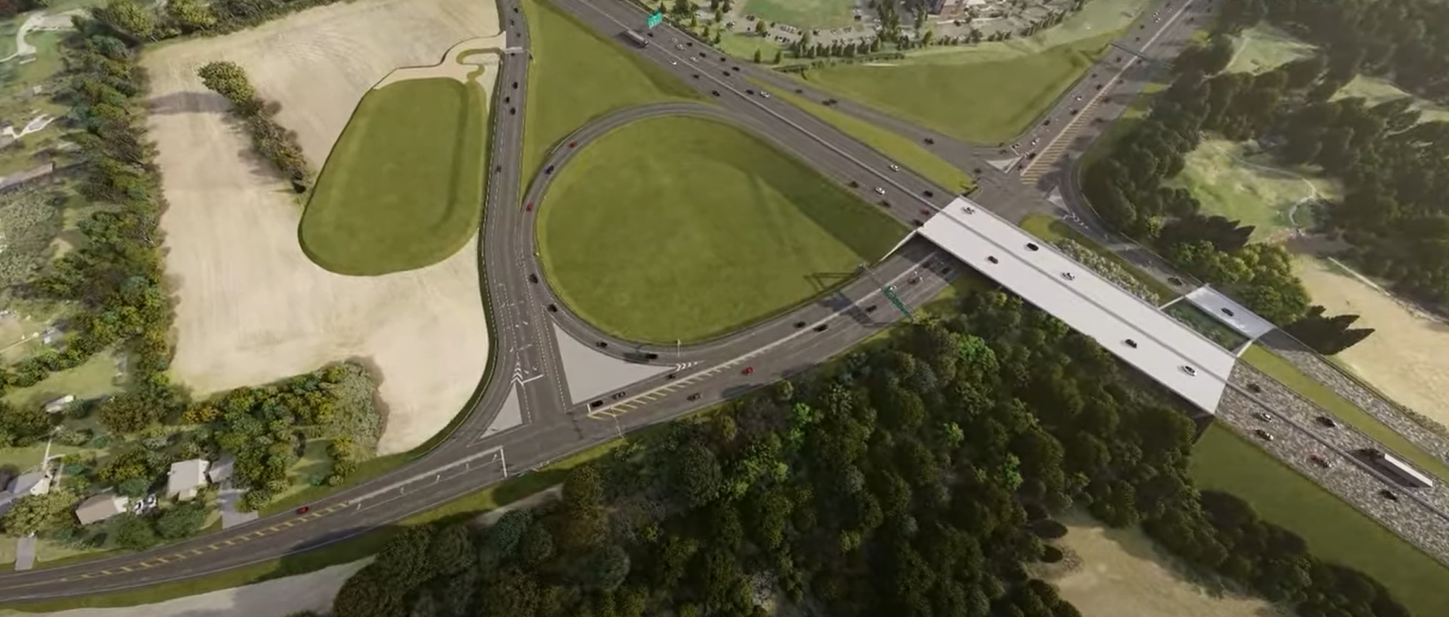
SR 309 & Center Valley Parkway Inter.– Lehigh County
Notes:
This project involves improvements to the SR 309/Center Valley Parkway intersection to address current and future congestion in
Upper Saucon Township, Lehigh County. It is anticipated that the existing signalized intersection will be converted into a full direction, grade separated interchange.

Slide 15
Major design projects
SR 378- Hill to Hill Bridge – Lehigh County
Notes:
This project involves the bridge rehabilitation of the historic Hill to Hill Bridge that carries State Route 378 over Lehigh River, Sand Island Park, D&L Canal and Trail and several railroads in the Bethlehem, Northampton and Lehigh County. The project also includes widening of the southern end to minimize traffic congestion. Construction is expected to maintain the existing four-lanes of traffic as much as possible with short term restrictions required.

Slide 16
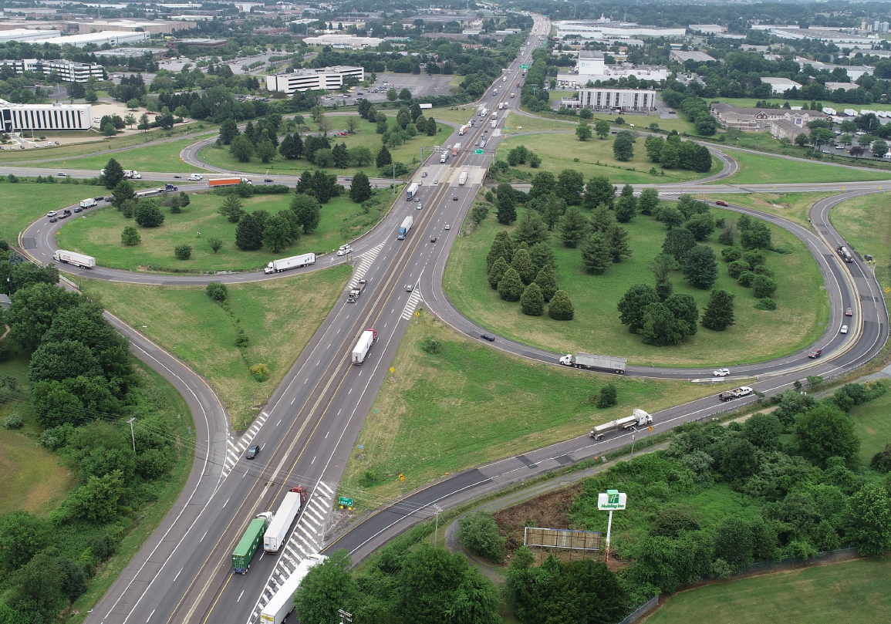
Major design projects
78-19M- Reconstruction from Berks Co Line through 78/100 Interchange
Notes:
This project, Design / Bid / Build, involves complete reconstruction and possible widening and/or addition of truck
climbing lanes on Interstate 78 from the Berks County/Lehigh County line to just east of the SR 100 interchange in Weisenberg and Upper Macungie Townships. The project also includes the
reconstruction of the I-78/SR 100 interchange and the addition of the SR 78/Adams

Slide 17
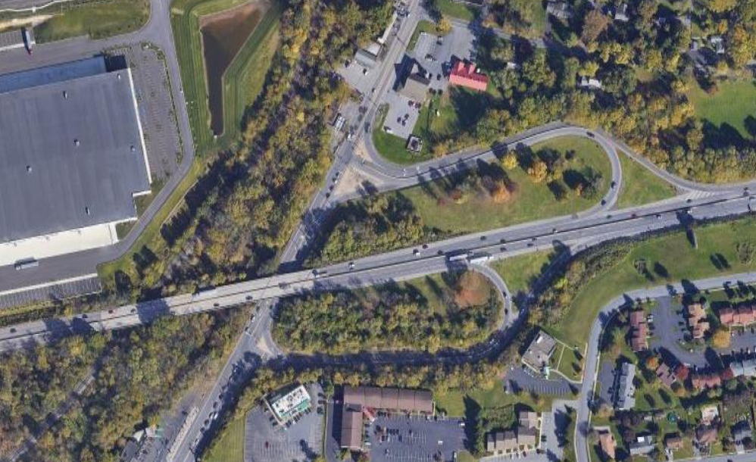
Major design projects
22-15M- SR22/SR191 Interchange Northampton County
Notes:
RKK Designer The SR 22 Sec 15M project includes the upgrade of the SR 22-SR 191 interchange. The interchange is currently congested and has
substandard geometry making it difficult for trucks to maneuver through the interchange. Work includes improved acceleration and deceleration lanes for the ramps, replacement of the SR 22
Bridge over Monocacy Creek and SR 191, realign the ramps to accommodate truck movements, additional capacity along SR 191 through the interchange, replacement or widening

Slide 18
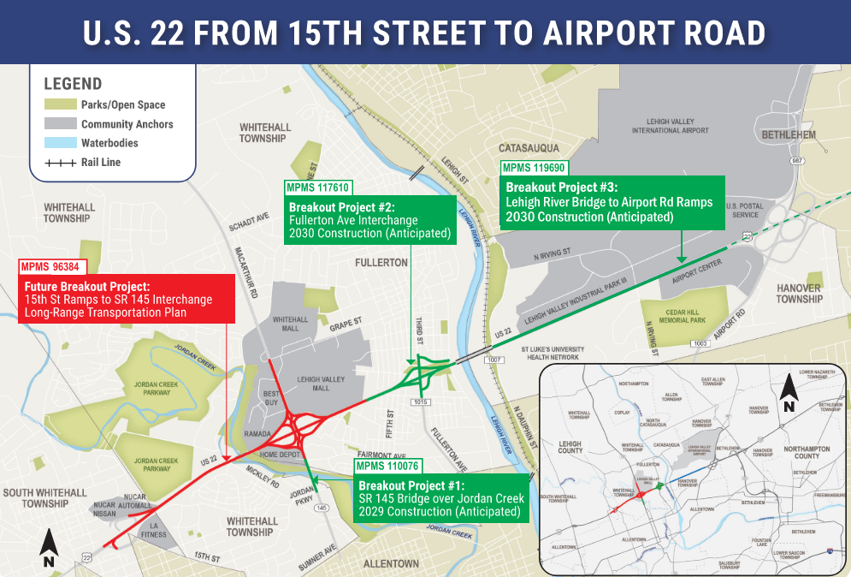
Major design projects
Notes:
Upon environmental clearance, the corridor will be broken up into 4 breakout projects:
MPMS 117610 - SR 22 Fullerton Interchange
Fall 2029 let planned
MPMS 94873 Fifth Street Bridge will be bundled with it since it will allow for more flexibility in construction staging
MPMS 119690 - SR 22: Lehigh River Bridge to Airport Road (though we are considering extending 3rd westbound to SR 378 on-ramp
Just received $6 million to complete engineering
Projecting a Fall 2029 let, possibly bundling with Fullerton Interchange
MPMS 110076 - Jordan Creek Bridge Replacement
MacArthur Road over Jordan Creek just south of the Route 22 interchange
Fall 2029 let planned
MPMS 96384 - US 22 Widening (15th Street Interchange through MacArthur Road including DDI interchange at MacArthur Road)
Currently projected for a 2035 let, but may also be accelerated

Slide 19
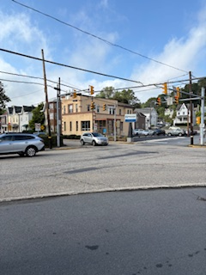
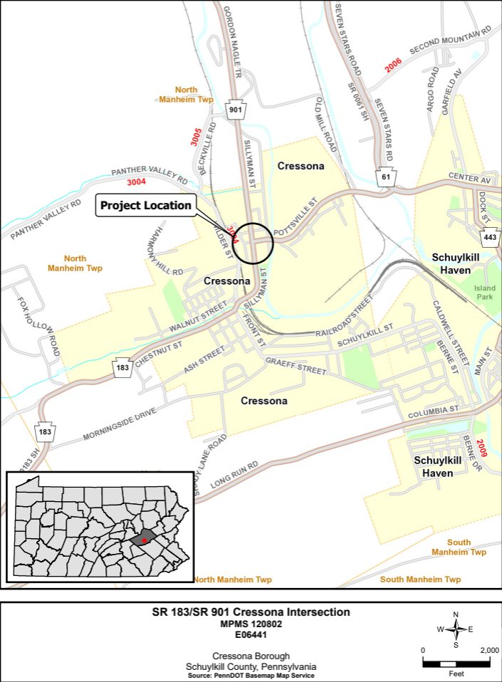
Major design projects
Cressona Study
Notes:
This project will begin with a study to identify potential improvements/alternatives to the SR 183 (Pottsville Street) and SR 901 (North Sillyman Street) intersection in Cressona Borough, Schuylkill County to address safety and congestion. Concerns are related to long queue lengths at the existing signalized intersection, truck turning movements, and high speeds.
The limits of the study include SR 61 to SR 901 north to Mengle Street, and SR 183 south just past the railroad bridge.

Slide 20
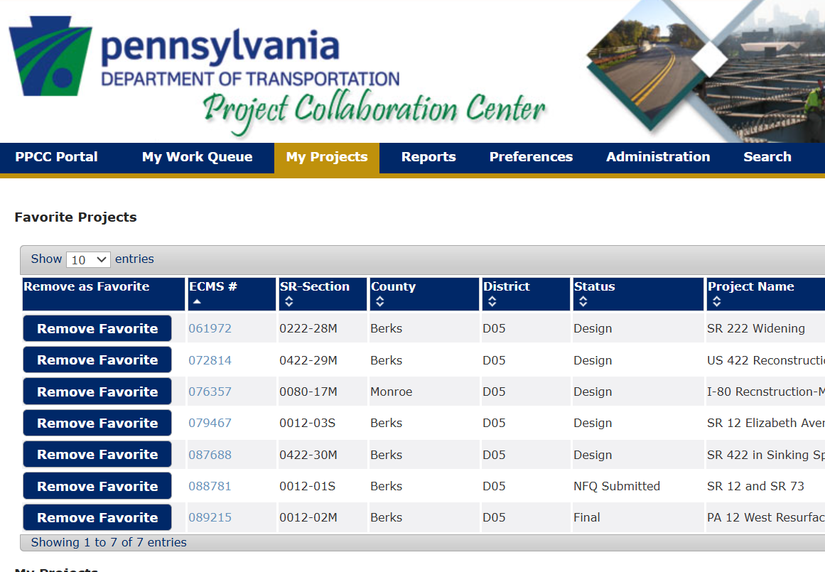
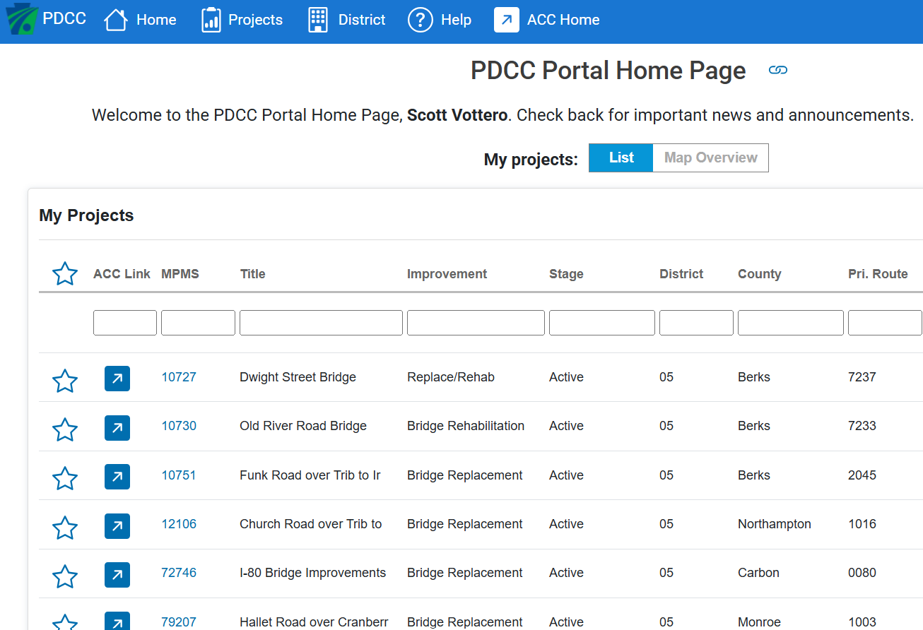
AUTODESK & Project portal
Typical SR 61 Section with Median Barrier
AutoDesk Pilot Projects:
SR 4003-07M Northampton – Let Date 09/25/2025 PM Dan Kim
SR 0309-07M Schuylkill - Let Date 02/12/2026 Mike McKinnon
SR 0033-05S Monroe – Let Date 09/17/2026
PPCC to PDCC
Hawk Ridge Drive Ext and two (2) retaining walls
Notes:
SR 4003 Main St - 21st St to Cherryville Rd - AutoDesk Pilot (First PennDOT Pilot Project
Ben Titus Rd to Lofty Hill - AutoDesk Pilot (PennDOTs 2nd Pilot
PA 33 Median Barrier SR 2002 to SR 2008
PPCC PennDOT Project Collaboration Cetner to PPCC Project Delivery Collaboration Center -

Slide 21
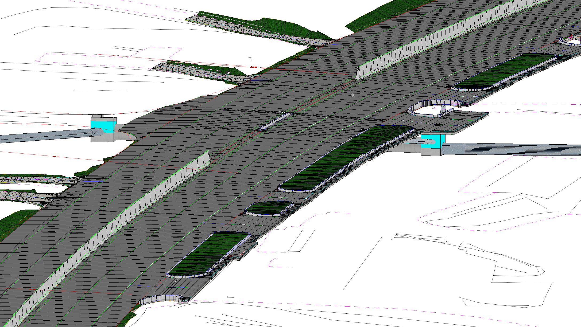
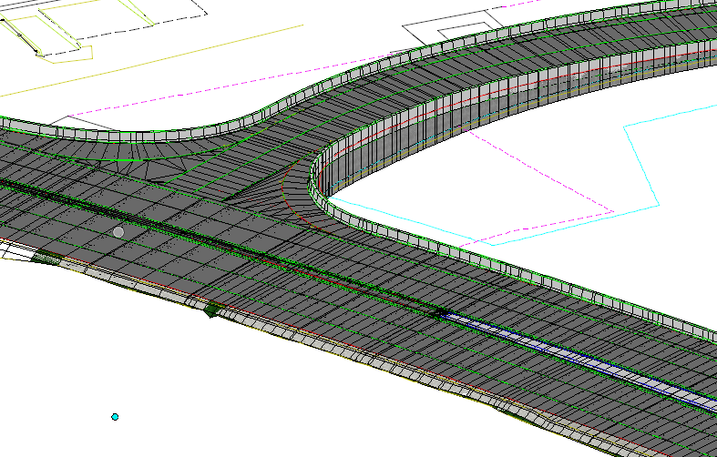
Digital delivery
Typical SR 61 Section with Median Barrier
Key OpenRoads Aspects:
Rapidly evolving CAD environment
Regular Scheduled Meetings with Central Office Digital Delivery Team
Use of OpenBridge for modeling moment slabs and rebar detailing
Planless Delivery
Hawk Ridge Drive Ext and two (2) retaining walls
Notes:
SR 61-15M Also Center Valley Parkway, I-80 (Roll Plots)
Project Overview:
In Final Design
Anticipated Let Date: 03/26/26
Approx. 1.5 Mi Mill & Overlay
Extension of Hawk Ridge Drive
Two (2) retaining walls
Installation of Median Barrier
Access Management throughout corridor

Slide 22
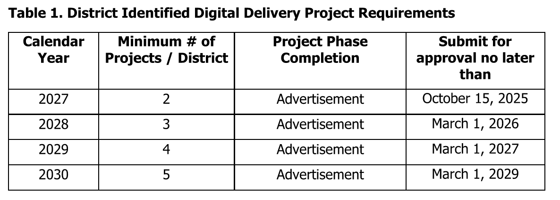
Digital delivery
Digital Delivery Implementation Policy :
Hawk Ridge Drive Ext and two (2) retaining walls
Notes:
Memo issued 08/07/2025
SR 1001 PTC OH Bridge Replacement: Digital Delivery

Slide 23
DIGITAL DELIVERY
2027 Digital Delivery Project Submission
MPMS 119940, SR 2001-01B
Bridge Replacement
Currently in PE phase, nearing completion of PE
Jeremy Crawford-Consultant PM
Design team led by RKK
Let Date: 1/14/2027; Advertisement date: 12/3/2026
MPMS 10751, SR 2045-01B
Bridge Replacement
Currently in PE, nearing completion of PE
Steve Sartori-Consultant PM
Design team led by HNTB
Let Date: 2/25/2027; Advertisement 1/14/2027

Slide 24
DIGITAL DELIVERY
2028 Digital Delivery Project Submission
SR 4028-03B
MPMS 117726, Bridge Replacement, PE Phase, PM: Stefan Eskesen, Consultant Lead design team, est. let 02/2028
SR 248-07S
MPMS 120952, Congestion Reduction, PE Phase, PM: Megan Fallon, Consultant Lead design team, est. let 3/23/28
SR 2021-01B
MPMS 121653, Bridge Replacement, PE Phase, PM: Dennis Wilson, Consultant Lead design team, est. let 05/11/2028
Alternates:
SR 662-02S
MPMS 105963, Safety Improvement, PE Phase, PM: Steve Sartori, Consultant Lead design team, est. let 2028/2029
Roll Plot/Digital:
SR 2025-03M
MPMS 113825, Highway Restoration, PE Phase, PM: TBD, in-house design squads, est. let FY 2028

Slide 25
Thank you!

