Slide 1
District 5-0 Project Overview Four Large Projects Letting in 2026
American Society of Highway Engineers – East Penn
Monroe Co SR 80-BO1
Lehigh Co SR 378-03B Hill to Hill Bridge*
Lehigh Co SR 309-19M Center Valley Pkwy
Berks Co SR 222-28M
* Additional details on SR 378 will be presented by Brian Teles
David Rostron, PE, District 5-0 Design Services Engineer
March 17, 2026
Notes:
* NEED POINTER DIRECTIONS *
Thanks to everyone for coming out early this morning
My name is Dave Rostron & I’m the DSE – been with District 5-0 my entire 34+ yr career, with 25 yr being in Bridge (but don’t hold that against me). I’m also on the ASHE East Penn board and want to thank everyone there that has worked to put this together. It’s tough to try to come up with a new twist on things so they don’t repeat last year’s or other recent events and this segment fits into that category where I’ll talk about 4 large projects the District is putting out this year. Scott touched on them a bit earlier and I’ll give a little more detail

Slide 2

District 5 2026 Large Projects
Many years of work coming to fruition
They always have twists & turns that test your sanity
Four projects have combined estimated cost of ~ $500M
There’s often last-minute surprises or issues so there’s no guarantee that all four will go out this year
Notes:
Wanted to talk about these since they’ve been a big part of District workload for years so we thought a high level overview of these projects that you’ve maybe you’ve heard about would give a sense of some of the big things that have been occupying our time in recent years especially if we didn’t always get to some other projects due to attention on these.
They have twists that can drive you nuts and go through starts & stops and revisiting issues
Total of $500M – gives a sense of the design effort that has gone into them
But these big projects can sometimes need additional work from Consultants during construction as well

Slide 3
District 5 2026 Large Projects
I-80
Hill to Hill
SR 222 Widening
SR 309 CVP

Slide 4
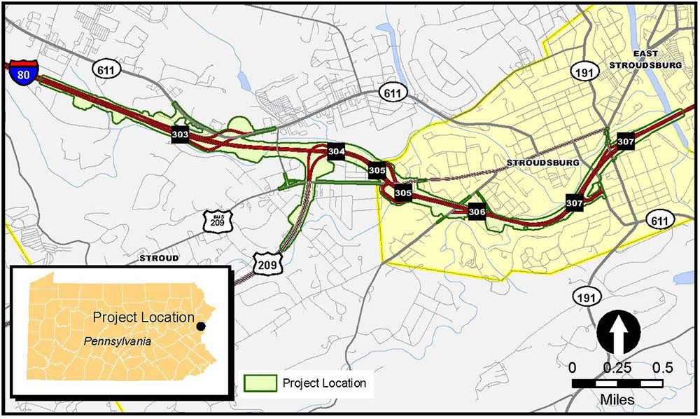

Monroe Co SR 80-17M → BO1 (Breakout 1)
I80project.com
PM: Imtiaz Nathaniel
Prime: AECOM
Subs: McCormick, CDR, AGES, SCI, L&V, BrightFields
Agmt Executed: Dec 2012
Notes:
Overall view of entire I-80 Reconstruction project
Design Team breadown
Note several exits, some partial, in a short distance. Also some challenging geometry & it gets more Urban as you go East

Slide 5
SR 80 Existing Conditions
Built in ’50s & ‘60s – poor condition, many substandard features:
Short accel/decel lengths
Insufficient weave (exits close together)
Narrow shoulder widths
Above avg crash rate - Safety Corridor w/reduced speed limit since early ‘00s
Busy corridor connecting NY Metro area w/PA and further West
Key connector for local/regional traffic & gateway to Poconos
2045 Design Year volumes expected to be ~ 130K
Notes:
Besides poor condition and substandard features being bad on their own, they also contribute to congestion
Narrow shoulders make pulling off unsafe & tougher for Emergency vehicles

Slide 6
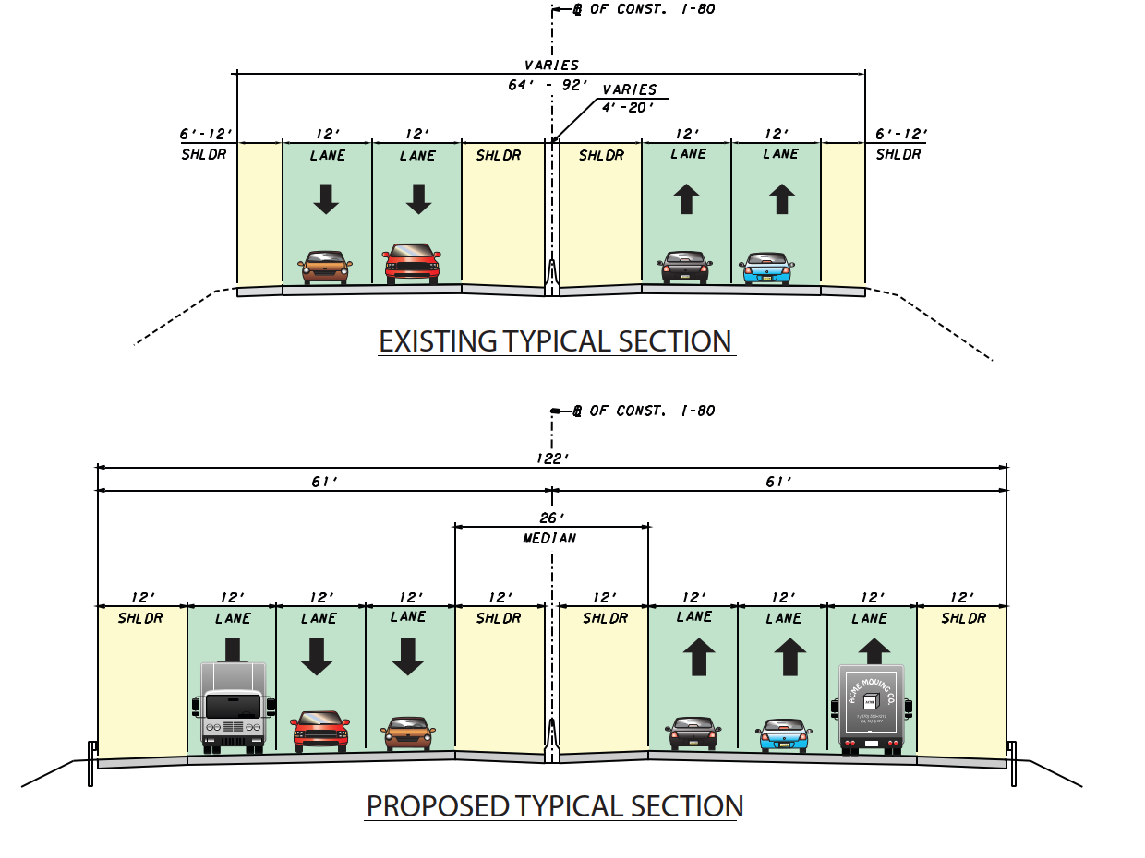
SR 80 Existing & Proposed Section
MPT must include two lanes of traffic in each direction
Wider section accounts for staging and current & future volumes

Slide 7
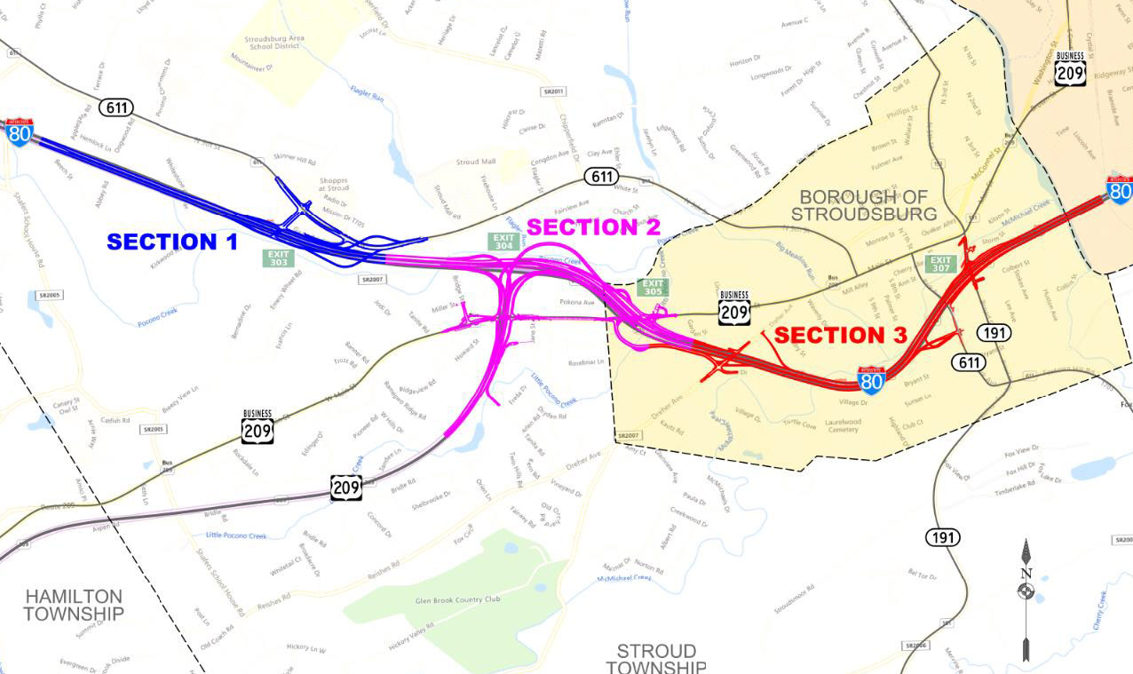
SR 80-BO1 (Breakout 1)
I80project.com
Notes:
Being built in numerical order but it will take a while – each one is about 4 years duration.
Started from the west since 80-05S E. Stroudsburg I/C construction just east of Section 3 (off page) is ongoing so we stayed away from that. And 26M project to rebuild 5 mi of 80 starting west of Section 1 is in design

Slide 8
SR 80-BO1 Key Improvements
Reconstruct & widen 1.5 miles of I-80 with new conc. pavement
Replace and widen 1 mainline bridge
Construct 7 ramp structures to replace partial interchange at Exit 303 (SR 611) with a new, full access interchange
Install 14 retaining walls and 2 sound barrier walls
Upgrade roadway drainage system and add multiple stormwater basins to improve water quality and control runoff

Slide 9
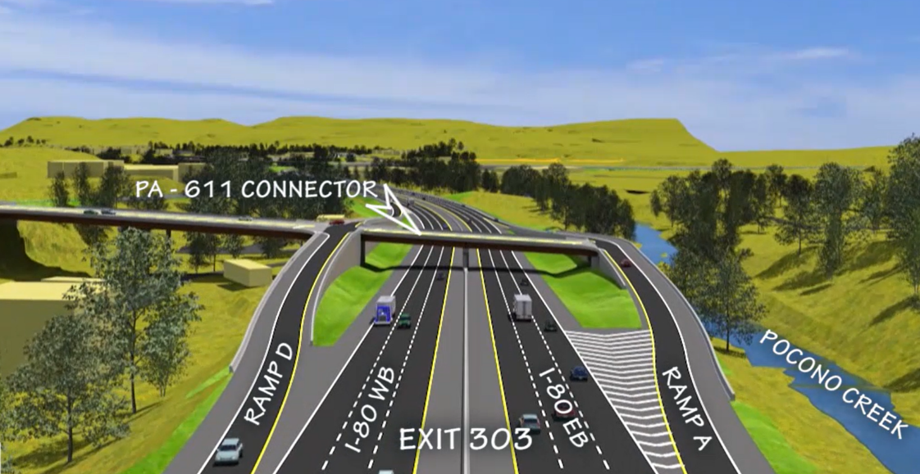
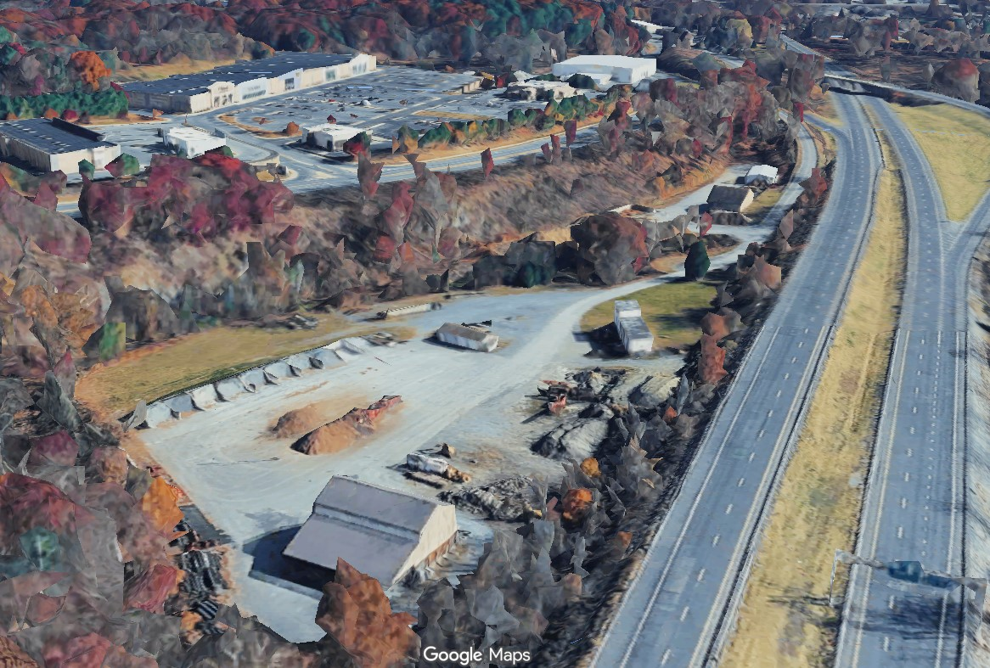
SR 80-BO1 Key Improvements
Exit 303 – Route 611
Notes:
Note the steep slope from Roue 611 down to the area below which is a Twp maintenance yard.

Slide 10
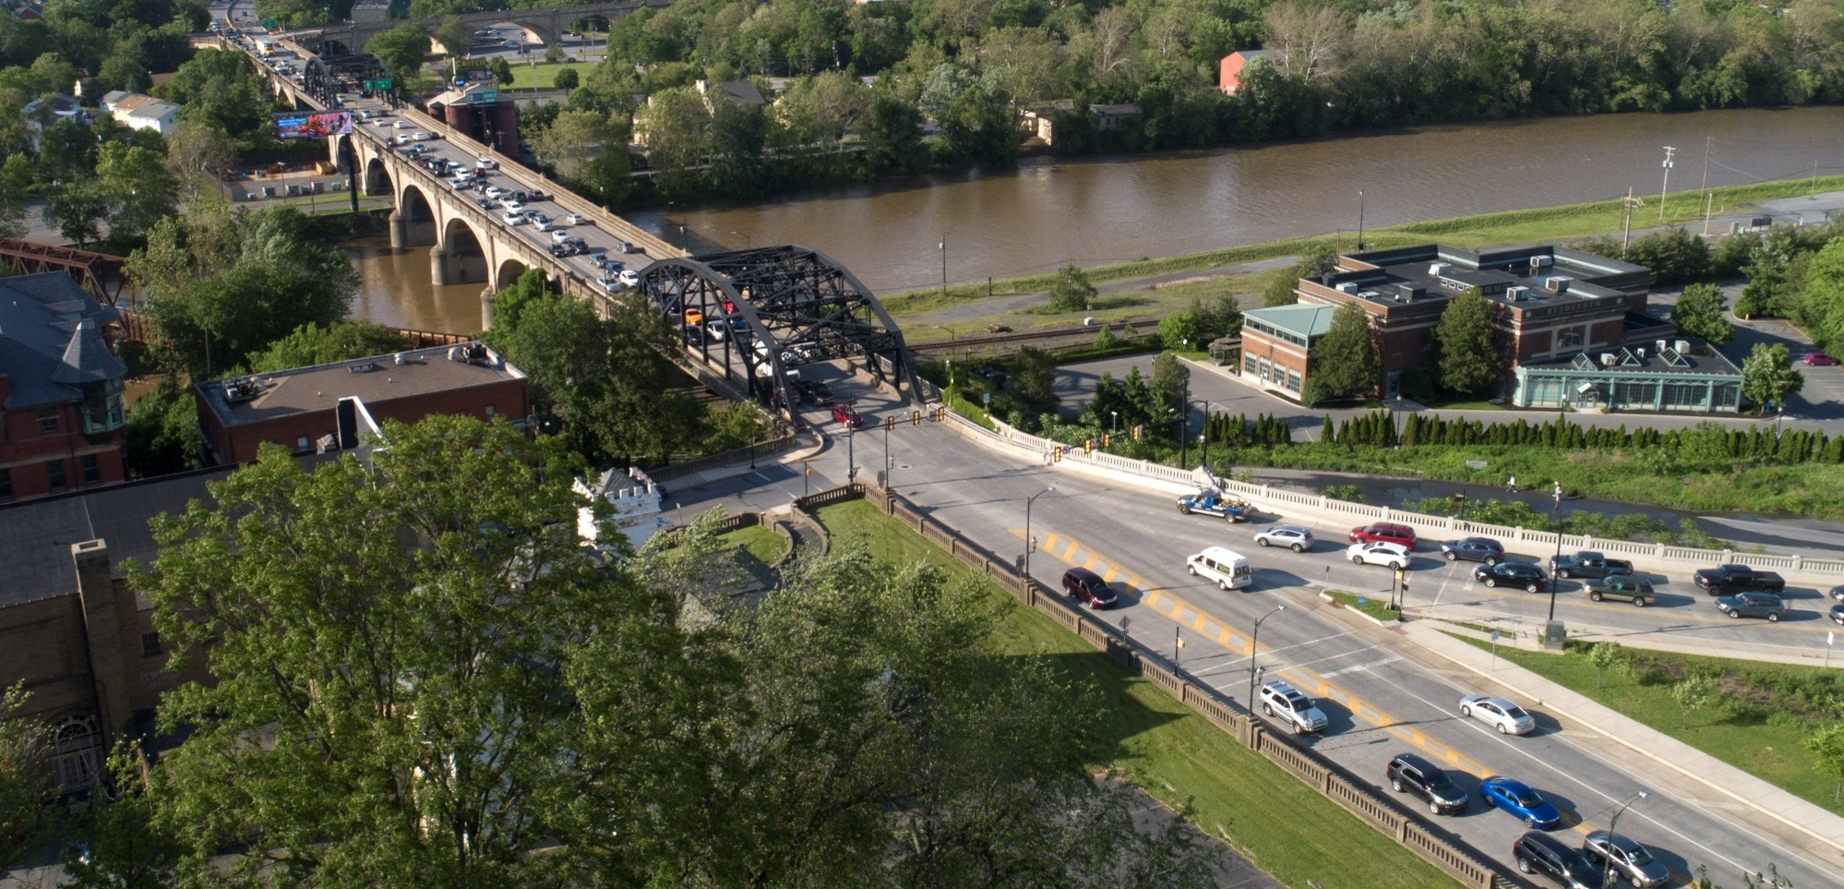
Lehigh Co SR 378 Hill to Hill Bridge
PM: Brian Teles, PE
Prime: HNTB
Subs: Pennoni, ASC, NTM, M&S, S&L, AGES, Colliers, Rettew
Agmt Executed: April 2017
Notes:
This project involves the rehabilitation of the historic Hill to Hill Bridge that carries Route 378 over Lehigh River, Sand Island Park, D&L Canal and Trail and several railroads in Bethlehem, going from Northampton to Lehigh County. The project also includes widening of the southern end to reduce traffic congestion.
Note the Design Team
Brian Teles is the PM and will make your head spin with more details later but here are the basics….

Slide 11
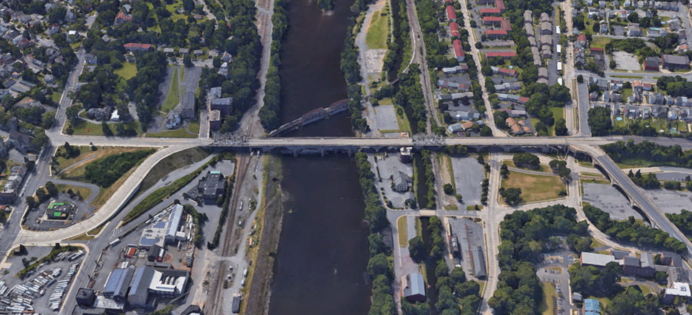
SR 378 Hill to Hill Bridge
NORTH
Built in 1924
13 spans – closed spandrel arches w/ 2 large trusses
New 3rd St Ramp & some bridge work done ~ 2010
Notes:
Lots of things to deal with and each of them has a Stakeholder that had to be worked with
Trusses are singular bridges that carry all 4 lanes of SR 378 as seen on the next slide….

Slide 12
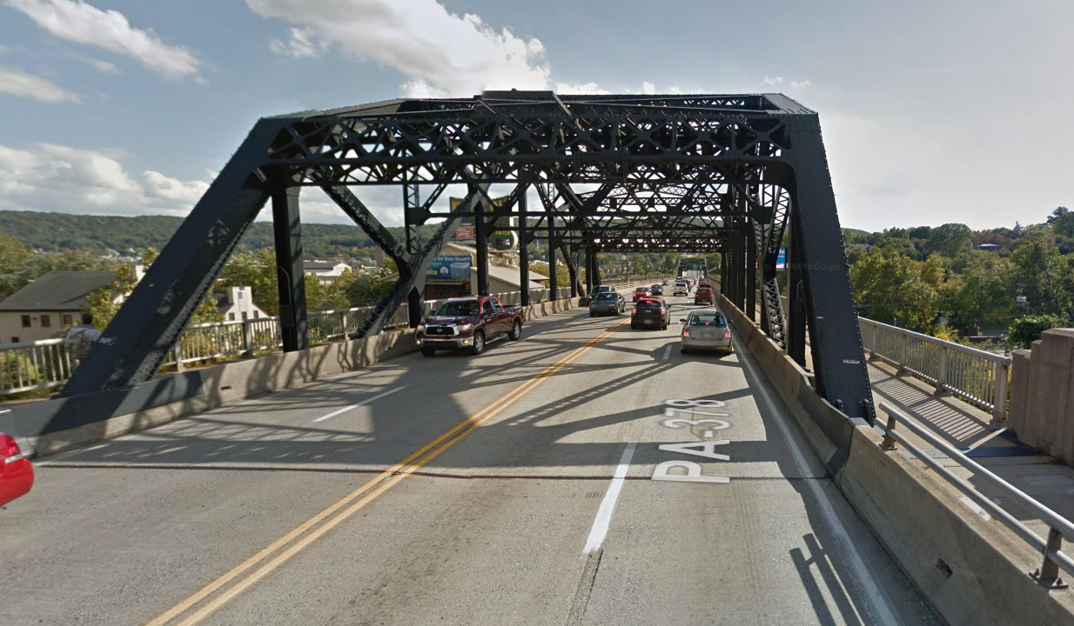
SR 378 Hill to Hill Bridge
NORTH
Started as Bridge Rehab project
Narrow curb to curb and challenging bridge types…
…how to stage traffic?

Slide 13
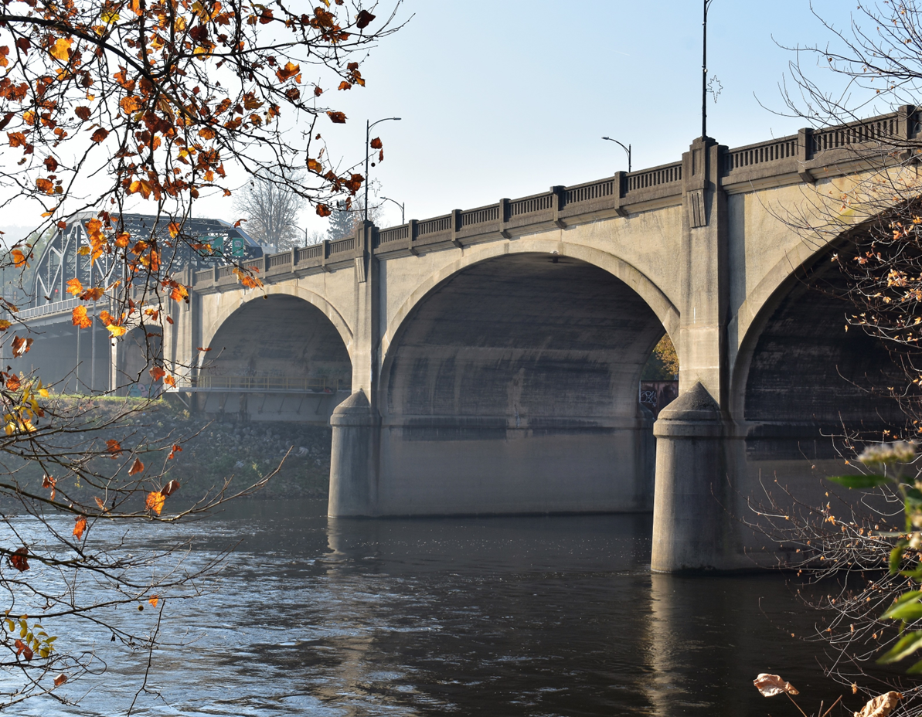
SR 378 Hill to Hill Bridge
As project progressed, Purpose & Need expanded
Since we’re going to have big impact on traffic, we need to address current congestion for this project and the future
Ped mobility is critical too
Many times during design, as circulation, parking, detours & other traffic items were dissected, the Bridge Unit would interject “this is a Bridge project & we have to fix the bridge!!”
NORTH
Notes:
Working on the bridge and dealing with traffic were really handcuffed together and had to be handled that way

Slide 14
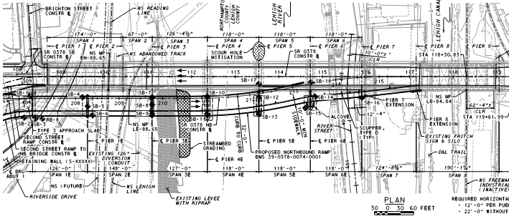
SR 378 Hill to Hill Bridge
Trusses
NORTH
NB new bridge
Ultimately ended up with this general layout
Brian will provide more details…

Slide 15
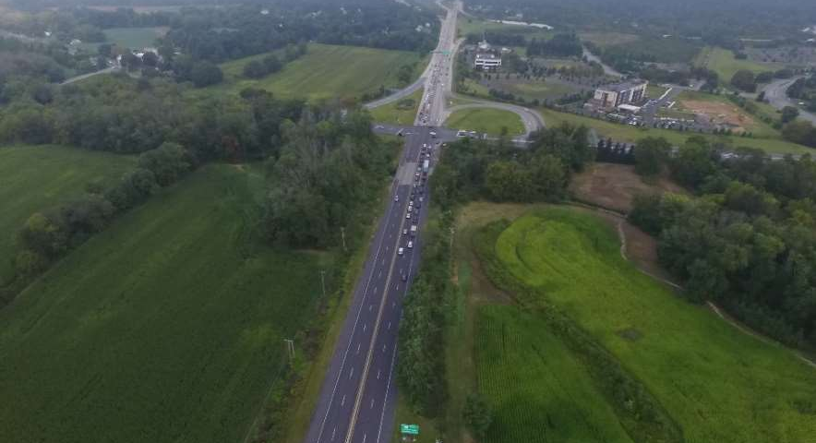
Lehigh Co SR 309-19M Center Valley Parkway
NORTH
PM: Megan Fallon, PE
Prime: Pennoni
Subs: Benesch, Baker, NTM, AD Marble, SCI
Agmt Executed: May 2019
Notes:
This project converts the existing at-grade signalized intersection to a grade separated interchange by raising Route 309 over Saucon Valley Rd/Center Valley Parkway.
Note the Design Team
We’re looking north and the jughandle ramps you see in foreground are for 309 traffic to make turns since left turns from Route 309 are not permitted. Further up the concrete portion of Route 309, which was rebuilt with I-78 in the late ‘80s, you can see the ramps with I-78.
One thing not evident in this photo is the intersection is the low point of the area with 309 in a sag curve

Slide 16
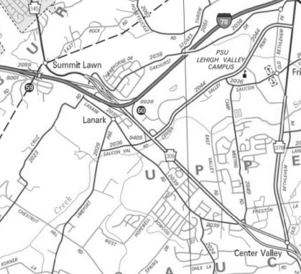
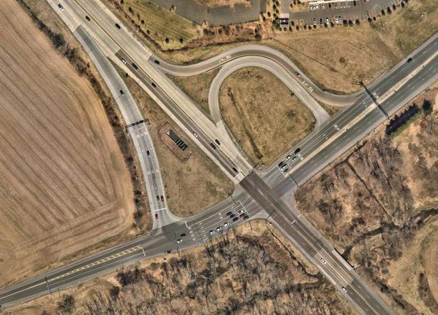

SR 309-19M Center Valley Parkway
SR 309 carries over 48,000 vehicles per day while SR 2036 & SR 2044 have over 8,000 and 23,000, respectively
Important link in local & regional network
Existing structure over Saucon Creek built in 1929, rehab in 1970
Intersection has a history of flooding during major storms
Notes:
Go over slide info and point out key items like SB off-ramp volumes, Saucon Creek, Stabler Corporate Center, Promenade Shops former Center Valley Golf Club and new development at SE quad for trucking/warehouse

Slide 17
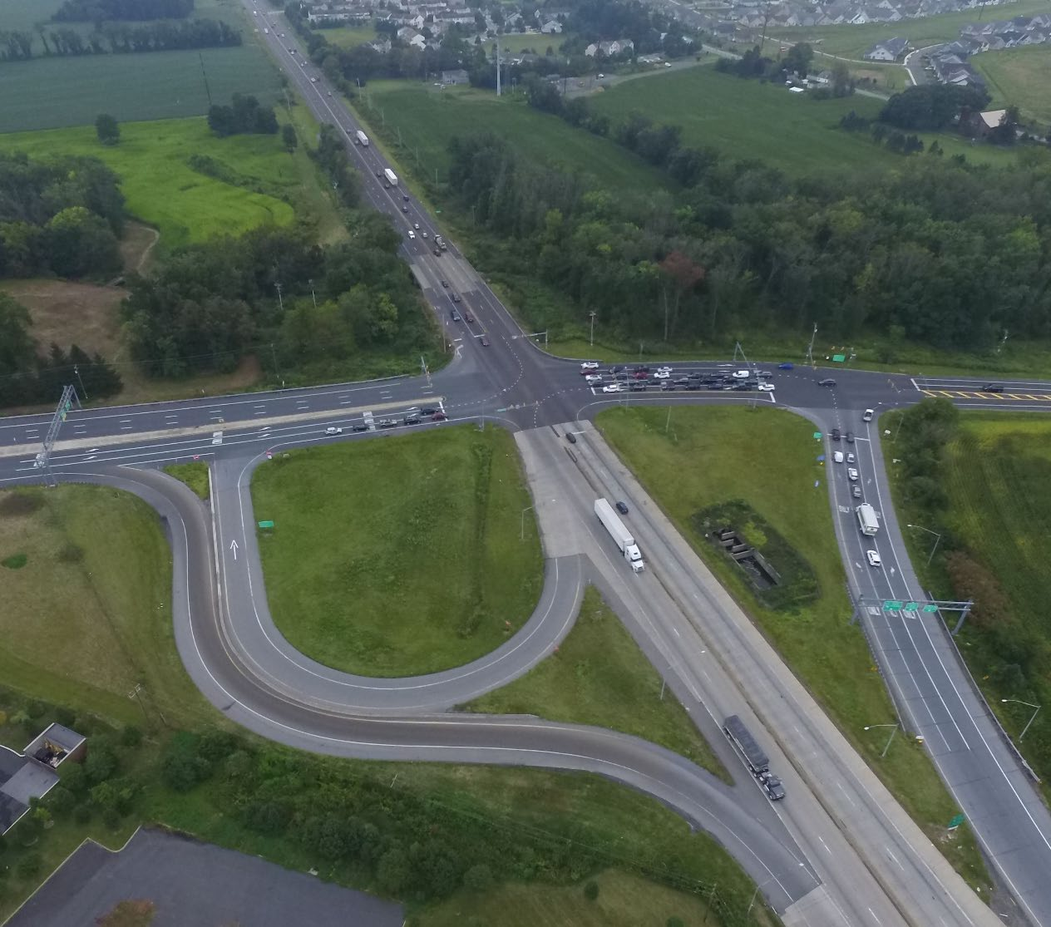



SR 309-19M Issues
Safety
Congestion
Facility Deficiencies
Facility Deficiencies
Safety
Congestion
Notes:
The project will improve safety, reduce congestion, accommodate planned growth & improve facility deficiencies
Safety: The two signalized intersections have experienced many crashes with at least three fatal crashes (four (4) fatalities) in the prior six years (which was from a couple years ago) The high volume of traffic on all four approaches, recurring peak hour congestion, and two closely spaced intersections on SR 2036, contribute to the 98 crashes that have been seen here.
Congestion: Limited stacking at these same intersections causes congestion on SR 309 South and on SR 2036 Eastbound approaching these intersections. These intersections already do not have sufficient capacity to handle the volumes & volumes will only increase on these roadways with the continued build out of the Center Valley area.
Facility Deficiencies: The S.R. 0309 median has a 4-foot width which does not meet the current minimum of 10-feet which may contribute to the elevated crash rate (hitting a fixed object) and the Saucon Creek bridge is approaching 100 years old.

Slide 18
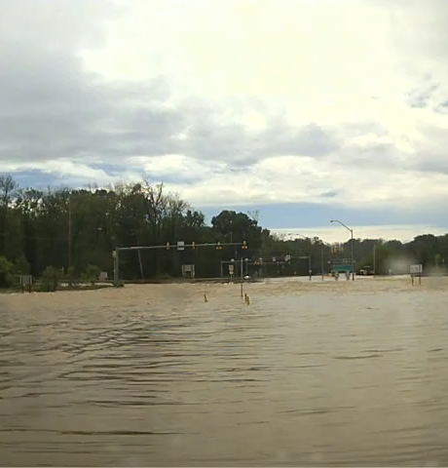
SR 309-19M Center Valley Parkway
Key Goals:
Reduce roadway flooding (including raising SR 2036/SR 2044 several feet) while adding fill for overpass structure
Minimize impacts to wetlands and streams
Avoid impact to historic properties
Minimize ROW impacts
Accommodate Twp’s future multiuse trail under new bridge

Slide 19
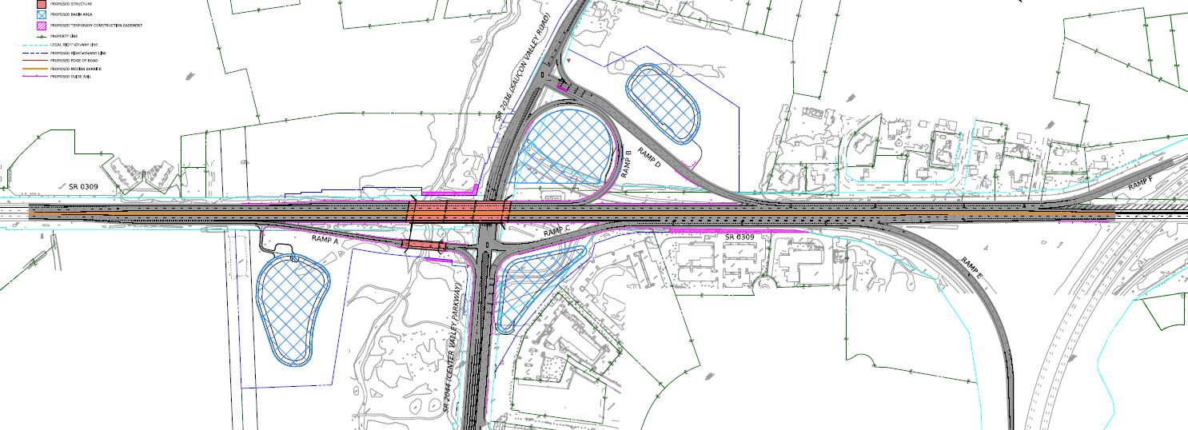
SR 309-19M Proposed Work
Entrance and exit ramps between EB SR 78 and SR 309 improvements
Full depth reconstruction and widening of SR 309/ SR 2036/SR 2044
New signal
New SB on and off-ramp
New SR 309 structure raised and lengthened
New NB off-ramp and bridge structure over Saucon Creek
New NB on-ramp
New stormwater basins
Notes:
Spoiler Alert – this project is one that is moving out of 2026 letting, just decided in the past week or so. It already had some D/B items for 2026 let and there’s been some archaeological artifacts and other items that were causing more things to go into D/B, which is not usually a recipe for success.

Slide 20
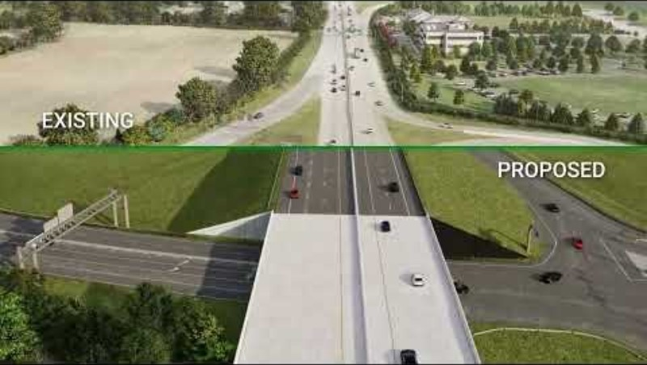
SR 309-19M Flythrough

Slide 21
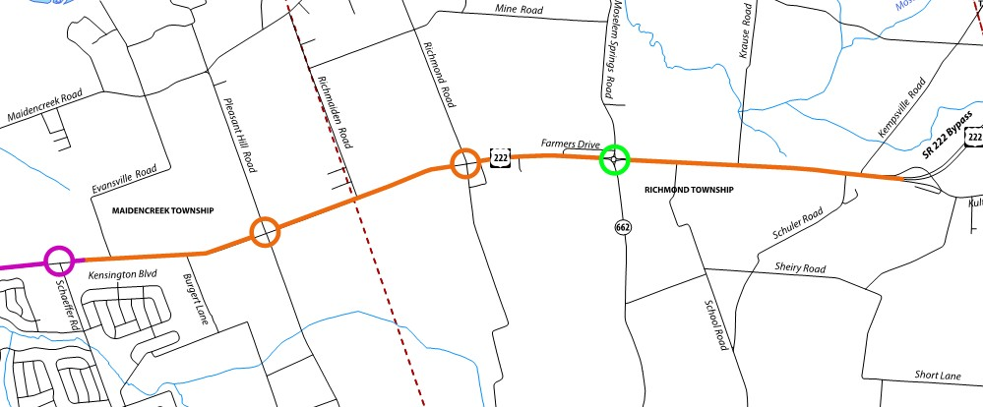


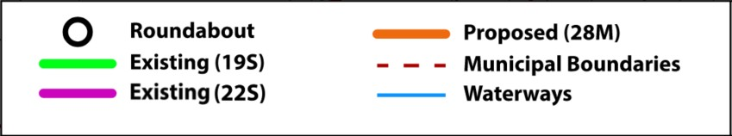
Berks Co SR 222-28M Widening
SR 222 Sec 19S
(Complete)
PM: David Molinaro, PE
Prime: Urban Engineers
Subs: JMT, Dawood, L&V, TranSystems, S&L, Kimball
Agmt Executed: Aug 2014
SR 222 Sec 22S
(Complete)
Notes:
This project involves recon & widening of SR 222 from the 22S project at the south, which is 2 lanes in each direction, to the Kutztown Bypass at the north, a divided highway leading to Allentown. SR 222 it currently one lane each direction with a center turn lane but will now be divided by a barrier along the length of the project except for the 2 new roundabouts that we are adding at Pleasant Hill Rd and Richmond Rd, plus the roundabout previously built by the 19S project at Route 663. There will also be a connection at the Kutztown Bypass that allows NB traffic to turn around to head SB similar to roundabout functionality.

Slide 22
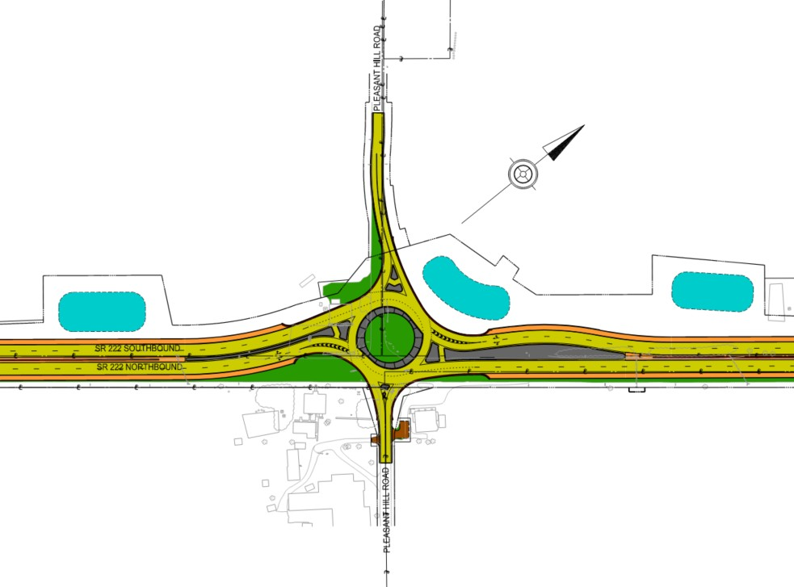
Berks Co SR 222-28M Pleasant Hill RAB
Provides mobility between Schaeffer Road & Richmond Rd
Located to minimize impacts to Kauffman Farm (Individually Eligible Property)

Slide 23
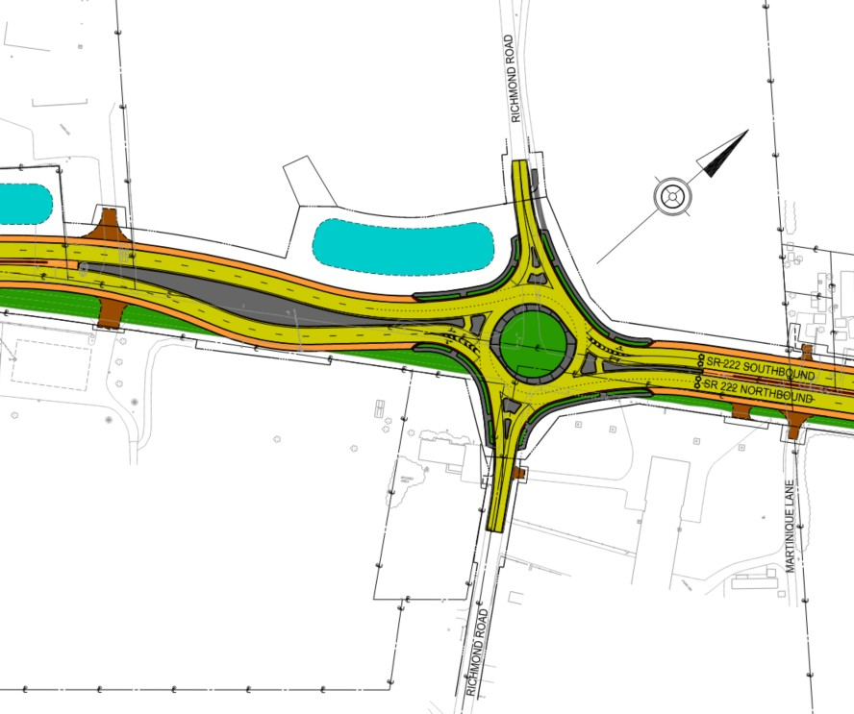
Berks Co SR 222-28M Richmond RAB
Provides mobility between Pleasant Hill Road and Moselem Springs Road
Provides safe crossing of SR 222 for pedestrians and farm equipment

Slide 24
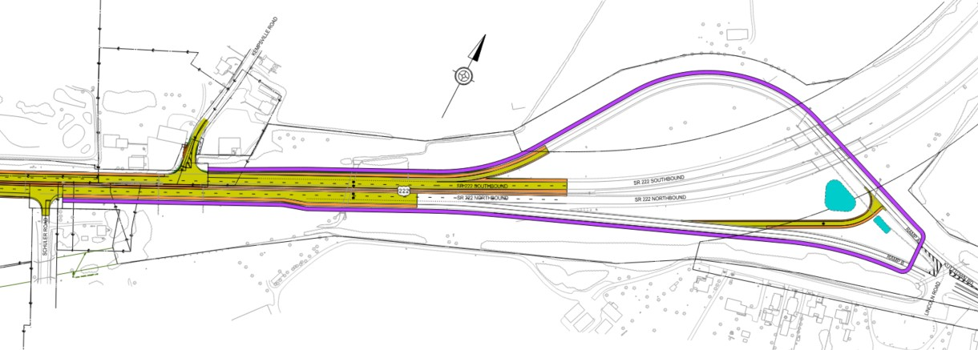
Berks Co SR 222-28M Kutztown Bypass Turn Around
Provides mobility north of Moselem Springs Road
Shared use path (purple) provides access from Schuler Road to Kempsville Road
Notes:
Amish/Mennonite population that cross over SR 222 on bikes or via horse & buggy

Slide 25
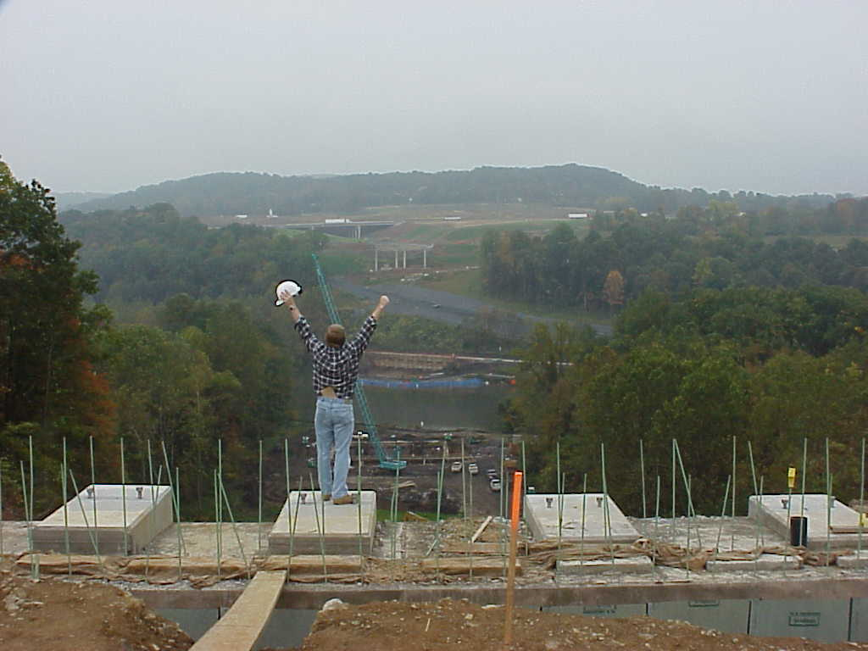
Questions??
American Society of Highway Engineers – East Penn
Looking S towards I-78 in Oct 2000, from North Abut of future SR 33 Truss bridge over Lehigh River

