Slide 1
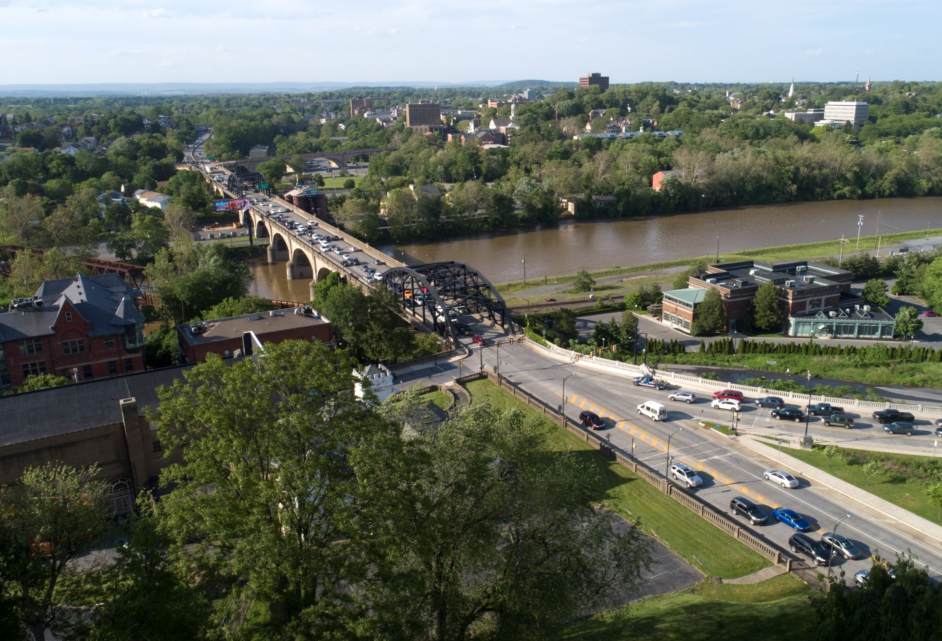
Mpms 93630 - SR0378 section 03B
Hill to Hill Bridge Project Update
March 17, 2026
PennDOT District 5-0
Brian P. Teles, PE Consultant Project Manager

Slide 2
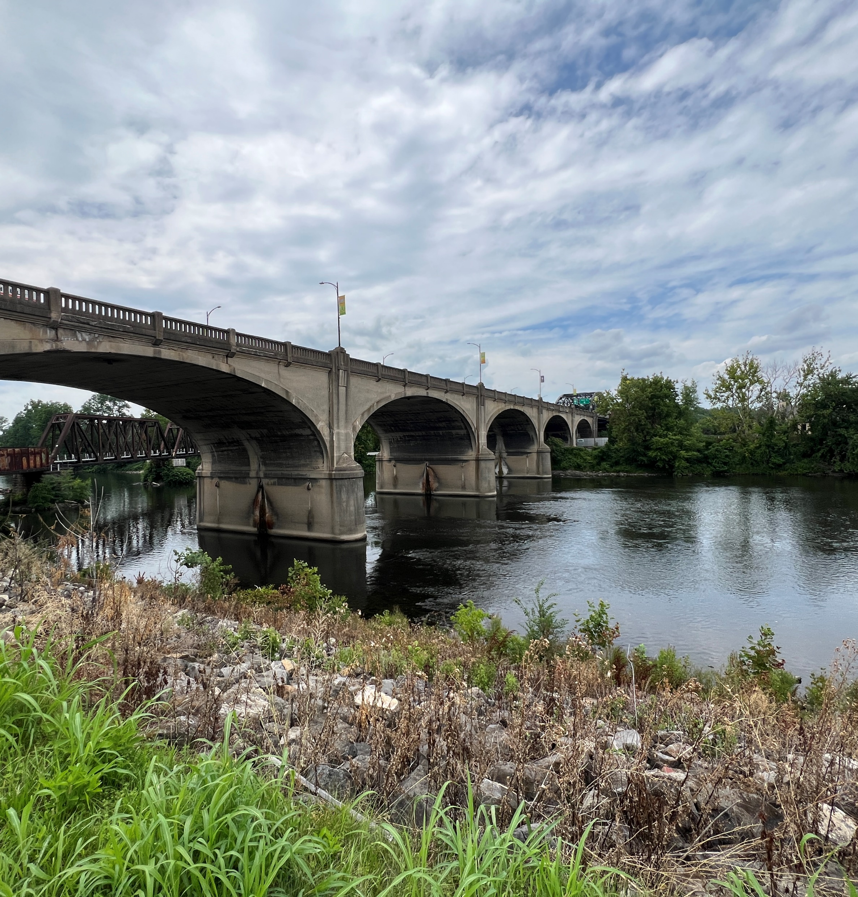
Design Team
HNTB (Prime)
Subconsultants
Pennoni
AGES
Malick & Scherer
Terracon/Skelly & Loy
NTM
ASC
Colliers
Rettew
Notes:
CP Meetings 5/20/20, 7/27/22
Virtual Public Officials Meeting – 4/6/21
Virtual Public Meeting (pre-recorded presentation with website) – 4/12/21 to 5/7/21
City Meetings – 4/23/18, 3/28/19, 11/23/20, 5/3/21, 12/10/21, 6/7/23, 8/15/23, plus lots of calls
St Lukes/Ostrum Street (besides Mayor mtgs): 9/18/18, 4/1/24
Fountain Hill (besides Ostrum St): 5/7/24
PD Connects 8/30/17
EMS 2/26/1/, regional 3/14/18
LVPC 4/12/18
CAT/LVPC 7/29/22
World Heritage Site, Church of Navitity., billboard,

Slide 3
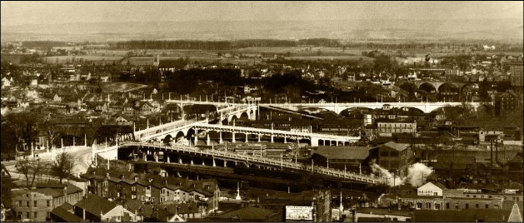
Hill to hill bridge - introduction
Constructed 1924
13-spans crossing Lehigh River, Sand Island Park, D&L Canal Trail and multiple rail lines
Carries more than 55,000 vehicles per day
Historic Aerial View of Hill to Hill Bridge looking North

Slide 4
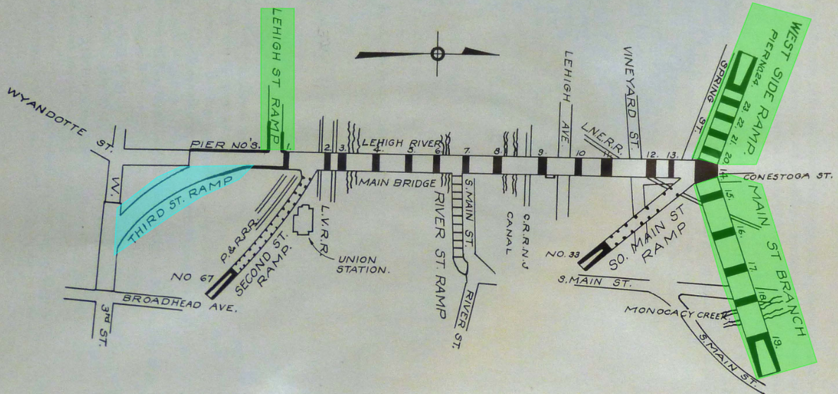
Hill to hill bridge - introduction
Seven original ramps (3 original remain; 1 relocated)
“Spur Route” built late 1960s to north (steel bridge added)
Sign structure added
Third Street approach ramp relocated circa 2010
Plan of Hill to Hill Bridge
Notes:
This is a sketch of the original bridge from a historical publication.
Seven original ramps (3 original remain; 1 relocated)
“Spur Route” built late 1960s to north (steel bridge added)
Sign structure added
Third Street approach ramp relocated circa 2010

Slide 5
Hill to hill bridge - introduction
3 original ramps remain – Main Street, Spring Street, Brighton Street
1 original ramp relocated – 2nd Street Ramp
“Spur Route” built late 1960s to north (steel bridge added)
Sign structure added
Spur Route (aka SR378)
Sign Structure
Main St. Ramp
Spring St Ramp
(fka West Side Ramp)
2nd St. Ramp
(fka 3rd St Ramp)
Brighton St Ramp
(fka Lehigh St Ramp)
Hill to Hill Bridge Looking North
Notes:
This is aerial of the site today
3 original ramps remain – Main Street, Spring Street (West Side), Brighton Street (Lehigh St)
1 original ramp relocated – 3rd Street Ramp now 2nd Street (but still connects to 3rd – but we are partially fixing that)
“Spur Route” built late 1960s to north (steel bridge added)
Sign structure added

Slide 6
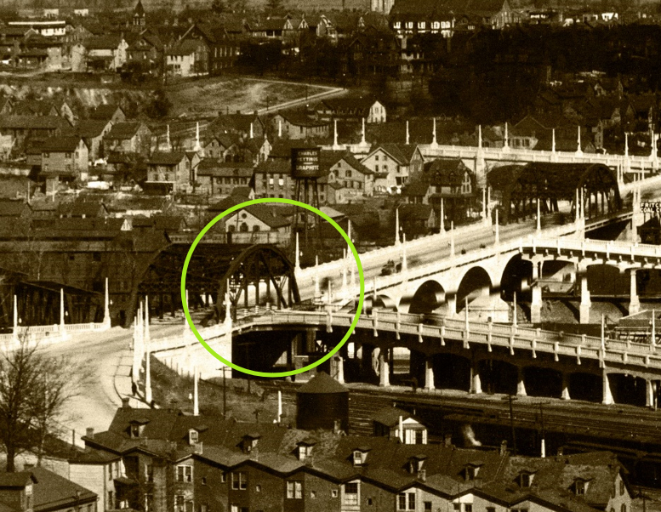
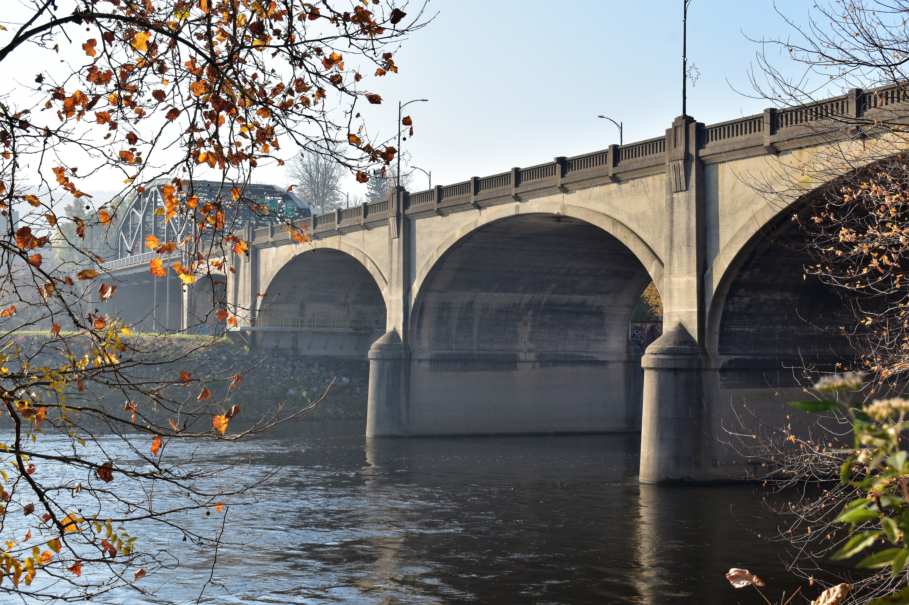
Hill to hill bridge - introduction
Notes:
Safety, mobility and congestion, on top of structural maintenance, topped the problems we aimed to solve. We are tasked with trying to meet those needs through work that could be completed within our project area. With Section 4(f) and Section 106 in play, we were required to consider ways to meet those needs while avoiding and minimizing effects to the resources present. As noted on the last slide, through consultation with our State Historic Preservation Office and consulting parties, we were able to avoid or minimize effects to most of the resources present. The most challenging one was obviously the bridge itself. It’s a complex structure, built to accommodate early 20th century traffic. The trusses are unique; they were designed for this specific location by Clarence W. Hudson, an 1889 graduate of nearby Lehigh University. As you can see from this historic photograph, the southern truss’ diagonals allowed for traffic to enter and exit in the middle of the truss. Preserving them were deemed a high priority. But, there were other character-defining feature of the bridge that needed to be considered as we addressed how to meet the mobility, safety and congestion issues. (SLIDE) The closed spandrel arch spans over the river feature decorative (and functional) pier noses. (SLIDE) The parapet walls have standard, first quarter of the 20th century open pigeon parapets that are thankfully fairly easy to replicate in kind, where needed, on the existing bridge. We’ll work to match the color and texture of the original parapets to try to minimize the visual difference. And, we were able to use a comparable parapet that was sensitive to the original design but meets MASH safety requirements for the new section of the structure. The biggest challenge was how to bring northbound traffic up to the bridge from below on 2nd and 3rd Streets, coming out of the busy downtown, Steel Stacks complex, and casino, in a way that wouldn’t introduce incompatible design elements into the mix or distract and block the structure. Based on consultation with the SHPO and consulting parties, (SLIDE) the design to construct a parallel ramp that meets the existing bridge on the east side between the trusses was the one that best met the project needs while minimizing effects to the bridge and surrounding resources. It preserved both trusses and could be constructed in a way that was secondary and complimentary to the existing structure’s materials, form, and design. We did end up with SHPO concurrence on a No Adverse Effect to the bridge as well as an overall project finding of No Adverse Effect. This helped us when trying to wrap our heads around how to handle our 23 Section 4(f) properties.

Slide 7
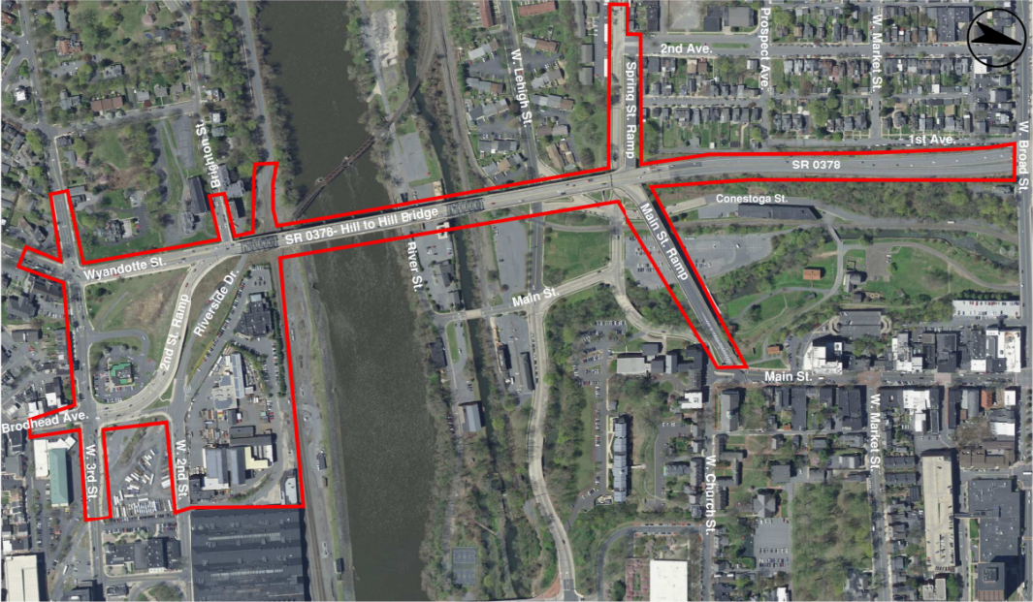
Hill to hill bridge - introduction
Project Area
Spring St. Bridge
(City owned)
Trusses
“Spur Route” Bridge
Brighton St.
W. Broad St.
“Hub” &
Sign Str.
Main St. Bridge
(City owned)
2nd St. Ramp/
Riverside Drive
Lehigh River, Canal and Sand Island
West 3rd St.
Notes:
This is the Project Study Area which is slightly larger than the project limits. Let’s review the main site features and a few key conditions.
SR378 (Wyandotte St) runs N-S (left to right)
2 original ramps – Spring Street and Main Street are at N end (which are City owned)
North of the HUB is a steel span connecting SR378 “Spur route” to the bridge.
SR378 is a a limited access highway that ends at the bridge. Everyone has to slow down and start driving like the City Street that it is because there is a couple signals on the other end of the bridge. Traffic is very bad in this area because of this situation.
2 trusses – main characture defining features of the bridge
Brighton Street ramp – main road for St Luke’s – Level 3 trauma center; ambulances and employees. Ambulances struggle to get to the hospital – traffic.
The bridge crosses the Lehigh River, Lehigh Canal, Sand Island, D&L Trail
On the S end, Riverside Drive is being relocated slightly to accommodate the project.
The 2nd Street Ramp currently only connects to 3rd St. – City requested a connection 2nd Street for events, etc.
On S end of SR378 (we will talk more later) – there are 2 signalized intersections
3rd Street (very awkward geometrics; double left on the minor which hurts SR378 NB and SB)
2nd signal (2nd ST Ramp) with a left turn to get into south Bethlehem. This left turn lane backs up for maybe ½ mile vs the straight movement is not as bad. This signal causes traffic delays across the bridge and much further. We will talk about this later.

Slide 8
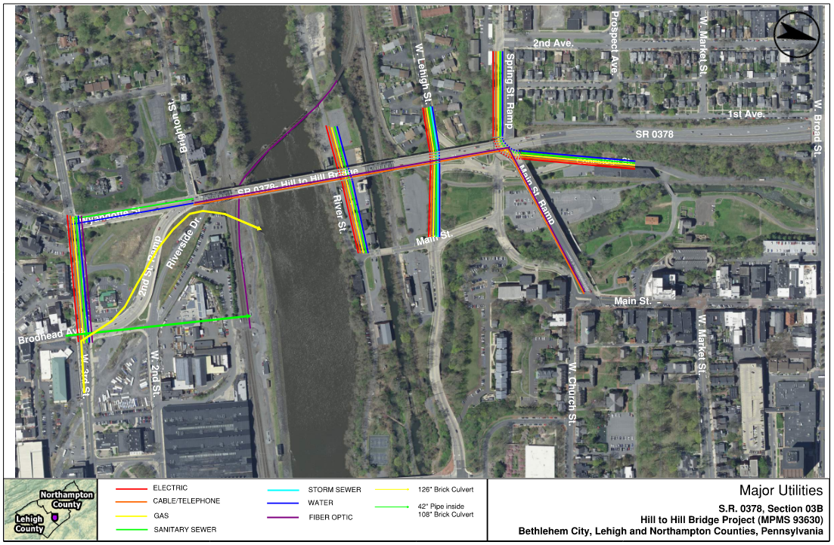
Utilities
Notes:
In addition to the features descried, there are quite a few utilities in the area that we strived to minimize impacts. In general the utility impacts are fairly minor compared to other parts of the project.

Slide 9
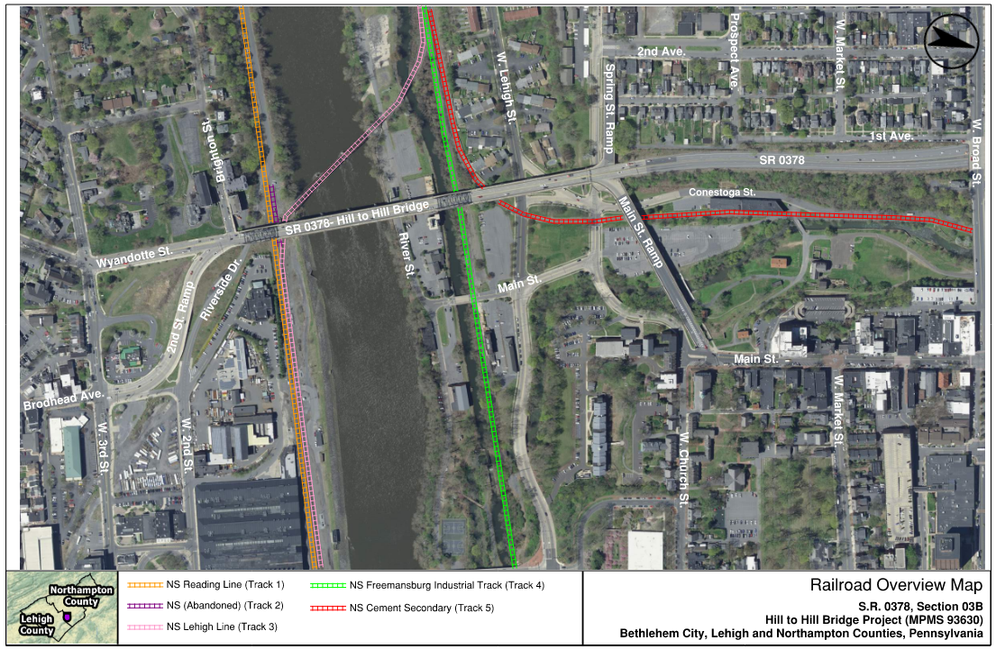
railroads
Notes:
Because this area served Bethlehem Steel Plant and other industries, there is a large and RR network that is still quite active. Our work has to minimize impacts to the railroads. Some tracks are more active then others, but according to NS everyone is a vital link, so we are trying to minimize impacts. Clearances and fencing was a big deal in the beginning. But in general we are grandfathered in for the existing bridge and have to meet all of NSs standards for any new bridge which you will see a little later.

Slide 10
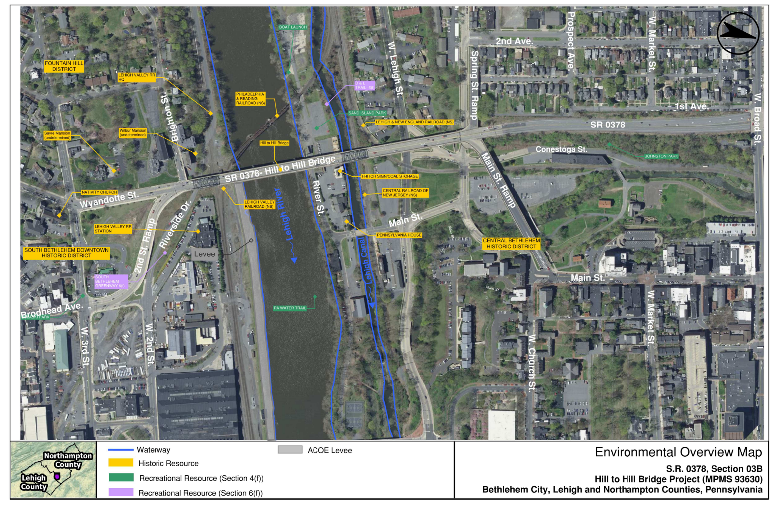
Environmental resources
EVERYWHERE!
Notes:
There are environmental resources everywhere on this project
Lehigh River and Canal
Many historic resources
23 Section 4(f) resources (a record)
Actually only 1 6(f) resource – D&L Trail

Slide 11
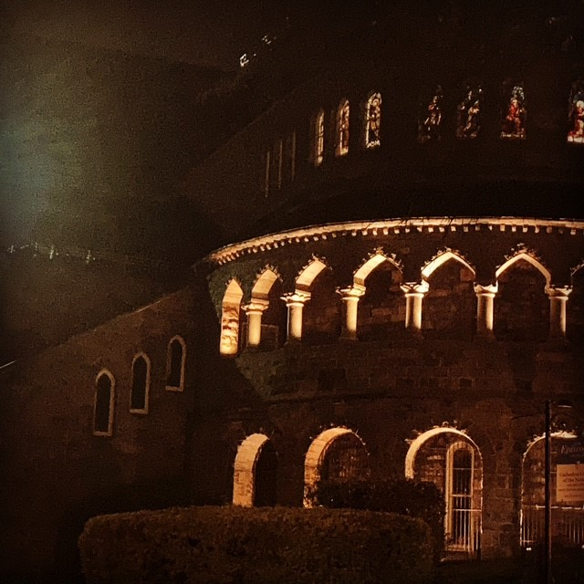
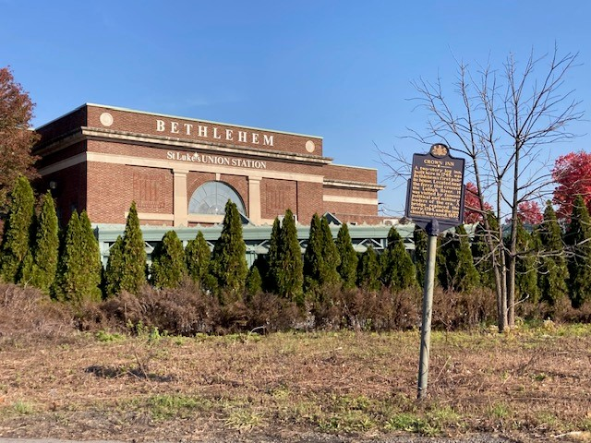
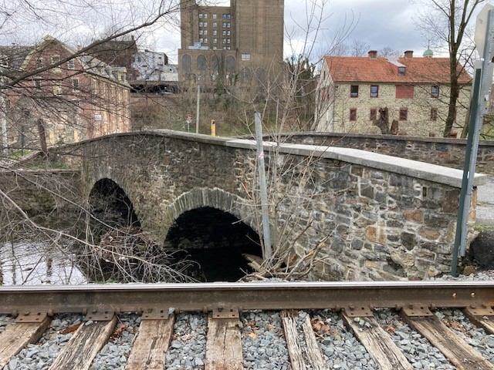
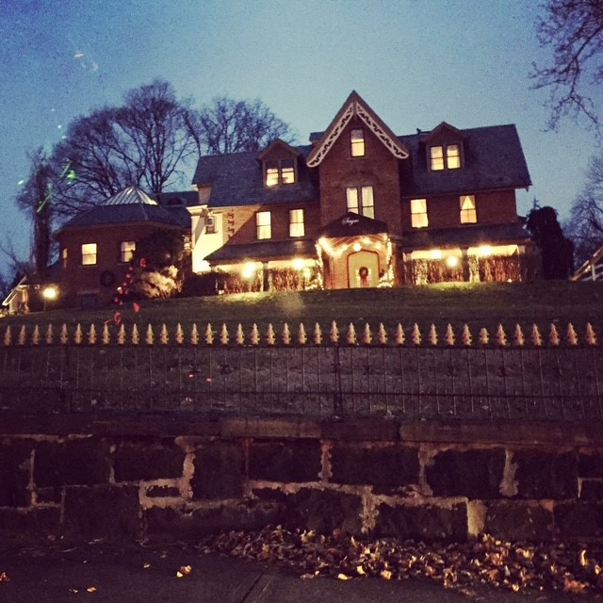
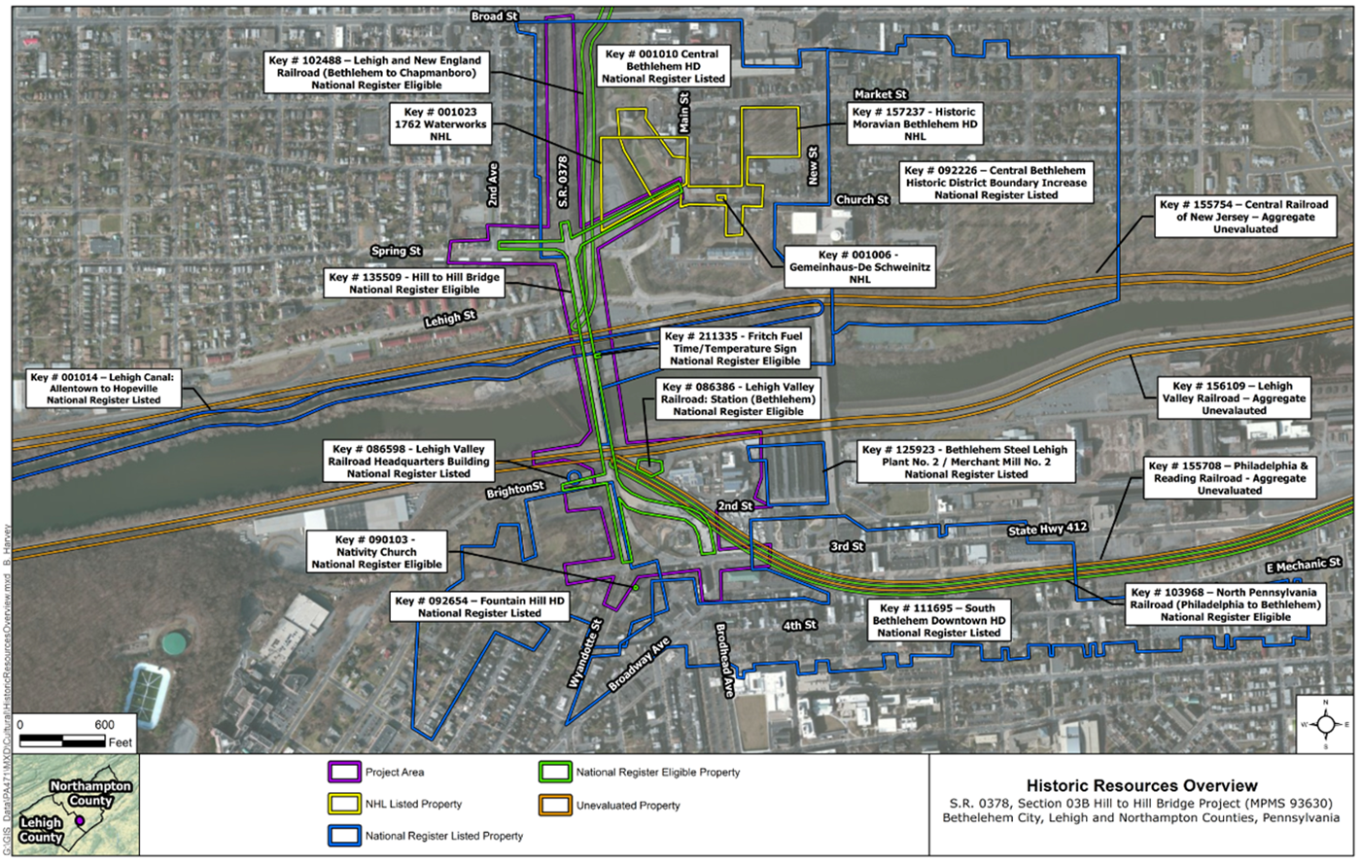
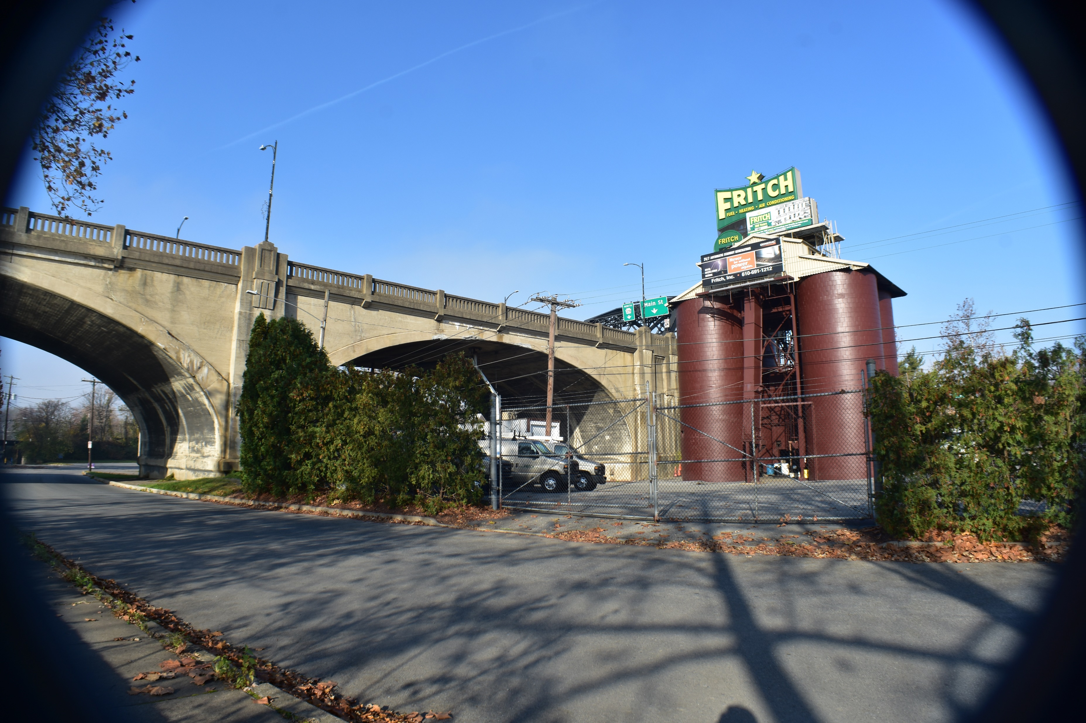
Environmental resources: Section 106
Notes:
As I mentioned, 18 of our 23 4(f) properties were historic, either listed in or eligible for the National Register of Historic Places. As you can see by this map, the resources are tightly packed together on the north and south sides of the bridge. We have the bridge itself, which is individually eligible AND contributes to a historic district to the north (Central Bethlehem HD) and one to the south (Fountain Hill HD). Also on the south side are the Lehigh Valley Railroad (slide), its headquarters, and a passenger station, (slide) an Episcopal Cathedral, and (slide) the Sayre Mansion. On the north side of the river are the eligible (slide) Fritch Fuel Time and Temperature Sign (just a stone’s throw from the bridge and a big consideration while we were examining alternatives that would meet the project needs); the Lehigh Canal with its intact prism and towpath, and (slide) the Historic Moravian Bethlehem Historic District. That last one is not “just” eligible but is also a National Historic Landmark, which triggered consultation with the National Park Service. In June of last year, it was named a UNESCO (United Nations Educational, Scientific and Cultural Organization) World Heritage Site. Thankfully, effects to this property are both temporary and minimal, which was the case with most of the historic resources.

Slide 12
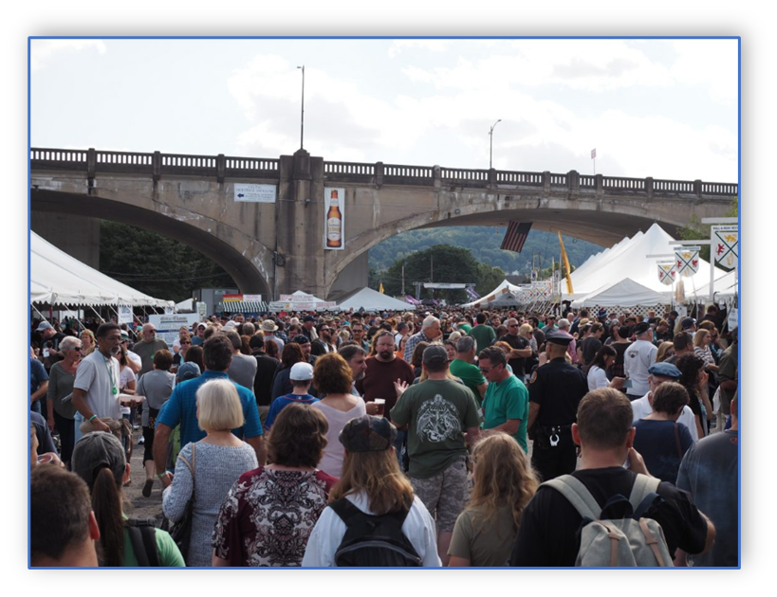
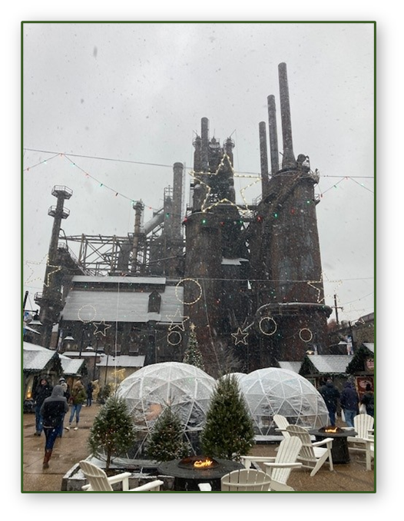
Hill to hill bridge
Other Key Site Features
  St. Luke’s University Hospital as it is a Level I Adult Trama Center and a Level II Pediatric Trauma Center
  Arts Quest / Festivals (e.g Musikfest, Celtic Classic, foot and bike races)
  Lehigh University
  Moravian University
  South Bethlehem Re-development on former Bethlehem Steel Site
Notes:
There are a number of other environmental resources the project had to take into consideration, largely from access, MPT and construction timing perspectives. Lehigh River is considered a navigable waterway by Coast Guard, it’s a Fish and Boat Commission Water Trail, and a Recreational Boating Waterway, all requiring ATON. The Lehigh Canal and Monocacy Creek are stocked trout and class A Wild Trout Streams, which restricts timing for in-stream access. And, one of the biggest considerations with the most moving parts is coordination with the City and Arts Quest. There are countless festivals, cycling and foot races, and attractions that bring in visitors to the area, often with events on both sides of the river and often happening on or under the structure.

Slide 13
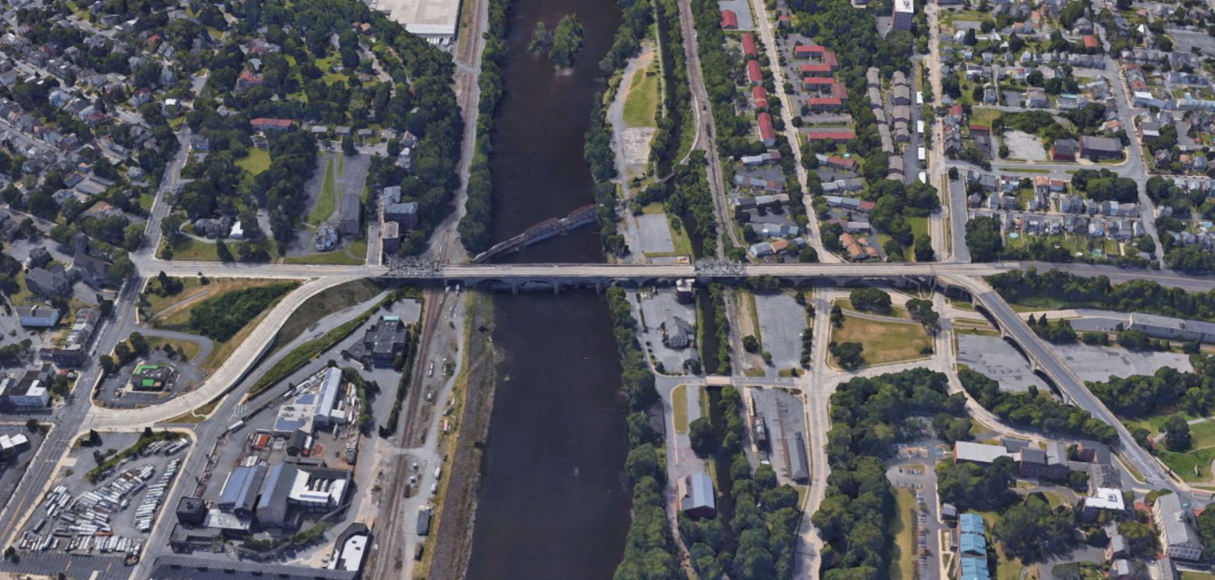




Purpose and need Overview
Mobility
Safety
Structure Condition
Congestion
Safety | Congestion | Structure Condition | Mobility

Slide 14
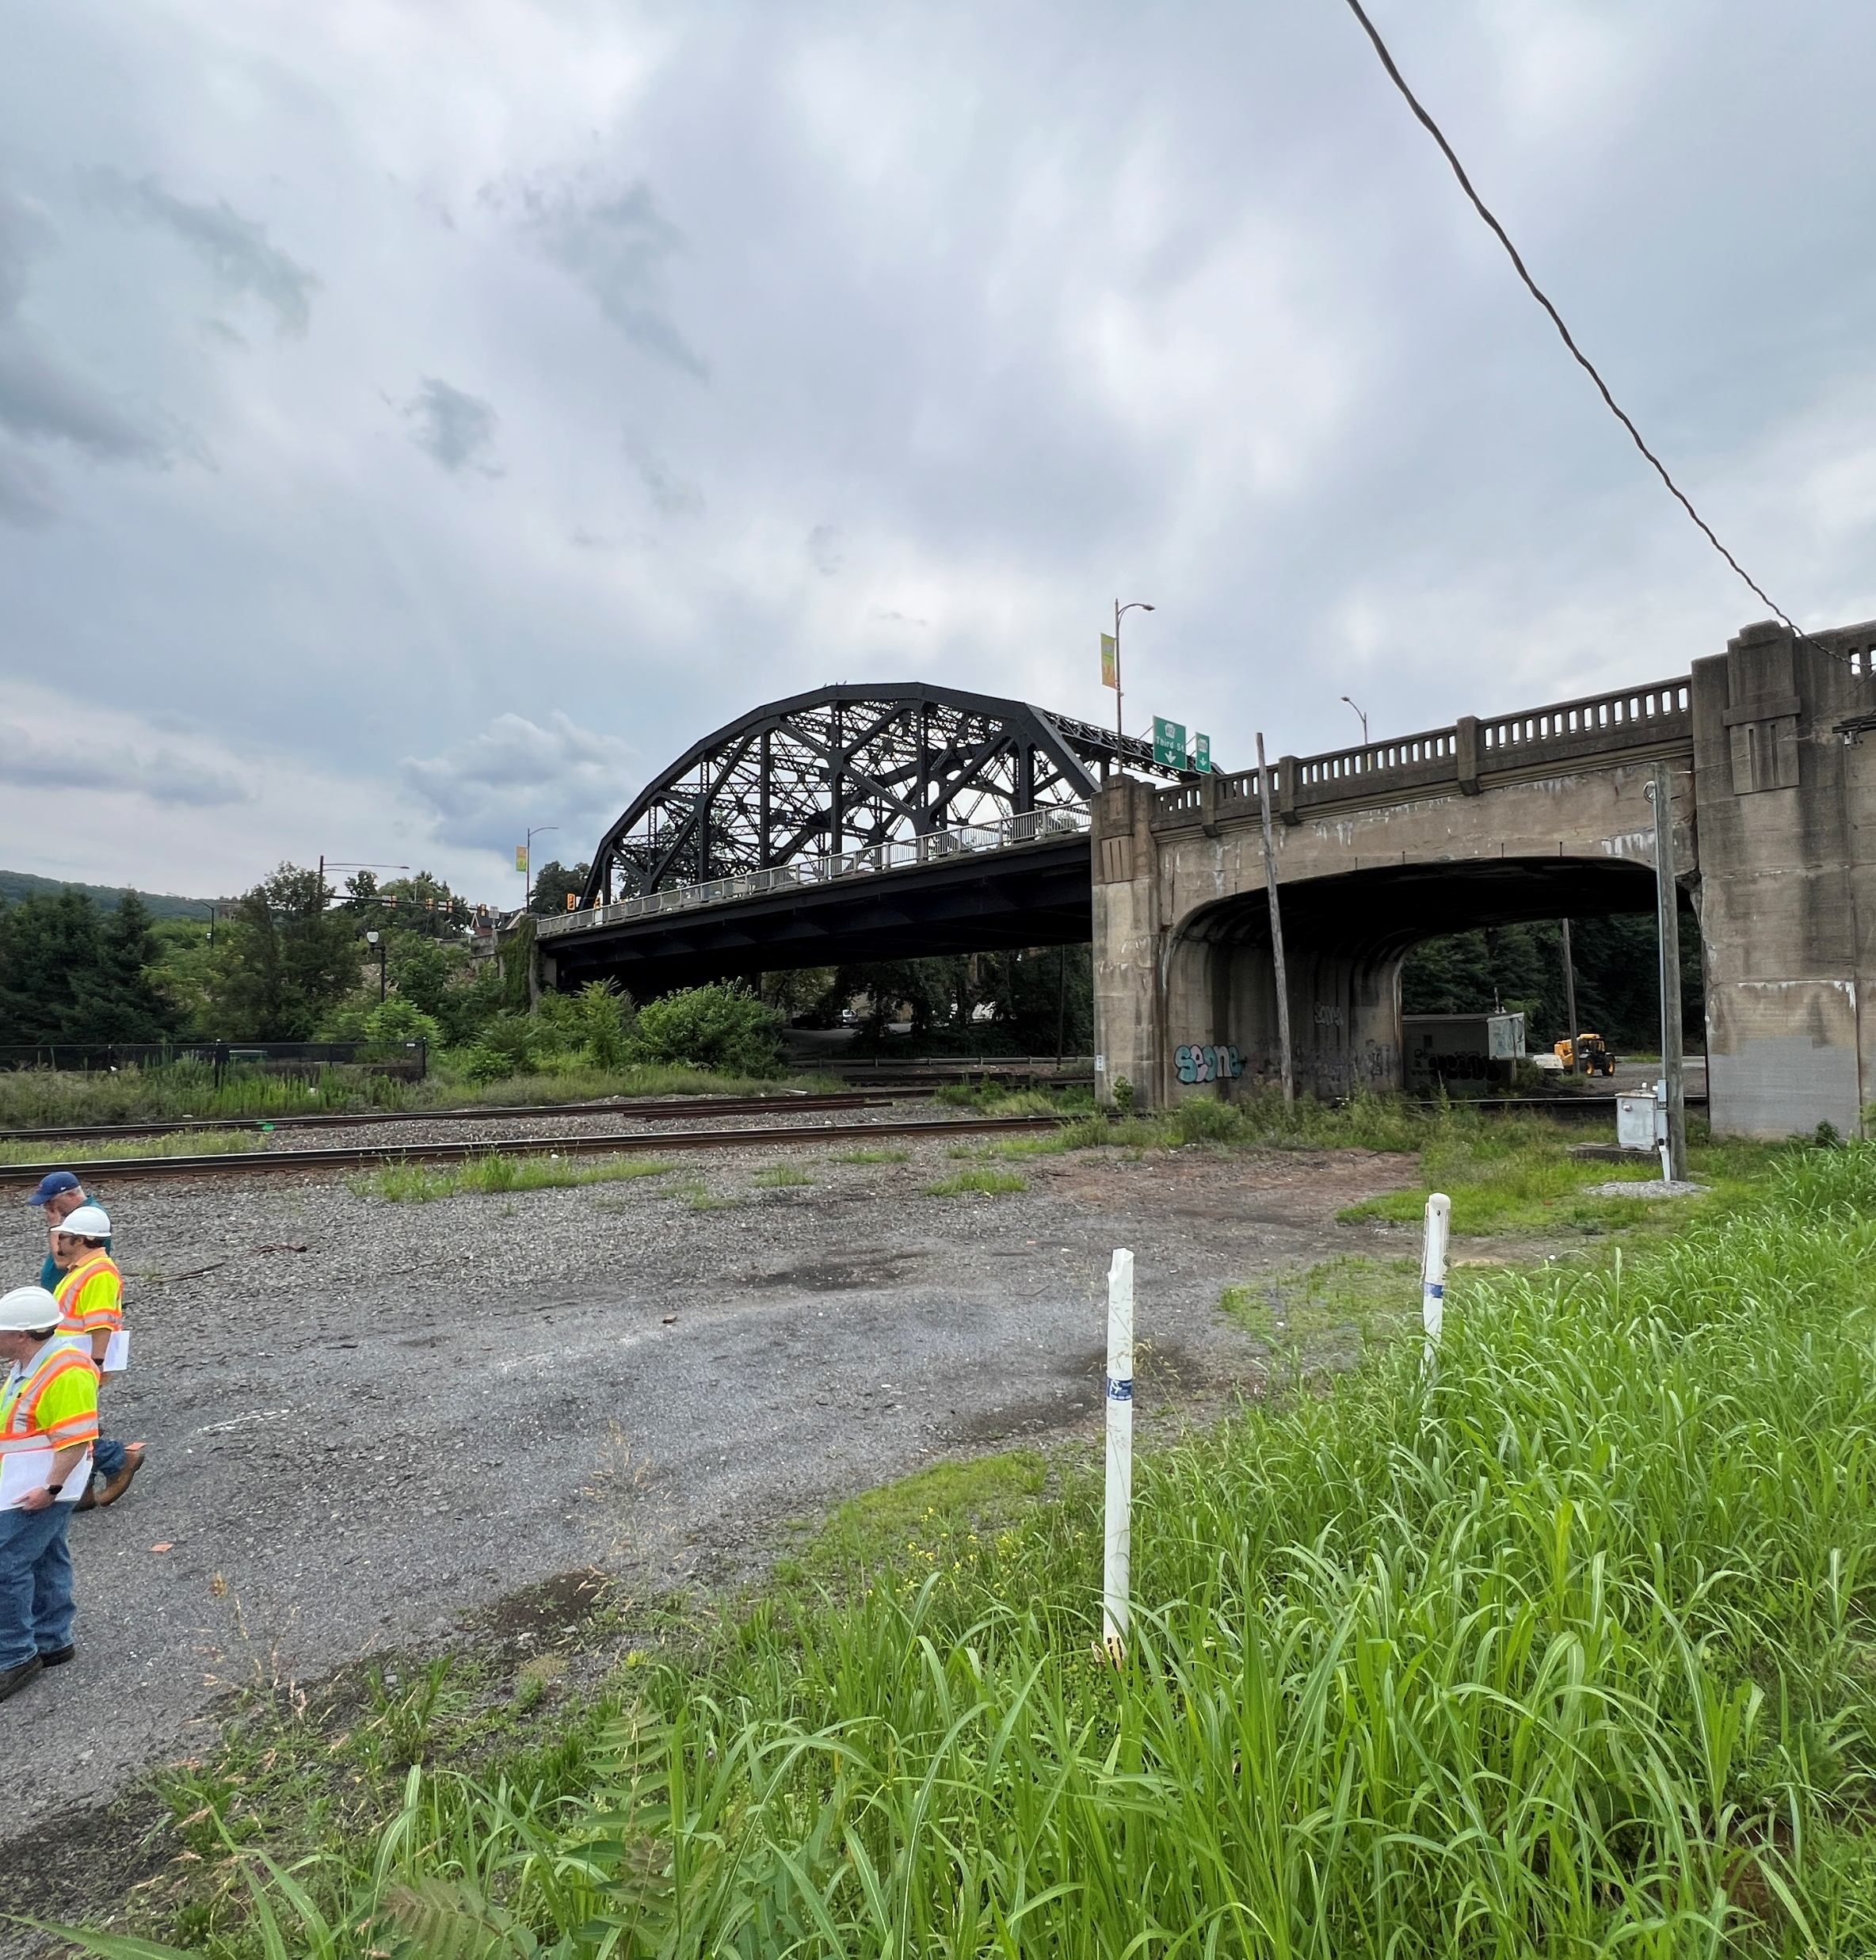
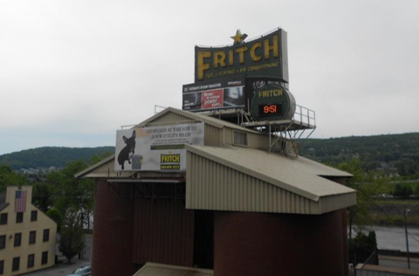
Project Goals
Maintain 4 lanes of traffic as much as possible
Goals are important but secondary to Purpose and Need
Communicate Road typology change from highway to city grid
Minimize impacts to cultural resources
Improve 2nd Street connection
Preserve Main Street
Do not preclude future improvements

Slide 15
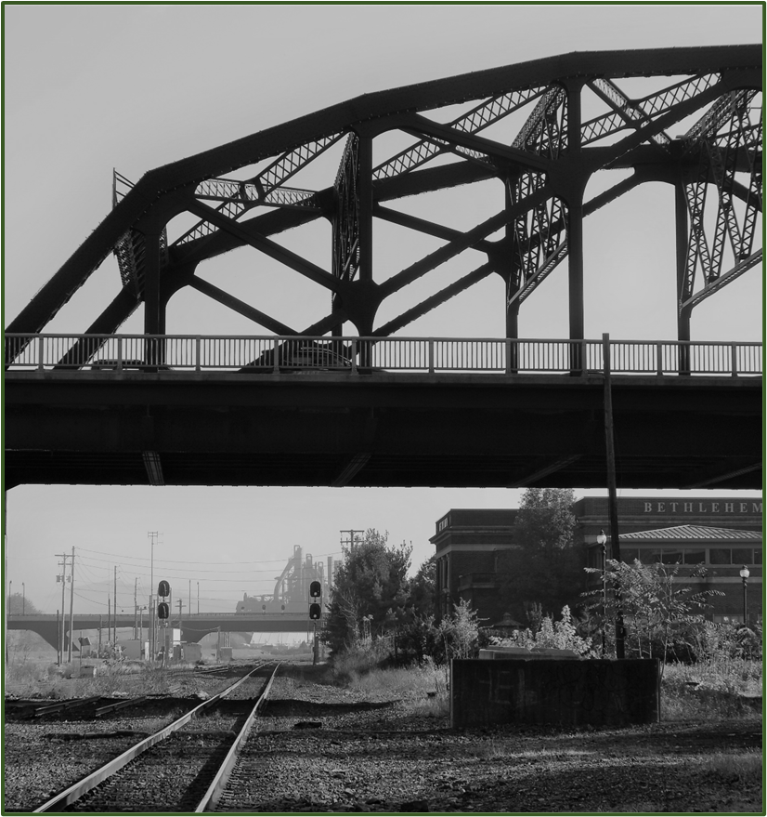
Project stakeholders
Public Meeting, Public Officials Meeting, Consulting Party Meetings, stakeholder meetings to share concepts and obtain feedback
Stakeholder input has been key on this project.
City of Bethlehem
St. Luke’s
Fountain Hill Borough
Arts Quest, Lehigh, Coalition of Appropriate Transportation
And others….
Notes:
CP Meetings 5/20/20, 7/27/22
Virtual Public Officials Meeting – 4/6/21
Virtual Public Meeting (pre-recorded presentation with website) – 4/12/21 to 5/7/21
City Meetings – 4/23/18, 3/28/19, 11/23/20, 5/3/21, 12/10/21, 6/7/23, 8/15/23, plus lots of calls
St Lukes/Ostrum Street (besides Mayor mtgs): 9/18/18, 4/1/24
Fountain Hill (besides Ostrum St): 5/7/24
PD Connects 8/30/17
EMS 2/26/1/, regional 3/14/18
LVPC 4/12/18
CAT/LVPC 7/29/22
World Heritage Site, Church of Navitity., billboard,

Slide 16
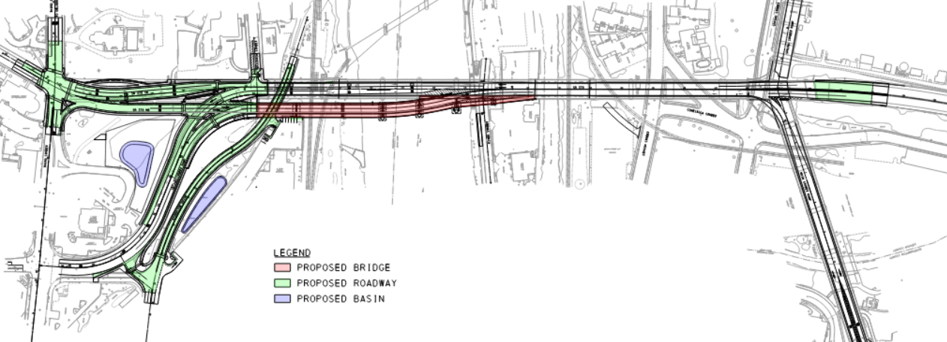
Project Approach
Key Features (Balance preservation with meeting needs)
Existing bridge carries SB SR378
New bridge carries NB SR378
Existing bridge carries
SB & NB SR378
Re-align/add
Rt Turn Lane
Brighton St. remains one-way. Add bump out.
New NB Roadway ties into SR378 at north truss (before Fritch)
New signal with pre-emption
Add second left turn lane
New NB roadway and re-aligned ramp
Rehabilitate bridges
New one way direct access to ramp/SR378 NB from 2nd St.
New NB bridge on southern end

Slide 17
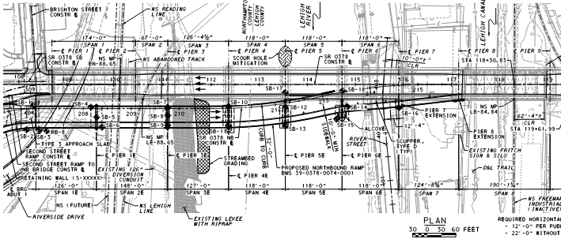
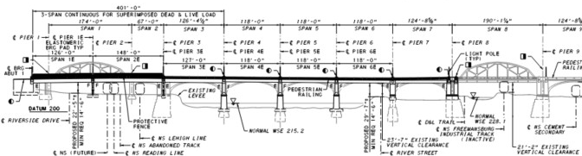
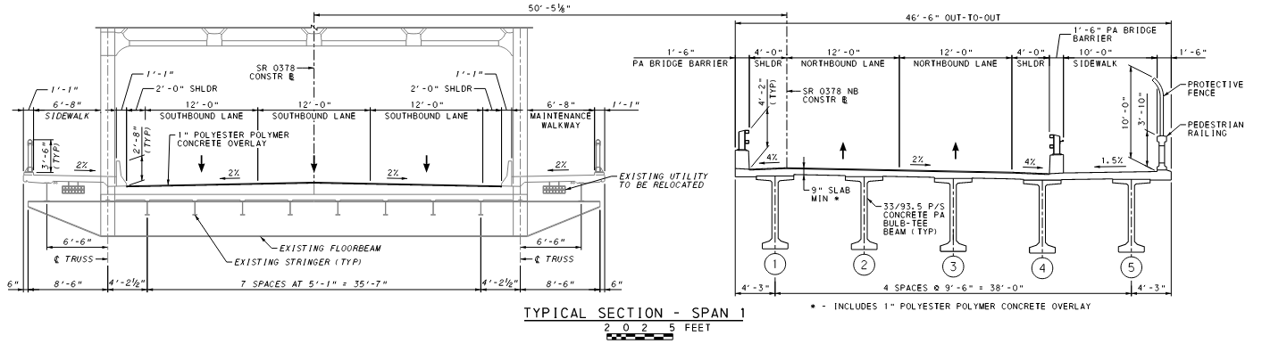
Project Approach - Balance
Trusses
NB new bridge
PROPOSED SB TRUSS (EXISTING)
PROPOSED NB BRIDGE (NEW)
Notes:
This shows the area in a little more details.
The southern widening (pink) allows for the southern portion of the existing bridge next to it to carry only SB traffic which will become 1 SB thru-lane and a double left to South Bethlehem.
Lanes will be 12’ plus small shoulders to improve safety.
The NB bridge will have 2 NB lanes plus shoulders and a wide sidewalk with a barrier at the curb to accommodate all modes of transportation.
This southern widening will tie-in before the northern truss shown in blue.

Slide 18

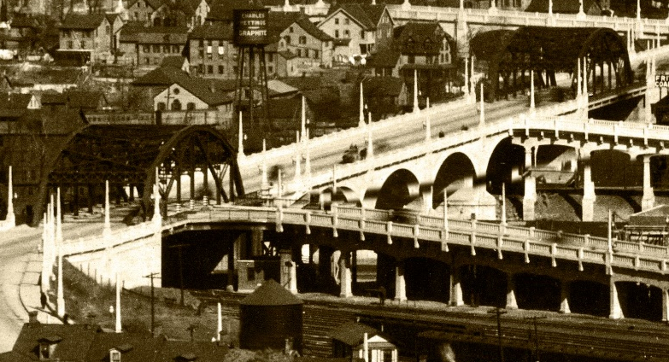
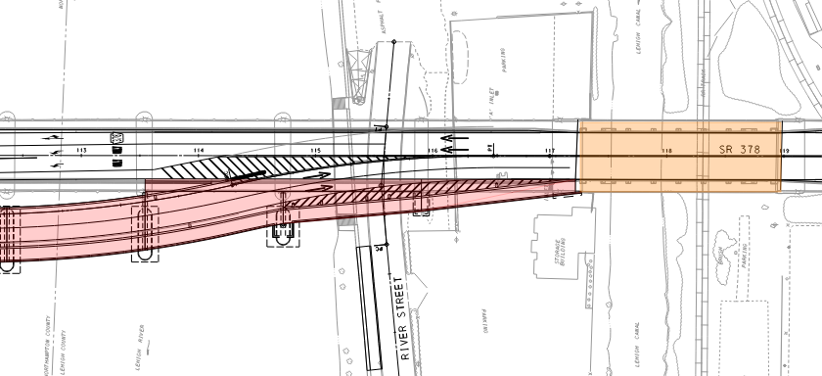
Project approach - balance
New NB bridge will tie in near original River St. Ramp
North HudsonTruss
Current Hill Bridge looking North
North Hudson Truss
North Hudson Truss
New NB Bridge
Original Hill to Hill Bridge looking North
Notes:
Ironically….

Slide 19
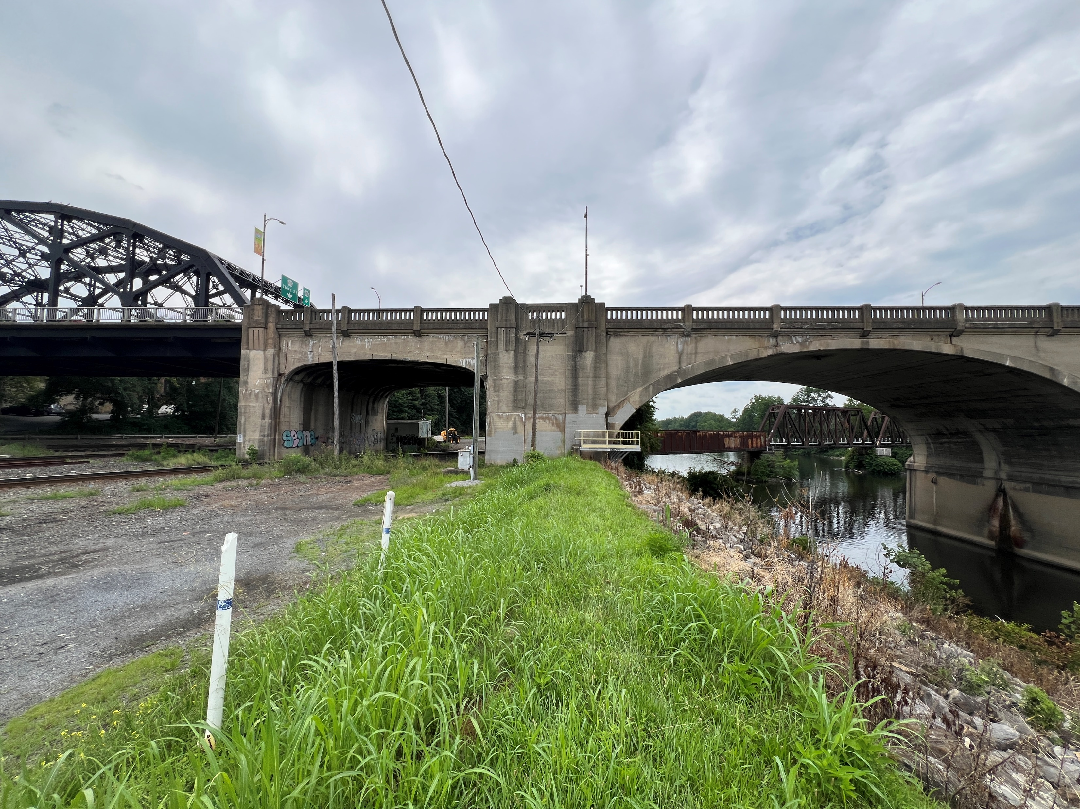
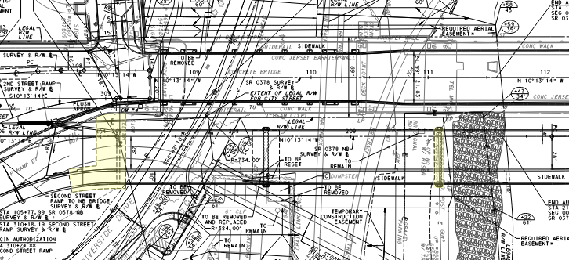
PROJECT APPROACH - Section 408
Circa 1960 Levee Impacts
  Pier 3 EB
  Abutment
Requires COE Section 408 Permit
  Impervious construction details
  Risk assessment during construction and post construction
Existing Levee
Abut EB
(spans diversion conduit)
Pier 3 EB
(within Levee footprint)
Notes:
There is an existing levy along the south side of Bethlehem built in the 60’s primarily for Bethlehem Steel
The new NB Bridge has Pier 3 EB on the back side of this levy
There is also a large diversion conduit where the new abutment needs to span.
Thus, a Section 408 Permit is required from the COE who regulates the levy and the City maintains

Slide 20
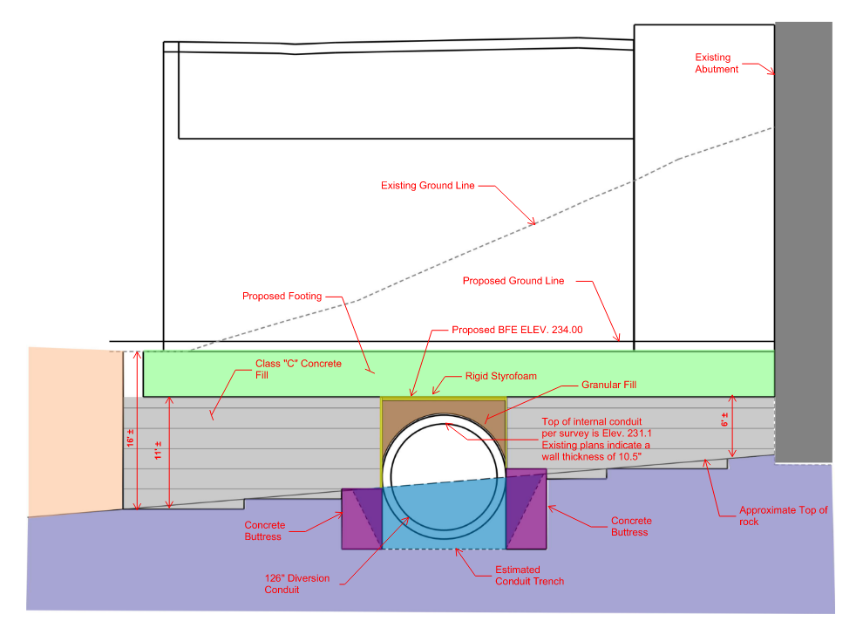
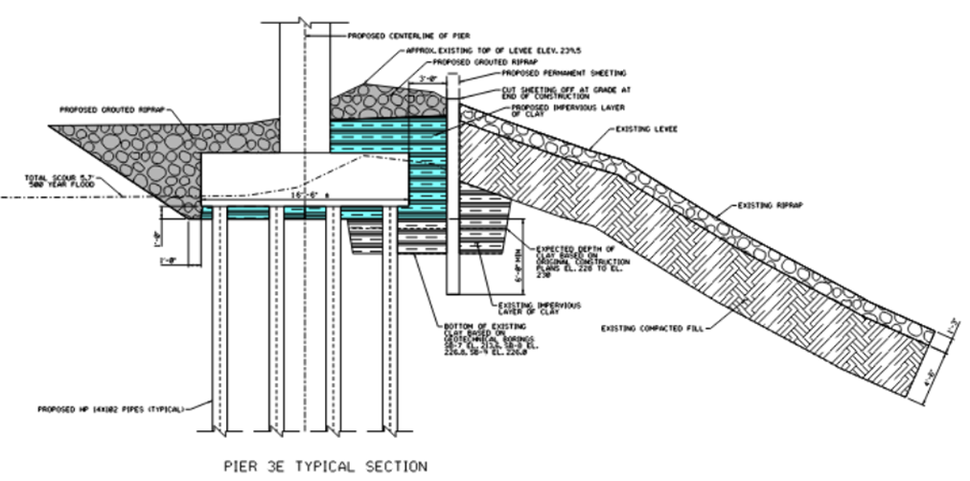
PROJECT APPROACH - Section 408
Pier 3 EB Special Construction
Abutment EB spanning diversion conduit
Abut and Footing
Construction to ensure levee remains impervious
Diversion Conduit
Notes:
The COE essentially requires Impervious construction details so the levy does not leak
Risk assessment describing construction and post construction details.

Slide 21
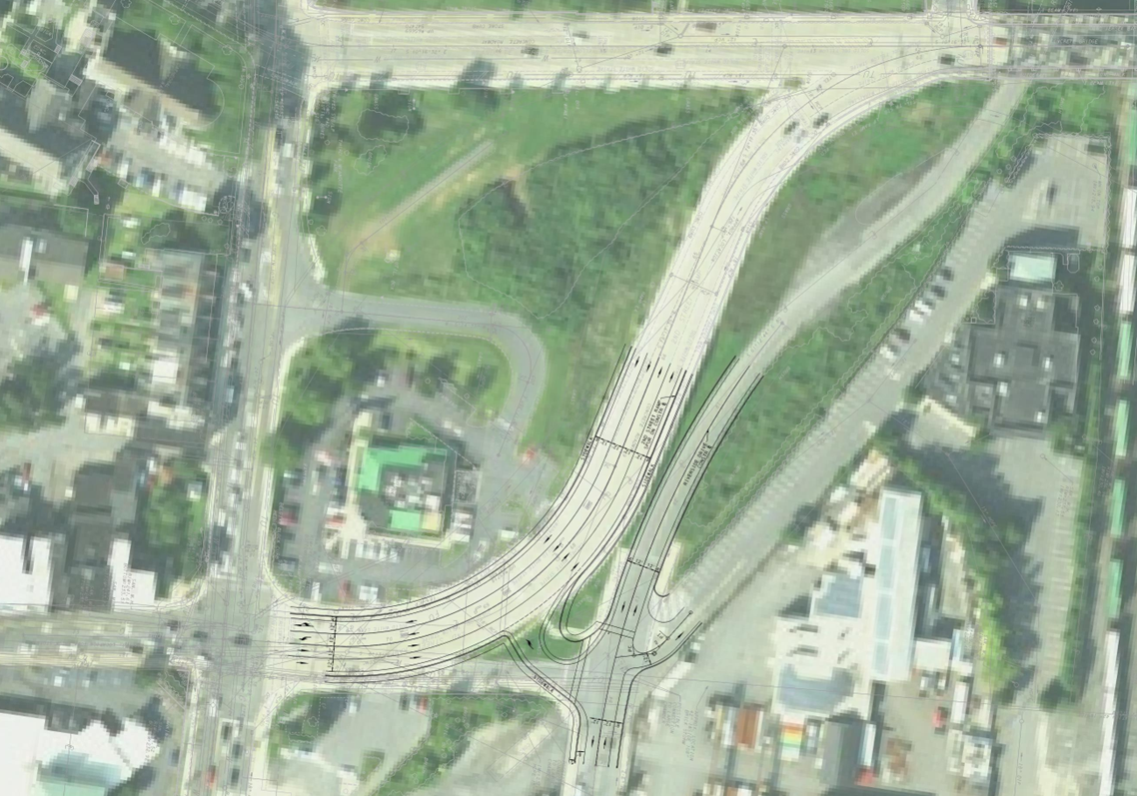
Project Approach – 2nd St
Connect 2nd Street Ramp to 2nd Street

Slide 22
Project schedule
Current Let: 8/13/26
Schedule status
  Continued stakeholder coordination
  Finalizing design/preparing bid package
  ROW, Permitting, PUC, Utilities
Preliminary Engineering (PE)
Final Design (FD)
Construction Start
Construction End
Finalize Alternatives Analysis
2021
2022
2023
Late 2026
2030

Slide 23
Questions ?
Contact Info
  Brian Teles, PE (PennDOT Consultant PM)
  c-bteles@pa.gov

