Slide 1

State of the PA Turnpike
Mark Compton, CEO
September 9, 2025

Slide 2
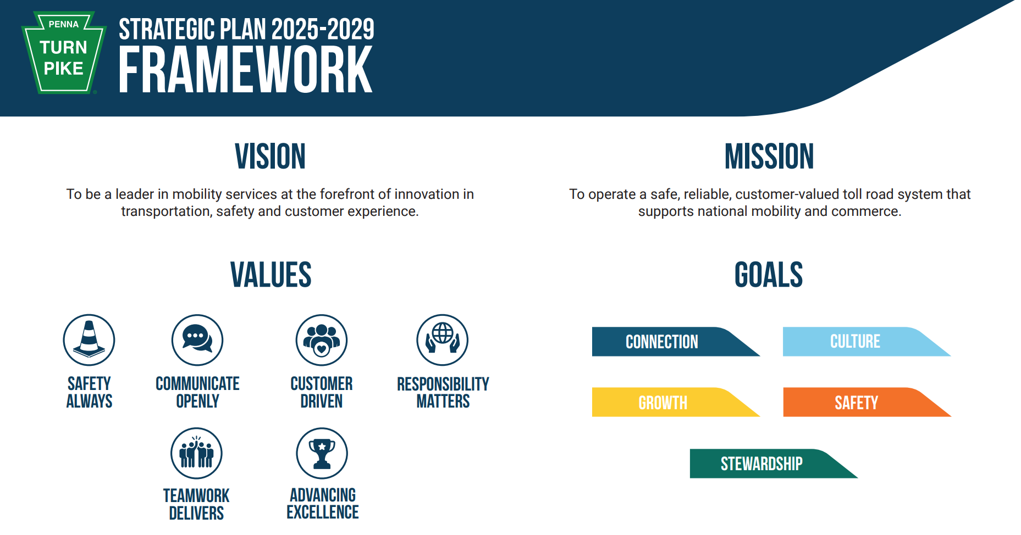
Strategic plan

Slide 3
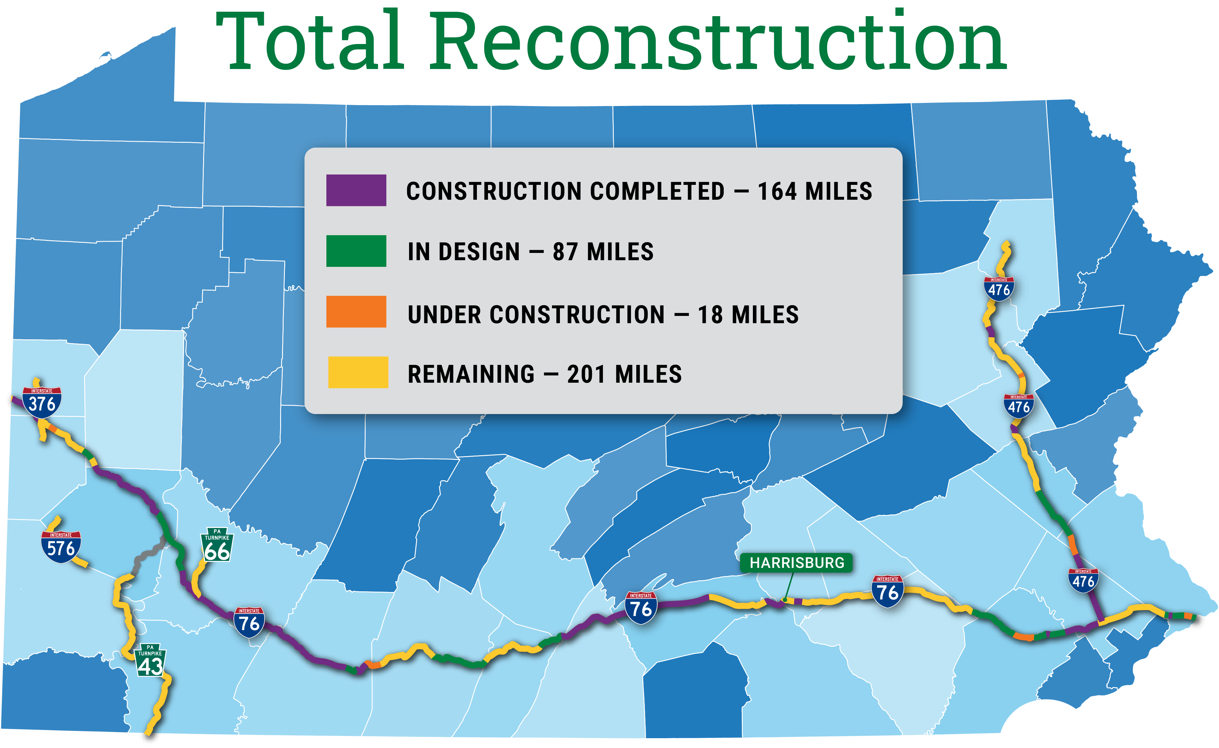
Total reconstruction
Notes:
The PTC is installing a large-scale fiber optic broadband network in the eastern part of its system to enhance communications capacity. This network will increase bandwidth, boost connectivity between the agency’s administrative buildings and support automated tolling and advanced telecommunications applications for improved customer safety and mobility.
It’s an important component of the PA Turnpike’s ongoing efforts to move our intelligent transportation systems forward and prepare for connected and automated vehicles, benefitting customers, employees, emergency responders and neighbors.
The 496-mile fiber optic network will also serve as a catalyst for broadband extension to underserved areas while generating non-toll revenue through a unique, private-sector partnership.
In 2020, the PTC awarded Plenary Broadband Infrastructure (PBI) a long-term contract for the Fiber Infrastructure Operations, Maintenance and Commercialization Services project to operate and maintain the network and extend broadband capacity along the Pennsylvania Turnpike. The 30-year contract includes operations and maintenance services, as well as commercialization services for a fiber-optic broadband network.
Construction began in early 2021 along the eastern Turnpike mainline, from the Harrisburg East Interchange to the New Jersey state line, and the entire Northeastern Extension (I-476) and completed by the end of 2023. The central and western sections are slated to be completed in 2026.
Updated 12/18/23, POC: Alan Williamson

Slide 4




Major roadway initiatives
Innovation and Customer Experience
Total Reconstruction
Open Road Tolling
Safety
Tuscarora Tunnel Rehabilitation
Allegheny Mountain Realignment
Major Bridge Replacements
Delaware River Bridge
Hawk Falls Bridge
Beaver River Bridge
Increased Access and Mobility
Mon/Fayette Expressway
Scranton Beltway
Lafayette Street Interchange
SR 130 Interchange

Slide 5
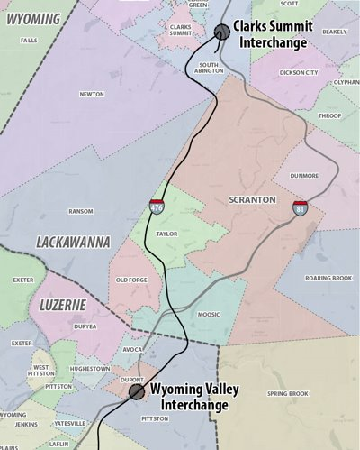
Scranton beltway
The project will include two separate connections between the Turnpike's Interstate 476 and PennDOT's Interstate 81​
Clarks Summit to the north of Scranton in South Abington Township, Lackawanna County​
Wyoming Valley to the south of Scranton in the Borough of Dupont and Pittston Township, Luzerne County​
Beltway formation projected to increase I-476 usage​
Seamless, highway-speed travel north and south​
Public hearings held in Nov. 2023 ​

Slide 6
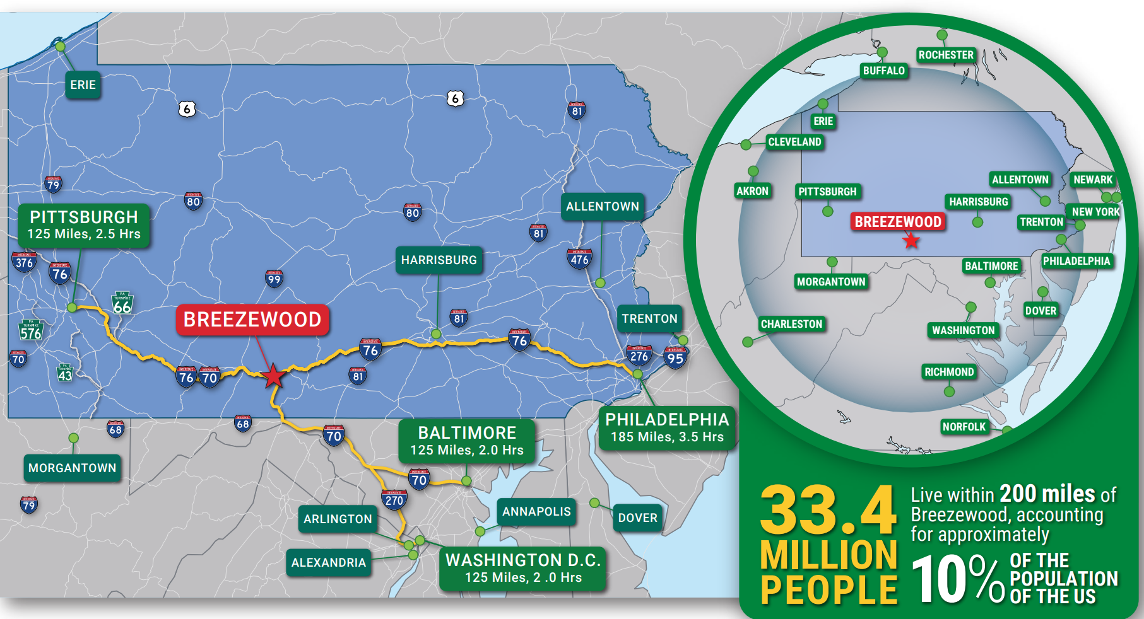
Breezewood interchange project

Slide 7


Sideling hill trailhead opening September 20
Constructing a trailhead to provide better access to this popular outdoor recreation area for our customers, truckers, and those in the local community. ​
Expanded parking areas​
A pavilion with seating​
Expanded green space​
Bike repair stations​
Bike wash station​
Bike racks​
EV Bike Charging Stations​
Wayfinding signage​
Landscaping/planters

Slide 8
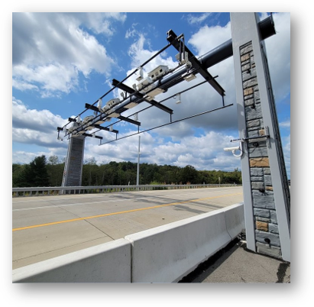
Open Road Tolling Conversion – 2025-2027
All tolling points move to the roadway, using overhead gantries to replace traditional exit/entry points.
Notes:
Open Road Tolling is the next innovation coming to the PA Turnpike, and it is coming to the Eastern portions of our network including the entire Northeastern Extension in early 2025.
We will be moving all our tolling points to the roadway, using overhead gantries to replace our traditional exit/entry points.
Implementation will be phased with the tolling points east of the Reading Interchange and the NE Ext. going live in early 2025 with all other points going live in early 2027.
You will already see gantry construction starting on the eastern portion this year, with construction of gantries taking place on the western section in 2024 and 2025.

Slide 9
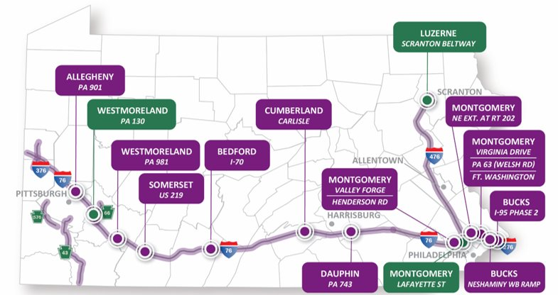
Expanded system access

Slide 10


Slide 11

Unexpected traffic backlog
Text messaging service to communicate about unexpected traffic backlogs
Not for daily commuter traffic or construction
Provides real-time, automated alerts about clearance times
First for any transportation agency and is designed only for PA Turnpike customers.

Slide 12






Connect with Us
Subscribe
Follow
Request a Speaker
Sign up to receive our monthly e-Newsletter: “The Road Ahead”
Connect with us on Facebook, Instagram, Twitter and LinkedIn
Check out the PTC Speakers’ Bureau

Slide 13
Thank you!

